Slide 1
School to work transitions for adolescent girls
Professor Pauline Rose
Director, Research for Equitable Access and Learning (REAL) Centre
University of Cambridge

Slide 2
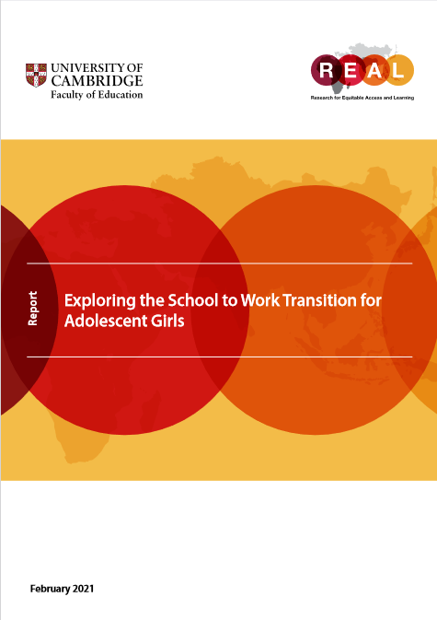
Skills for livelihood opportunities
Livelihood opportunities:
  Secure: not vulnerable to short-term change
  Productive: that it pays a decent and fair wage.
  Safe: free from exploitation and violence
  Fulfilling: that they have some choice in the type of work they are able to engage in.
  Skills needed for gaining livelihood opportunities:
  Foundational
  transferable
  technical and vocational.
  For the majority of adolescents (age 10-19), the expectation is that these skills will be primarily be accessed through schooling.

Slide 3
Many of most disadvantaged in sub-Saharan Africa
don’t make it to secondary school
Source: WIDE database

Slide 4
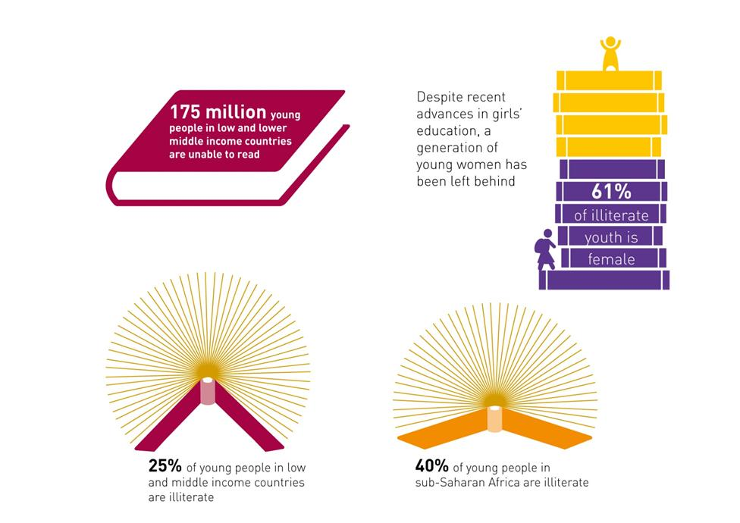
One-quarter of young people aged 15 to 24 in poor countries are unable to read a single sentence
Source: 2013/4 EFA Global Monitoring Report

Slide 5
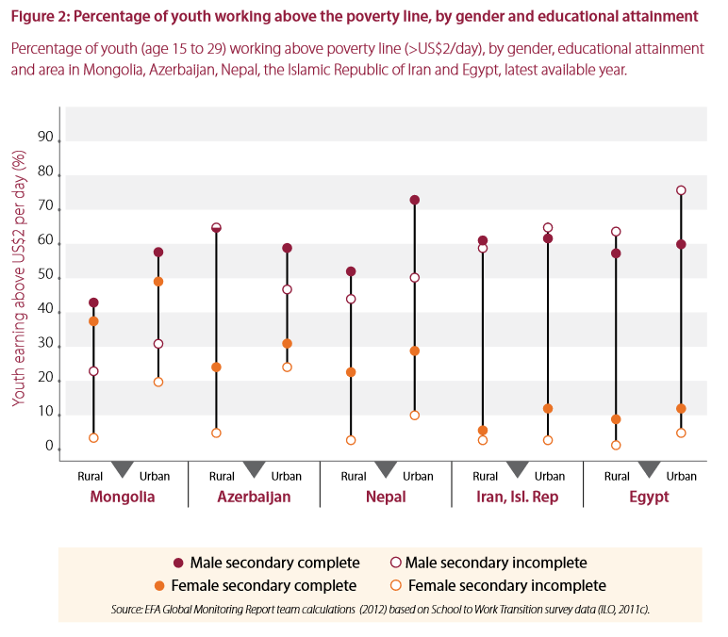
Young women who have not completed secondary education more likely to be in low paid work
Notes:
Unpaid and domestic work can impact on girls’ schooling: 8.1% of girls working for 14-20 hours a week compared with 4.7% of boys.
Girls account for 57% of all children aged 5 to 14 in hazardous work globally.
In sub-Saharan Africa, 82% of female workers in rural areas were in vulnerable informal work/working for the family, in comparison with 68% in urban areas.
Young men aged 25 to 29 are almost twice as likely than young women to have completed the school to work transition
In low- and middle- income countries, only 39% of 15-29 year olds with no or primary education are in formal employment, compared with 59% with some secondary education and 84% of those with post-secondary education.
Across more than 30 low- and middle- income countries, it takes an average of 7.8 months for a young woman to access her first form of work after completing education, compared with an average of 6.9 months for men

Slide 6
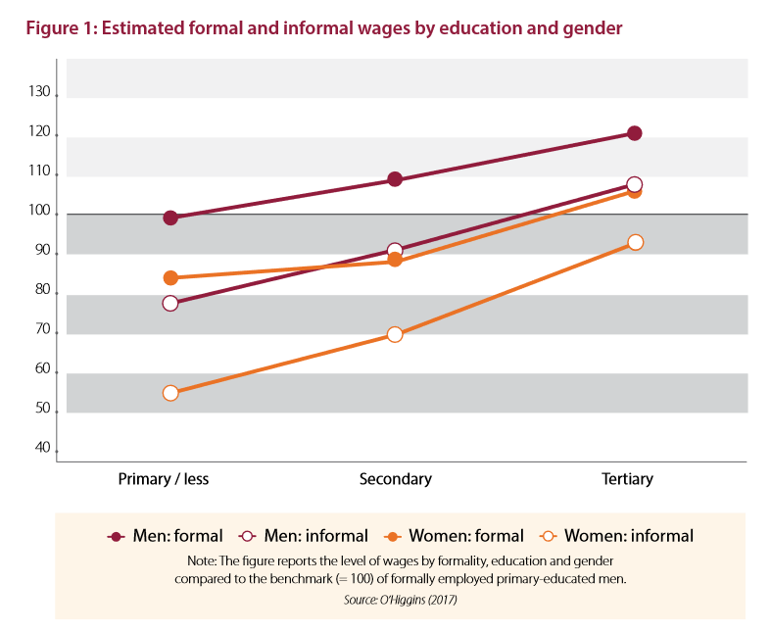
Women with no more than primary schooling in informal sector paid the least
Notes:
The ILO survey found that, for both men and women in the formal and informal sectors, wages are higher if levels of education are higher.
However, across all levels of education, wages are lower for women in the formal and informal sectors than for men, with women in the informal sector with no more than primary schooling being paid half of men in formal sector
Amongst those surveyed in sub-Saharan Africa and Asia, 45% of those surveyed juggled three or more income-generating activities.

Slide 7
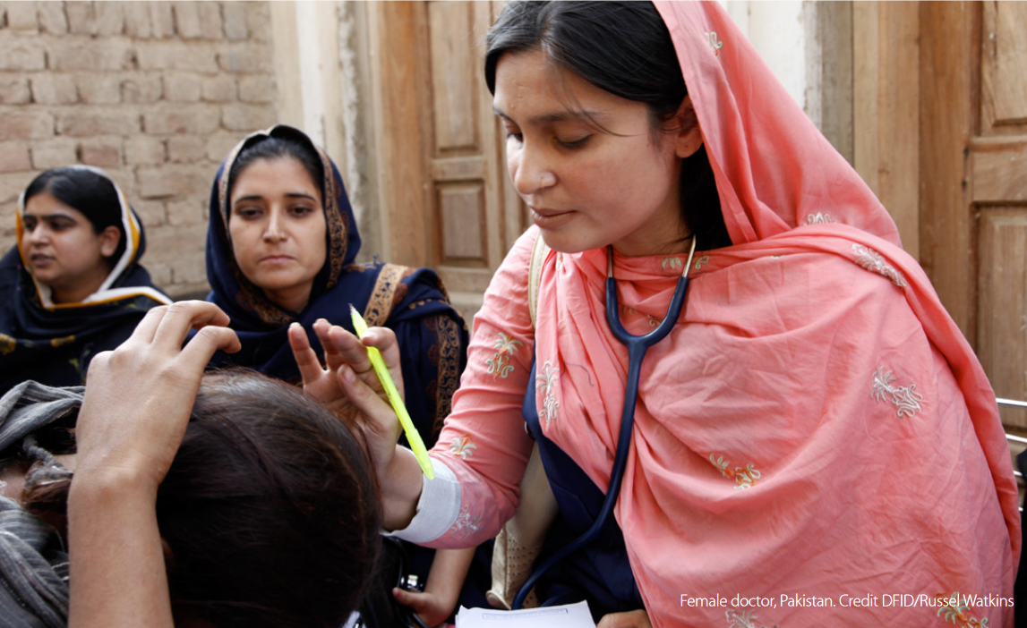
Barriers to accessing secure, productive, safe and fulfilling livelihood opportunities
  Limited opportunity to develop foundational skills in school
  Gendered expectations and norms affecting aspirations
  Gender discrimination in labour market
  Early marriage and pregnancy
  Harassment and violence
  Lack of financial savings and credit
  Lack of peer networks and role models
Notes:
Early marriage, schooling and work:
In sub-Saharan Africa, marrying at age 16 reduces the likelihood of completing secondary education by 7.8 percentage points. This subsequently limits girls’ ability to develop foundational and transferable skills.
Gender gaps in parents’ and children’s aspirations for education and livelihoods start appearing between middle childhood and early adolescence, in many cases due to expectations about the role of women in society.
ILO survey - 84% of young fathers in work, but less than 50% of young mothers in work
Discriminatory inheritance laws, which deny access to assets such as land or property, are widespread and limit girls’ opportunities to earn a livelihood. Additionally, young women face discrimination when seeking access to finance, resources, assets and support services that are crucial to creating and expanding small enterprises.

Slide 8
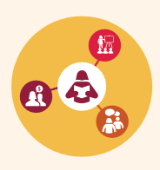
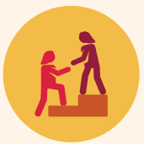
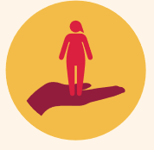
Examples of evidence on what works
  Educate! In Rwanda and Uganda addresses mismatch between education and livelihood opportunities, resulting in increased income and business ownership for female participants.
  CAMFED’s livelihoods programme in Malawi, Tanzania, Zambia and Zimbabwe supports highly marginalised rural women in sub-Saharan Africa as they complete secondary education to set up their own businesses, resulting in increased incomes and savings.
  An intervention in Kenya for secondary school girls provided HIV and sexual health education to combat child marriage and teenage pregnancy, resulting in reduced teenage pregnancy.

Slide 9
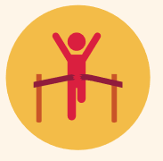

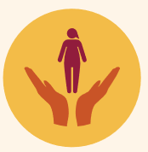
Evidence on what works
  BRAC’s Empowerment and Livelihoods for Adolescents programme in Sierra Leone provides health education, vocational training and microcredit for adolescent girls, resulting in increased learning and reduced teenage pregnancy.
  The Social and Financial Empowerment programme in rural Bangladesh provides girls’ clubs, financial literacy, livelihood and life skills training, increased financial literacy, ownership of poultry and small livestock, and involvement in economic activities.
  The Child Hope programme From Sexual Exploitation to Education for Ugandan Children helps girls in sex work to find alternative livelihoods where they are less vulnerable to violence. The programme resulted in girls not returning to unsafe work.
But many interventions short-term and small scale, and don’t address wider gender discrimination in school and labour market

Slide 10
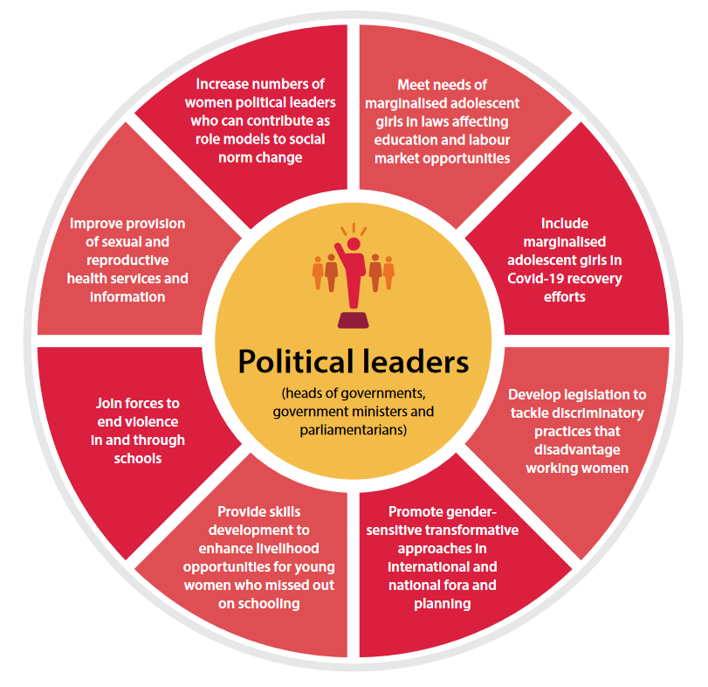

Slide 11
