Slide 1

THE Adolescent girls initiative – Kenya: A multisectoral approach To delay marriage for marginalized girls
Karen Austrian, PhD, MPH
Director, GIRL Center & Senior Associate
@KAustrianPC
kaustrian@popcouncil.org
CRANK Research Meeting
September 28, 2022

Slide 2
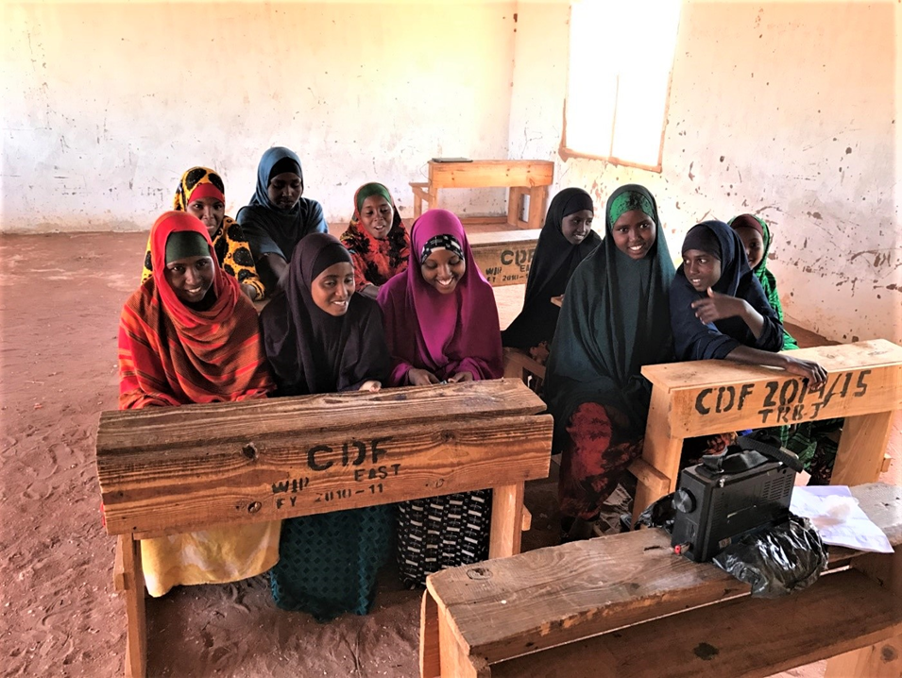
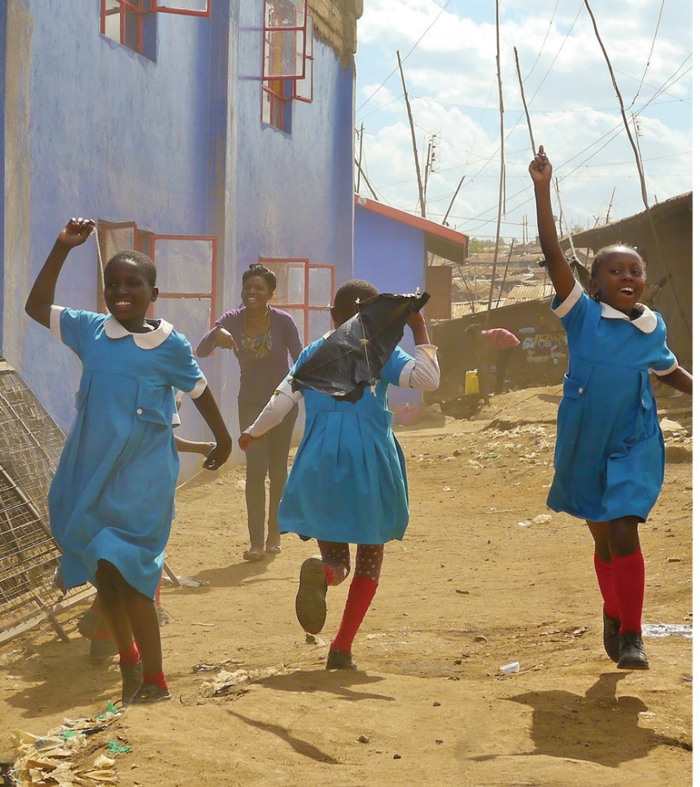



Adolescent Girls Initiative – Kenya

Slide 3

What did we want to learn?
What package of multi-sectoral, multi-level interventions has impact for adolescent girls?
Can early interventions improve longer-term outcomes?
Community
Household
Girl
Notes:
Investment in Very Young Adolescents
Similar program/trial (Adolescent Girls Empowerment Program) in Zambia, but only with the girl circle, and while we did see some individual outcomes on SRH knowledge, savings and self-efficacy, we did not see long term effects on continued education, timing of pregnancy or marriage, etc.

Slide 4
Intervention Arms
ARM 1
Community engagement
ARM 2
Community engagement
+
Education Cash Transfer
ARM 3
Community engagement
Education Cash Transfer
Health/Lifeskills
+
+
ARM 4
Wealth
Community engagement
+
Education Cash Transfer
+
Health/Lifeskills
+
Community engagement

Slide 5
Theory of Change
EXPERIENCED IN:
ACQUIRED BY:
IMPACT ACHIEVED BY:
Early adolescence
Early & Mid- adolescence
Mid- & Late Adolescence
Wealth Creation (Financial Literacy & Savings)
ECONOMIC ASSETS: financial goals, budgeting/money management skills, savings activity; asset accumulation
SOCIAL ASSETS: positive gender norms, self-efficacy, friends, a trusted mentor, improved decision making skills
HEALTH ASSETS: knowledge on SRH, HIV and nutrition, condom self-efficacy
EDUCATIONAL ASSETS: schooling self-efficacy, educational attainment, literacy and numeracy skills
OVERALL: Improved wellbeing for women and girls in Kenya enabling a safe, healthy and productive transition into adulthood
● delayed sexual debut /increased FP/condom use (in Kibera)
● delayed age of marriage (in Wajir)
● delayed childbearing
Health (Safe Spaces w/ SRH & life skills)
Education (Conditional Cash Transfer)
Girl
Household/Community
Increased household economic assets
Positive change in community norms on value of girls, including timing of marriage and educational attainment for girls
Violence Prevention (Community Dialogues)
Reduced experience of sexual and gender based violence

Slide 6
Randomized Controlled Trial Design
Jan-Apr ‘15 Aug ‘15-Jul ’17 Apr - Sep ’17 Jun-Aug ’19 Sep-Oct ‘21
Violence only
Arm 1
Baseline
Midline
Endline
Round 4
Violence + Education
Arm 2
Baseline
Midline
Endline
Round 4
WAJIR:
Random assignment
80 Clusters (~3,400 girls)
Violence + Education + Health
Arm 3
Baseline
Midline
Endline
Round 4
Violence + Education + Health +
Wealth
Arm 4
Baseline
Midline
Endline
Round 4

Slide 7

ENDLINE RESULTS – 2019
(two years after program end)

Slide 8
Wajir: in school enrollment, in early marriage and pregnancy
*Among out of school girls at baseline
Notes:
What we saw was that there were very strong impacts, especially for girls who were out of school when the program started. We see that girls were three times more likely to still be in school (two years after the end of the program), 20 percentage points less likely to be married and half as likely to have been pregnant
Also improvements in literacy (14% of control literate v. 31% of VE/VEH/VEHW)
Also improvement in numeracy (mean score of 4.6 for control v. 8.2 for VE/VEH/VEHW) – out of 20
Green bar is the control - % at endline
Blue bar are the three intervention arms combined - % at endline

Slide 9
FOLLOW UP RESULTS – 2021
(four years after program end)
Notes:
Now we came back after two more years – that is four years after the program ended – to see what effects were still there

Slide 10
4 years after the program, there is still in school enrollment, in early marriage and pregnancy
*Among out of school girls at baseline
Notes:
We see that the impacts from 2019 have largely remained
Girls in the program are now five times more likely to still be enrolled in school, 20 percentage points less likely to be married and thus less likely to have ever been pregnant.
We did look to see if there were effects on the children of the girls from the original AGI-K study. However, we did not see any main differences except that girls in the program were a bit less likely to have had a still birth (3% in VEHW compared to 10% in V-only reporting stillbirth).

Slide 11
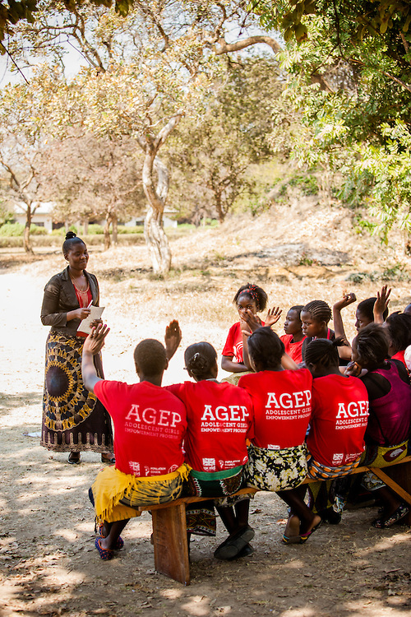

Adolescent Girls Empowerment Program
Safe spaces groups
Health Voucher
Savings Account
No impact on
  Education
  Marriage

Slide 12
Program Implications
1
Working across sectors and at multiple levels of a girl’s eco-system is important
2
Addressing underlying economic constraints at household level opens up change for girl-level outcomes
3
Girls empowerment – life skills with both SRH and economic content – is critical

Slide 13
Ongoing/Future Work
Understand longer term effects as girls transition into early adulthood, especially on the transition to work and parenting
Explore how to integrate AGI-K components into sub-national level implementation structures for delivery at scale
  2022-23 – testing scalable model in Wajir County with CIFF funding

Slide 14




Acknowledgements
Notes:
Save the Children and Plan International – implementers in Wajir and Kibera
APHRC – research partner
Itad – partner on costing work
PopCouncil – thank you also to team that collected and provided oversight of data
UK government - Kenya as primary funder

Slide 15
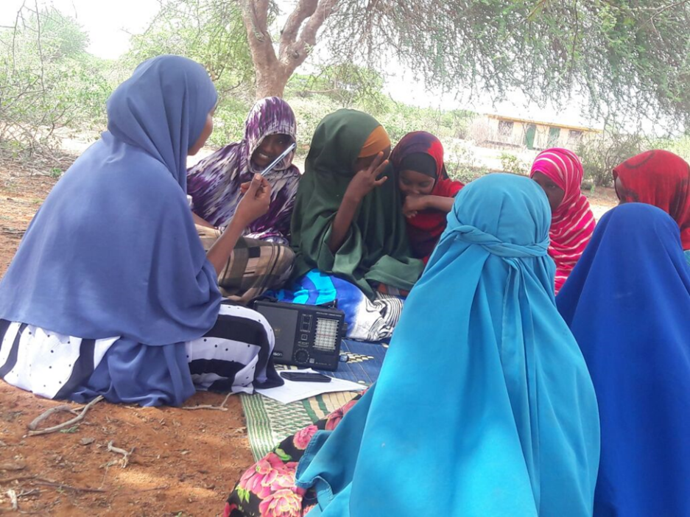
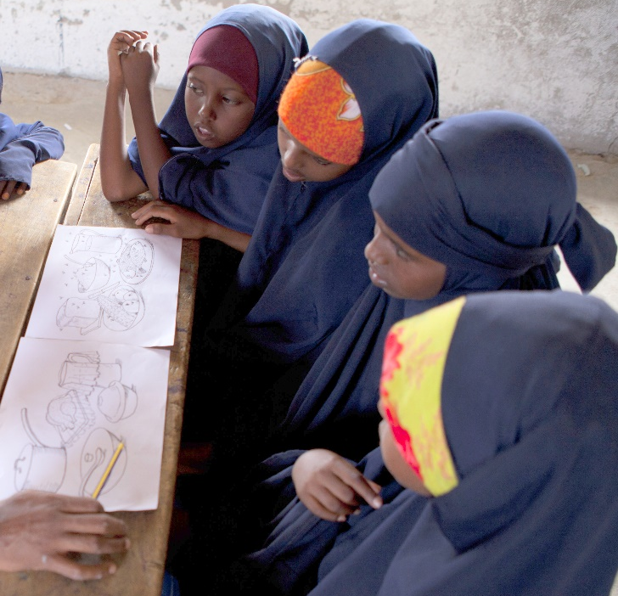
Thank You
Study websites:
http://www.popcouncil.org/research/adolescent-girls-initiative-action-research-program
Contact:
Karen Austrian – kaustrian@popcouncil.org
Beth Kangwana – bkangwana@popcouncil.org

Slide 16

Web: popcouncil.org/GIRLCenter | Email: GIRLCenter@popcouncil.org Social Media: #GIRLCenter
Contact: Karen Austrian| kaustrian@popcouncil.org | @KAustrianPC

