Slide 1

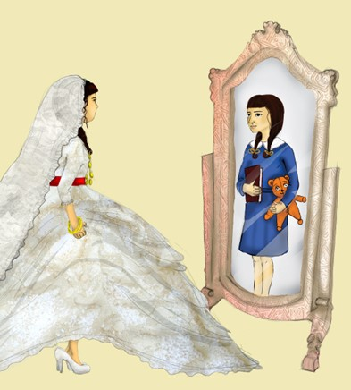
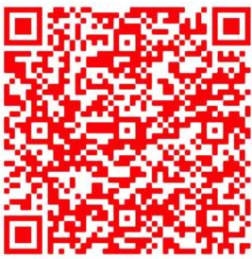



Early Marriage among Female Youth in Displacement
Early Marriage among Female Youth in Displacement:
The Kurdistan Region of Iraq & South Sudan
Access reports here
Or follow this link
Kimberly Howe, Elizabeth Stites, Meg Moran,
& Anastasia Marshak
Khalat Ahmed Hammada & Shilan Sulaiman
Tabitha Nyaleel Maguek & Nyachar Lony
This project has received funding from the European Union’s Horizon 2020 research and innovation programme under the Marie Sklodowska-Curie grant agreement No. 786064
This project has received funding from the European Union’s Horizon 2020 research and innovation programme under the Marie Sklodowska-Curie grant agreement No. 786064
Notes:
https://fic.tufts.edu/research-item/child-marriage-in-humanitarian-settings/

Slide 2

RESEARCH QUESTIONS
What are the holistic experiences, needs, challenges, and opportunities for adolescent girls who have been displaced by conflict? And how do each differ by:
  Marital status (unmarried, married, divorced, widowed)
  Early pregnancy
  Disability?
How are decisions made about early marriage? And what is life like after marriage?
2 DISPLACEMENT CONTEXTS
Kurdistan Region of Iraq
South Sudan
Longitudinal Methodology
Cohort-Family Members-Key Informants
Semi-Structured/Open Interviews/Holistic
Quantitative Measures
Participatory (photography and drawing)
Researchers from Affected-Communities

Slide 3
Sample Characteristics
Syrian Refugees
Displaced Yazidis
Iraqi Arab and Yazidi Returnees
Displaced South Sudanese
Aged 14-23
Unmarried, Married,
Divorced & Widowed
Early Pregnancy, Living with Disabilities
594 Interviews;
140 Youth in Cohort,
2-12 interviews per participant

Slide 4



Marital Status Predicts Well-being Outcomes
Divorced
Widowed
Married
Unmarried

Slide 5

Why?
Many divorced youth have experienced extreme abuse
Divorcees are excluded and severely ostracized
Widows and divorcees female youth usually must give up custody of children
Widowed female youth in SS are “inherited” by their brothers-in-law
Widowed female youth reported having been exploited in the KRI
Mixed bag of MHPSS impacts after early marriage
Unmarried female youth were often in school and invested in their futures, as are their parents/relatives

Slide 6
In their Own Words
“I thought to myself, even if I remained here all my life it would stay the same, and I would have more children. Leaving one child is better than leaving four or five behind.” Divorced Yazidi IDP
“I am not allowed to look out the doorway or even have friends. I would be killed immediately by my younger brother. We girls are nothing in the community, we don’t have any value. Every night I stay awake trying to dream of a better life, but in the morning, I wake up and my life is still the same. My family says, ‘now you have a new name “divorced” so you are not allowed to do anything or go anywhere.’” --Divorced Syrian Refugee
“I am not excited about anything because I am struggling about everything together with my child. Nothing is good in my life or my daughter’s life. I worry a lot about getting soap to wash her clothes and getting her milk to drink” --Widowed IDP South Sudan
“Widows in our culture, they are a kind of dead people. They have no rights. They have no dreams. Even if you want to do anything, the community says, ‘no, you can’t!’”-- Widowed Syrian Refugee

Slide 7
Spotlight on Youth Living with Disabilities
Difficulties accessing education
Harassment is common
Socially excluded
Feel burdensome to natal families
Few quality marriage prospects
At risk for exploitation

Slide 8
In their Own Words
“I used to want to be a doctor and help treat sick people. But now I just want not to be a burden on my family.” –Syrian Refugee
“He told me he doesn’t want to marry a crippled girl…I feel bad because people don’t want me and they see me as nothing because I don’t have one leg.” –Displaced South Sudanese
“I attended school for only one year and then I was ‘fired’ because the school director said I couldn’t see well.”--- Syrian Refugee
“I felt I wasn’t equal to the people around me. Everyone looks at me as less than…there was such much bullying that I had to change schools.”– Displaced Yazidi

Slide 9
Social Connections Key for Well-being
Positive relationships with friends, boyfriends, husbands, family, in-laws
Safe space outside home to congregate with others
Sense of belonging
Meaningful Activity
Qualitative/Longitudinal research as an unexpected contributor
Religion/Faith
Education

Slide 10
Food for Thought
For the humanitarians:
-Are programs/projects inclusive of these populations?
-If yes, are their needs understood and addressed?
-What are the best ways to improve well-being for displaced female youth—particularly those married early, divorced, widowed, living with disabilities?
For researchers:
-Are we including these populations systematically in our research?

