Slide 1
Tipping Point Phase 2 RCT Results and
10 Years of Learning
Anne Sprinkel
Project Director
Dr. Ruchira Naved Tabassum
Iccdr,b
Notes:
Hi everyone, CARE is so happy to be back in this space with you all. We shared our Phase 2 baseline at the launch event for hte CRANK, so to be back here with you and have the chance to hear your thoughts on our results is a great feeling. Next slide, please.

Slide 2
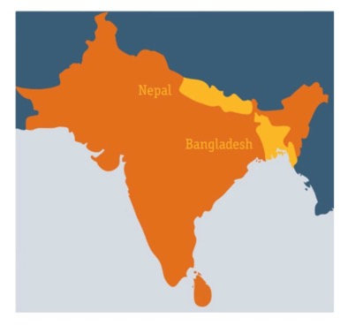
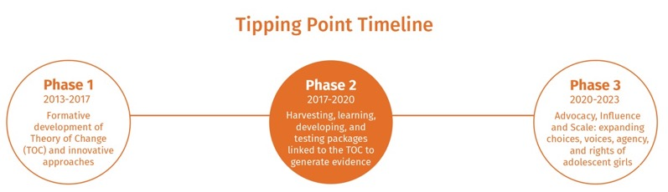
The Tipping Point Initiative
Three-phase project that addresses the root causes of child, early and forced marriage (CEFM) and promotes the rights of adolescent girls.
Nepal:
Siddhartha Samuyadayik Samaj
Dalit Social Development Center
Bangladesh:
Jaintia Shinnomul Songstha Gram Bikash Kendra
Association of Slum Dwellers
We work with
Parents
Community and religious leaders
Adolescent boys
Adolescent girls
Notes:
For those of you not familiar with the initiative, Tipping Point is a multi-country program addressing child marriage by focusing on its root causes. We see child marriage as an act of violence, so we enable girls to assert their rights, help families and communities to support them, and influence policy to sustain change. We’ve done this through community-level programing in Bangladesh and Nepal, evidence generation, and multi-level advocacy and influencing
In Phase 2, we had about 6,000 direct participants spread over approximately 60 remote villages in the terrai region – or lowlands - of Nepal along the border with India and Rangpur, Bangladesh, which is in the northwest. You can see our partners that we work with in both countries – we fully implement at village level through our partners and their staff

Slide 3
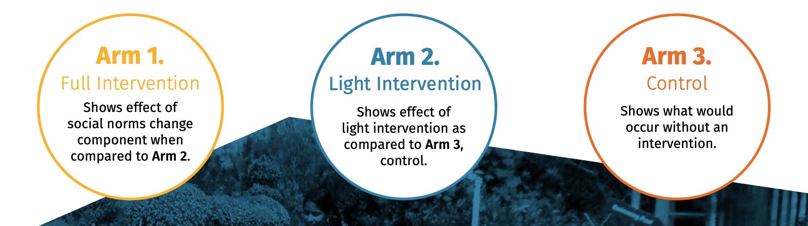



Cluster
Randomized Control Trial
TPP+
TPP
Girls’ agency and Social Norms’ Measurement
Notes:
Time – 40 seconds
Phase 2, we used a 3-arm cluster randomized control trail design for our evaluation led by our external research partners, Emory University and IDA in Nepal and icddrb in Bangladesh. We chose this evaluation design as it’s understood as the gold standard of impact evaluation.
Arm 2 includes clusters that get a ‘light or basic intervention’, so while it’s still a multi-component approach, it is more focused on individual attitudes, knowledge and behaviors among girls, boys and parents. We compared this to Arm 1 clusters which received a heavier social norms-focused package, which emphasizes community level social norms change and girl led collective action. Arm 3 is the control.

Slide 4
PARTICIPANTS’ GROUPS
SESSIONS
CORE SESSIONS/TRAININGS
GIRL-LED ACTIVITIES
JOINT SESSIONS
Weekly
45 ^{sessions}
Social norms [all participant groups]: equity and equality; rights and duties; gender; patriarchy; power and privileges; puberty; sex and love; honor; GBV; child marriage.
Access to Alternatives [girls’ groups only]: financial literacy and girls from the group who are interested participate in Village Savings and Loans Association (VSLA) (starting in the 7th month).
ASRHR [all core participants’ groups]: menstruation; masculinities; female sexuality; contraception; HIV/AIDs.
Girls-centered movement building [girls’ groups only]: (starting in the 7th month): leadership; empowerment dialogues; collective action; civic participation.
Activist training [select champion boys, fathers, mothers]: (starting in the 7th month): trainings and meetings to support adolescent girls’ activism.
Activist training [select girl leaders]: girl leaders receive training on campaigning and activism, linked to other girls groups & networks, and given access to a budget and mentorship to execute 4 community level activities.
6 Community level social norms activities
Organized and lead by adolescent girls’ groups on following themes:
Mobility
Menstruation
Gender Division of Labor
Dowry
Family Honor/ Sexual Harassment
Girls Aspirations
6 Intergroup Dialogues
Facilitated dialogues between core participant groups in the following combinations:
Adolescent Girls with Boys
Adolescent Girls with Mothers
Mothers with Fathers
Adolescent Girls, Adolescent
Boys, Mothers, and Fathers
Adolescent GIRLS
Weekly
45 ^{sessions}
Adolescent BOYS
CORE PARTICIPANTS’ GROUPS
Monthly
18 ^{sessions}
MOTHERS Group
Monthly
18 ^{sessions}
4 Activist-led activities
Created, organized, and lead by network of activist girls
The network of girl leaders elected across villages will organize and execute 4 activities of their own choice in each of their communities, using their own budget.
DURATION = 18 months
CORE FACILITATION APPROACHES
A mix of facilitation approaches designed to maximize empowerment, critical thinking and action
[didactic, participatory teaching, reflective analysis, and facilitation for action].
FATHERS Group
RELIGIOUS LEADERS
LOCAL GOVT
SCHOOL PERSONNEL
^{Intensive}
^{Trainings*}
^{Follow-up}
^{Meetings*}
OTHER PARTICIPANTS
INFLUENTIAL PEOPLE
PROJECT STAFF CORE CAPACITIES
Gender Equity and Diversity
VSLA
Social Norms
Participatory and Reflective Techniques
Movement Building
Facilitation Skills
Social Analysis and Action
Indicates components that are part of the full package and are not present in the light package
Notes:
Before Dr. Ruchira dives into the results from Bangladesh, I wanted to give you a view of the components of Tipping Point. We did traditional girls, boys, mothers and fathers groups, but for Arm 1 - the social norms heavy component - we added everything you see in orange, so girl-led activism for norms shifting and community-facing norms shifting events as well as targeting stakeholders with quarterly dialogues. COVID cut our implementation short to anywhere between 15 and 18 months, depending on the location.
Over to you, Dr Ruchira!

Slide 5
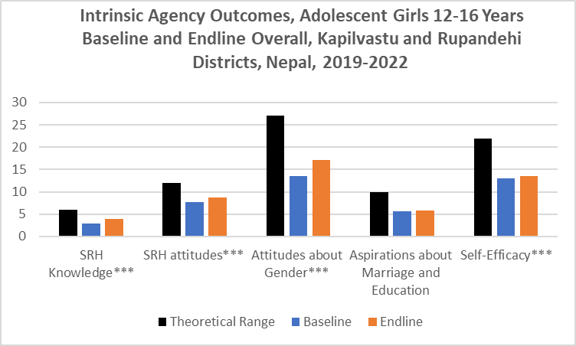
Results from Nepal
Baseline:
  Rates of child marriage have decreased, but median age at marriage remains below the legal limit.
  Girls and boys had similarly high levels of self-efficacy (ex. confident that they could achieve their desired level of education)
  Education as an acceptable pathway but insufficient reason to delay marriage
  Norms are somewhat in flux, especially among educated families, but girls who violate them are at risk of being married off early.
  Restrictive norms around girls’ mobility, interacting with boys, and participating in leisure activities outside the home intensify during adolescence to guard against’ reputational damage.
  Gaps in leadership competence and group membership
Cluster of risk and protective factors: What sets girls up for success
Strong relationships with parents
Parental support for educational, employment and marriage aspirations
Endline:
  Those married at endline had less schooling (mean 6.7 versus 7.7 grades) and were living in more impoverished households
  Significant increases in girls’ intrinsic, instrumental, and collective agency; network social norms, and perceptions of discrimination in the family.
  Significant increases for adolescent boys’ intrinsic, instrumental, and collective agency.
  Community gender norms among adults increased over the study period to reflect greater endorsement of more gender equitable norms
Clark, et al. 2022; Yount, et al. 2022
Notes:
Let’s talk about some results.
Quickly on the Baseline to set the stage in Nepal:
School-going girls had more agency to reject marriage proposals than out-of-school girls. Not super surprising.
However, even girls in school were at risk of being married early if perceived to be disobedient, for example by roaming or interacting with boys. This reflects one of the biggest findings across countries from our baseline – education can only protect you to a certain point. As soon as sexuality is involved or honor is threatened, marriage becomes a very real and immediate consequence.
Group membership and leadership competence among girls were significantly lower than among boys, and group leadership was very low among adolescents generally.
Collective action among adolescents was in a nascent stage, but there are key stakeholders who were committed to supporting such activity
Note that we’re reporting results for boys and girls in Nepal as child marriage among is much more pronounced in this setting.
Now for the Endline
I’ve highlighted a central finding on the right, but specifically: Marriage essentially stopped during COVID – according to our research partners, Marriage was a rare outcome for adolescent girls and boys in the overall sample (<4%).
For Intrinsic agency = The increases we saw included sexual and reproductive health (SRH) knowledge, SRH attitudes, attitudes about gender roles, and self-efficacy
TPP participants also reported equality of boys and girls labor in support of the household by parents and adolescents
For Instrumental agency = Girls experienced significant increases from baseline to follow-up in their mobility and freedom of movement, communication and negotiation with parents, and participation in decision-making, but their leadership competence and participation in financial activities did not change over the period.
Adolescent boys experienced significant increases in their leadership competence, communication and negotiation with parents, and participation in decision-making
Really interesting that but even with COVID lockdowns, we saw girls’ mobility increase
And for collective agency = Reported gender norms among peer networks also did not change among girls, but their perceptions of discrimination in the family increased, perhaps in part due to greater awareness of these issues. Among boys, levels of cohesion, solidarity, and mobilizations skills and participation in events also increased
We’d really like to dig on this as it’s a really important finding - we spent so much effort on girls’ connections to each other and their ability to mobilize their allies against child marriage. COVID obviously threw a wrench in the Learning Communities on the Move model for girl-led activism, but there’s lots of budding work and questions around girls’ agency, and collective agency, and what’s needed for diffusion of norms change

Slide 6

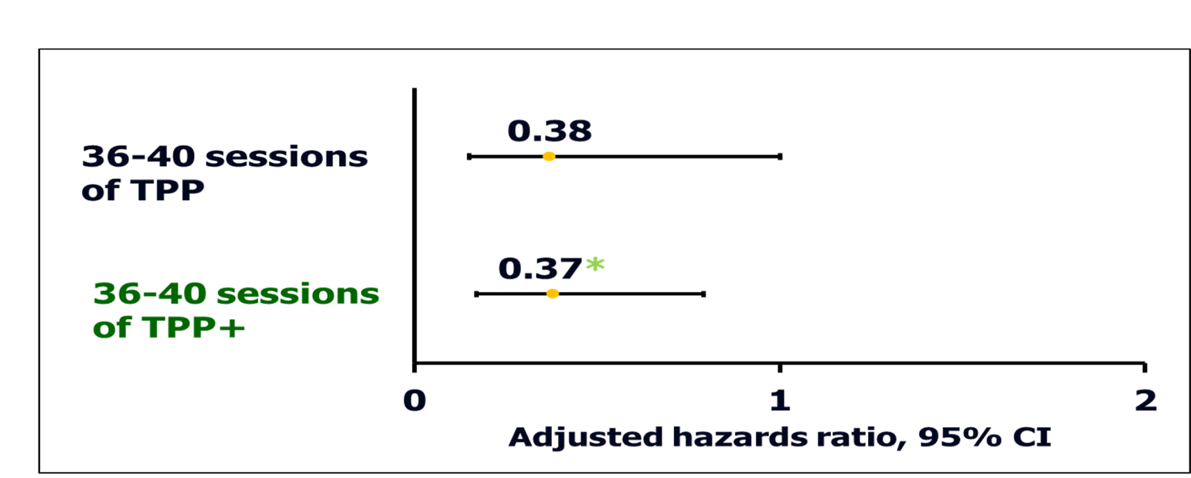



Notes:
The results from Bangladesh lends support to the hypothesis that an emphasis on norms shifting does reduce the risk of child marriage. On this slide, we show the impact of TP among girls who attended the highest number of sessions, as opposed to those who did not attend any. As you see, although CM reduction in the ‘light’ social arm did not achieve statistical significance, the social norm ‘heavy’ arm, which is TPP+, reduced the hazards of CM by 63%.

Slide 7
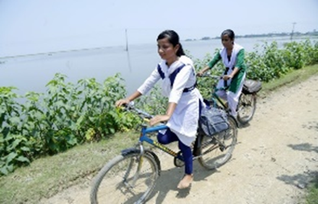
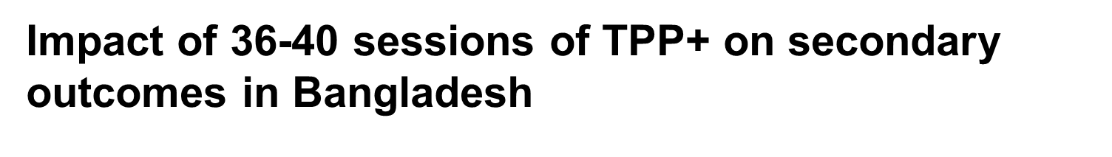
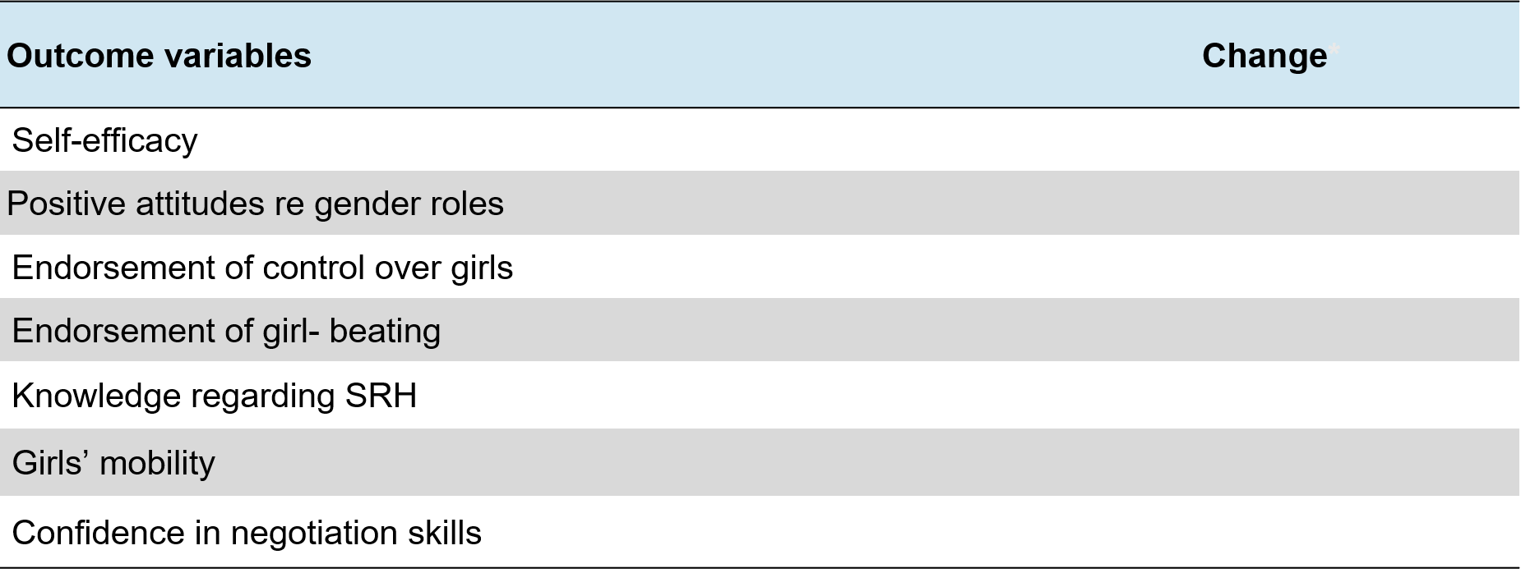
Notes:
In line with this are the findings that TPP+ strengthened the known protective factors against child marriage among the girls attending the highest number of sessions. Thus, for instance, at endline they achieved lower endorsement of control over girls and girl-beating and more positive attitudes regarding gender roles. Their mobility increased and they gained greater confidence in negotiation.
Summarizing the findings, I’d say that TPP+ or the social norm heavy intervention was be able to reduce the hazards of child marriage by 63% despite implementation challenges due to COVID. This leaves us to ponder whether an optimal implementation of the program could achieve an effect at a lower threshold level than 36 sessions.
If we compare the TPP+ effect size with those reported in the recent review of effective interventions to reduce CM worldwide, the TPP+ or social norms heavy arm’s effect far exceeds any other intervention effects worldwide. There is a single intervention that achieved a 90% reduction in CM but that was only among very young girls aged 10-14 years, an age group we know is easier to reduce very early CM compared to CM among older adolescents.

Slide 8
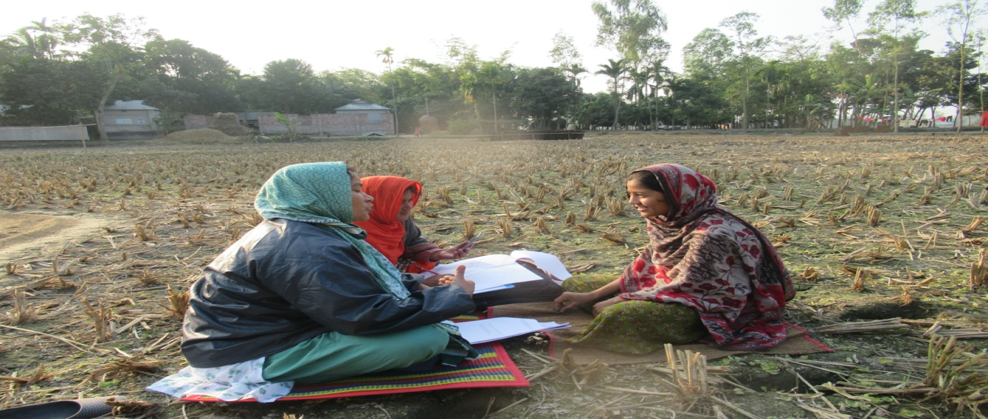
Implications for Practice:
Girls need allies
Structured Allyship
Girl-led Activism for Norms Shifting
Training
Mentorship
Notes:
Time : 1 minute
As you can see from the findings today, girls’ individual agency is rapidly expanding – but these individual and even household-level changes are not enough to address the root causes of child marriage and thus sustainably end the practice. We know concerted norms shifting interventions move the needle on reducing the risk of marriage.
Girls and mothers in Bangladesh pointed out that unity among all villagers is the most important factor in preventing child marriage. According to them, the ground is not yet ready for the girls to bring about this unity all by themselves
So these agency-, household-level and norms-shifts can become mutually supportive but they also require allyship for sustainable change: it is important to build the capacity of people around the girl to come alongside her as an ally instead of a protector, so we found a lot of value in our structured allyship approach where members of Boys’, mothers’ and fathers’ groups were offered the opportunity to challenge inequitable gender norms and stand by the girls in their activism.

Slide 9
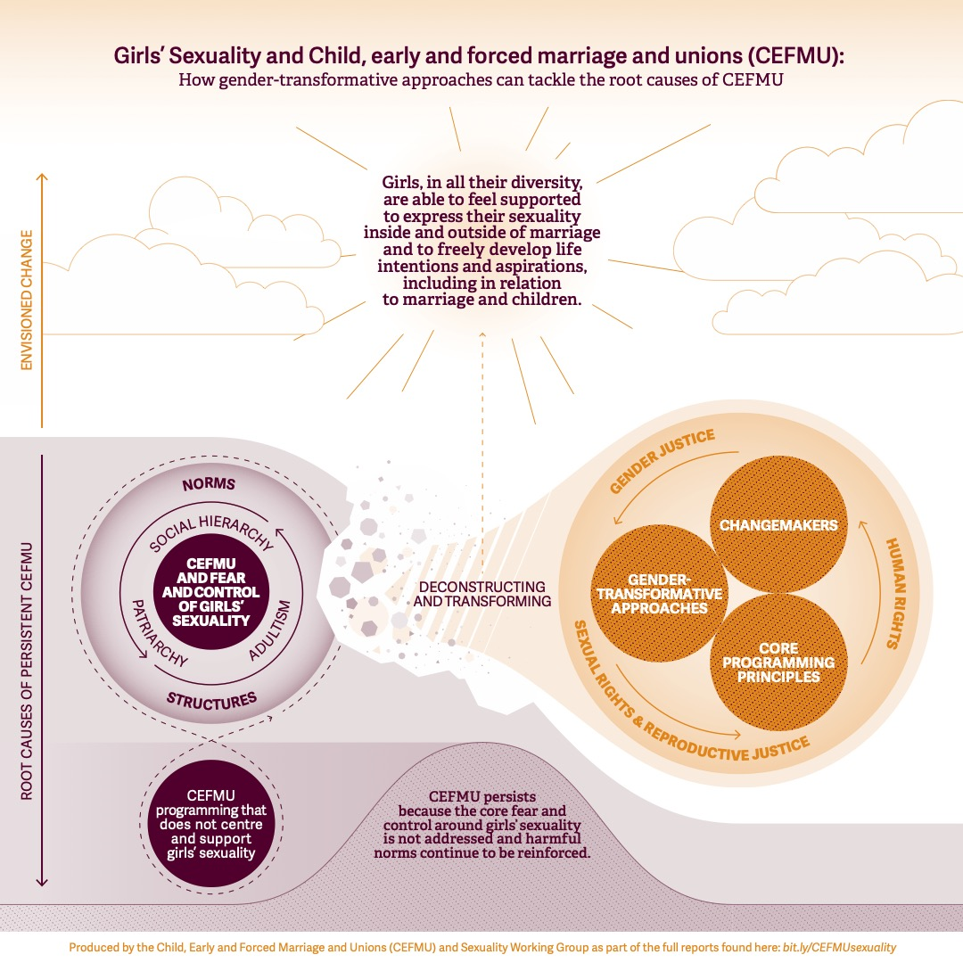
Implications for Practice:
Focus on Sexuality
Notes:
I’m so glad Jose Roberto mentioned redistribution of power and the gender binary in teh opening, because Tipping Point’s formative research, our Theory of Change, our baseline and endline studies, and the CEFM and Sexuality Conceptual Framework that you see here all make a really clear link between the norms controlling adolescent sexuality and child marriage. They all also make the case for how gender transformative approaches are needed to address norms and sustainably end the practice. The Conceptual Framework has SO much in it, but one thing i’d pull out from the recommendations for donors is their investment in girl-led and feminist movements and organisations, because these groups are intrinsically poised to take on this work with a more transformative lens EVEN IF they might have a learning curve in applying gender transformative approaches.

Slide 10
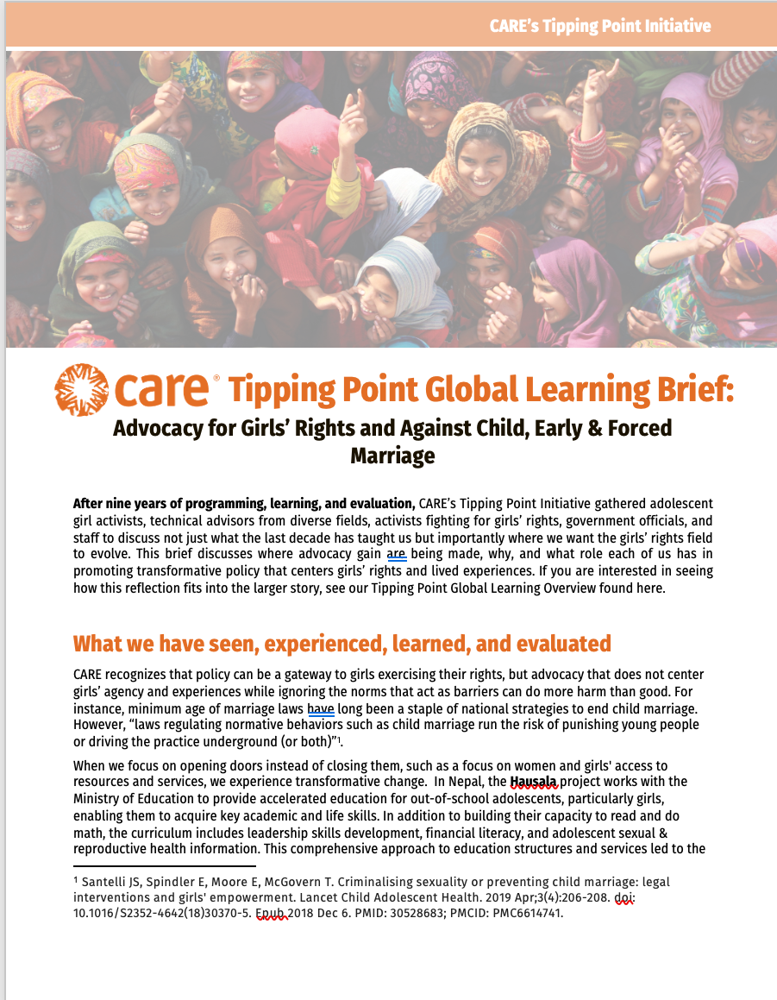
Global Learning Briefs
Focused briefs:
Economic Empowerment & Financial Opportunities
Family Support
Girls’ Leadership
Cross-cutting issues and approaches:
Gender at the center
Holistic & Inclusive
Movement-founded
Meaning of youth-led must evolve
Notes:
So what is TP saying after 9 years of implementation? We created one overall summary and 3 focused briefs you can see here, but I wanted to bring your attention more to the cross-cutting issues and approaches that just kept coming up as necessary for sustainable, gender-transformative impact
One thing that Tipping Point’s really learned more about than expected was the meaning of youth-led – I think a lot of the field has become comfortable with certain approaches, making things more participatory and inclusive, but we discuss in a few of these briefs how the evolution towards something more transformative necessarily requires shifting power. I include myself when I’m saying this – I have a role to play in that, too, so we talk about this on a personal level as well as within institutions like donors and CARE, not just communities with work with.
That’s it for our presentation, we’re really excited to hear people’s thoughts and reactions!

