Slide 1
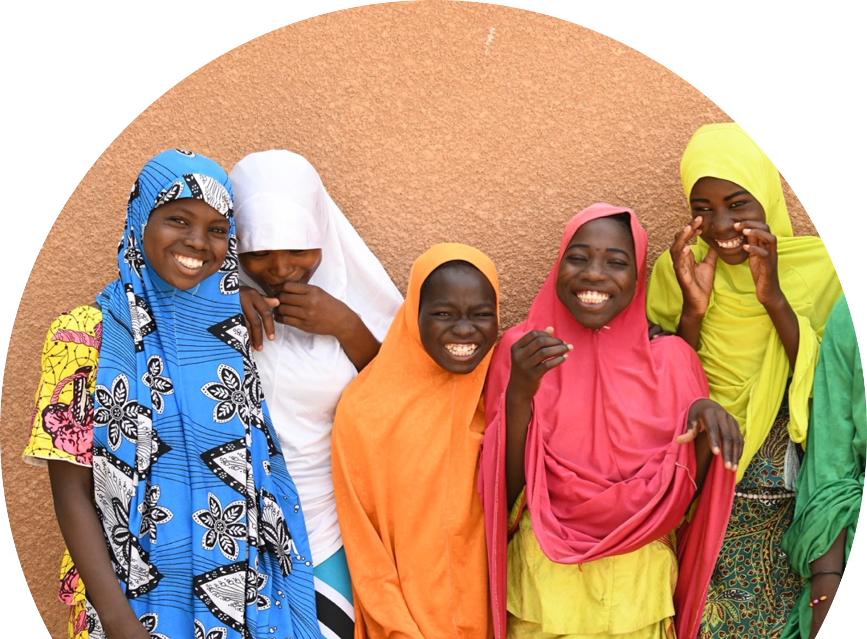


Addressing social norms to prevent child marriage and empower adolescent girls:
A systematic review
Margaret E. Greene, Jeffrey Edmeades
& Manahil Siddiqi

Slide 2
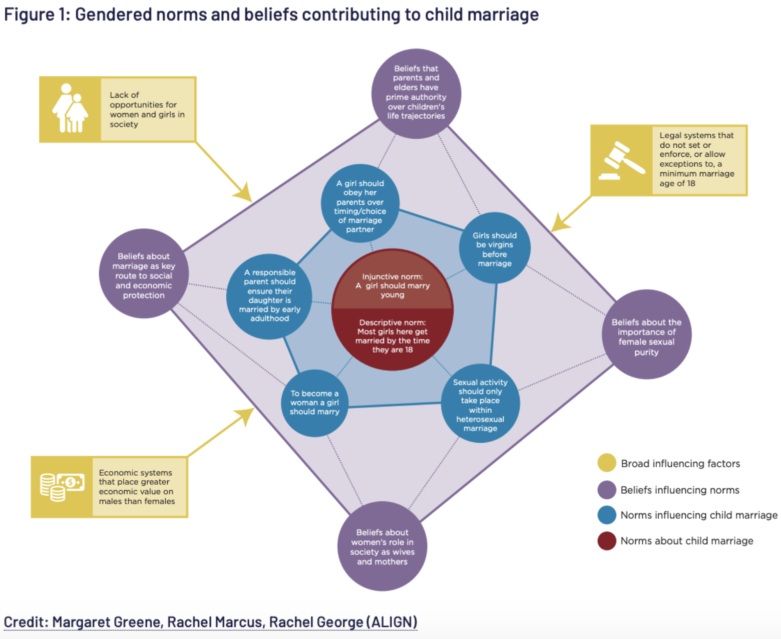
Harmful gender and social norms are at the root of child marriage.

Slide 3
Growing awareness that preventing child marriage requires social norms change.
Until now, no systematic assessment of child marriage and norms interventions, so difficult to assess learning and gaps.
Notes:
At the root of child marriage lie harmful gender and social norms.
By definition shifting norms requires working with people other than the “beneficiary”
How this perspective has especially been missing in child marriage field which doesn’t pay much attention to men and boys
Evidence on child marriage overall has expanded exponentially.
How there has been growing talk about the need to take a broader norms change approach… but that the evidence so far on the delivery of these programs and their impact is very limited
So we conducted a systematic review

Slide 4
Inclusion criteria
Study design: Impact evaluations using experimental or quasi-experimental designs (including mixed-method approaches).
Aims: Sought to change norms or attitudes related to child marriage and collected data on age at marriage AND norms/attitudes
Outcomes: Preventing or delaying marriage before age 18, participation in the marriage decision, norms/attitudes related to child marriage
Materials: Peer-reviewed articles, project evaluation reports
Dates: 1 January 2000 to 30 June 2021

Slide 5
Table 2: Results from evaluated interventions shifting norms to prevent/delay child marriage (N=12)
Lead author and year | Country/ Countries | Effect on norms related to child marriage | Effect on child marriage or delaying marriage | Summary
Comprehensive Intentional Norm Change Programming
IFS, 2018 | India | No statistically significant effect /negative | No statistically significant effect | Norms related to child marriage:1 out of 3 programs had statistically significant impact on measured norms related to child marriage, though effect was mixed; and 2 had no statistically significant effect. Child marriage or delaying marriage: 2 out of 3 had positive and statistically significant effect on child marriage or age at marriage; 1 had no statistically significant effect.
Munthali A, 2021 | Malawi | Mixed | Positive
Sieverding M, 2016 | Egypt | No statistically significant effect | Positive
Limited Intentional Norm Change Programming
Buchmann N, 2017 | Bangladesh | No statistically significant effect | Mixed | Norms related to child marriage: 1 out of 5 programs had positive and statistically significant effect; 1 had mixed effect; 2 had no statistically significant effect; and 1 did not report effects on norms. Child marriage or delaying marriage: 1 out of 5 programs had mixed/positive effect; 2 had mixed effects; and 2 had no statistically significant effect.
Erulkar et al, 2017b | Burkina Faso | None reported | Mixed
Melnikas AJ, 2021 | India, Malawi, Mali & Niger | Mixed | Mixed/Positive
Stark L, 2018a | Democratic Rep of the Congo | No statistically significant effect | No statistically significant effect
Stark L, 2018b | Ethiopia | Positive | No statistically significant effect
Little/No Intentional Norm Change Programming
Amin S, 2018 | Bangladesh | None reported | Positive | Norms related to child marriage: 1 of 4 programs had positive and statistically significant effect; 2 had no statistically significant effect; and 1 did not report effects on norms. Child marriage or delaying marriage: 1 of 4 had positive and statistically significant effect; 1 had mixed effects; and 2 had no statistically significant effect.
Austrian K, 2018 | Zambia | No statistically significant effect | No statistically significant effect
Sivasankaran A, 2014 | India | Positive | Mixed
Nanda et al, 2016 | India | No statistically significant effect on outcomes of focus | No statistically significant effects

Slide 6
A growing number of child marriage programmes intend to address social norms.
19
total studies that intended to address child marriage norms
12
total studies that evaluated impact for both child marriage and social norms outcomes
7
high quality studies
5
low or medium quality
studies

Slide 7
A number of child marriage programmes intend to address social norms.
All of the included interventions indicated their intention to address norms in their programmatic activities,
The 19 studies were concentrated in 4 countries, with 4 studies in Bangladesh, 4 in India, 2 in Ethiopia, 2 in Malawi, and the remaining 7 distributed across other settings.
19
total studies that intended to address child marriage norms
12
total studies that evaluated impact for BOTH child marriage and social norms outcomes
Of the 19, 7 programmes failed to measure child marriage AND norms-related outcomes leaving us with just 12 programmes.
Notes:
We included papers that highlighted norms in describing their theories of change and indicated their intention to address norms in their programmatic activities. We were guided in the inclusion/exclusion process by a study by Watson[18] on norms and child marriage in that we did not focus narrowly on interventions intended only to delay marriage, but also included those that would drive change in how girls might be viewed or the life choices open to them.

Slide 8
A focus on norm change does not always translate into comprehensive norms-related activities.
3
comprehensive
5
limited
4
little to none
Male engagement: Only 5 included activities that worked directly with boys
Reference groups: Only 4 worked directly with family members. 11 worked with community - 1 with teachers, one on broader social influence, one on legal reform and public advocacy.
Notes:
What would be the gold standard? Need to work with reference groups;
need to measure impact on norms as well as timing of marriage

Slide 9
Many programmes are not even measuring social norms change in their focus on child marriage impact.
Only 5 studies measured attitudes or norms held by individuals other than participant girls themselves
Two of the studies did not report any quantitative normative outcomes related to child marriage, although the program descriptions emphasized norm change to a significant extent.
Despite strong interest in social norms as drivers of CEFMU, these studies provide only weak evidence of programmatic impact on norms, and the links with marriage. In particular, several studies found significant shifts in marriage-related behaviours with none of the appreciable changes in norms that would be consistent with the broader argument that these norms drive marriage behaviour.

Slide 10
“Norms” measures employed by the 12 included studies
Gender attitudes of participant girls
Gender attitudes of caregivers
Odds of girls 15-24
-Reporting they can decide for themselves who to date
-Agreeing it is appropriate for a girl to propose using a condom
____ agrees appropriate age at marriage is 18+: Mother, brother
Empowerment index (girls aged 15-17 at start of program)
Agree boys have right to refuse arranged marriage (BRRAM)
Agree girls have right to refuse arranged marriage (GRRAM)
Caregiver attitudes towards gender inequitable norms
Among girls:
-Appropriate age of marriage
-Appropriate age at first birth
Among participants:
-Attitudes towards gender roles in adolescence
-Acceptability of IPV
Gender attitudes (GEM scale)
Aspirations to study ↑ 12th grade (adolescent girls)
Aspirations for daughter to study ↑ 12th grade (mothers)
Among all women:
-Empowerment index
-Marriage decisions/attitudes
Norms research is a field in its own adolescence, especially with regard to child marriage.
Notes:
Norm change treated as a “black box” leading to behavioural shifts. Not clearly articulating the necessary steps to complete this causal pathway makes it difficult to identify how specific programmatic approaches work together to change norms, or how norms mediate their contributions to behavior change.
Lack of consensus on which norms should be changed, which programmatic activities should be used, and which groups to focus on in programme activities

Slide 11
Call to Action
Research and programming on norm change needs shared definitions, terminology and theories of change to precisely link activities to the specific norms they seek to address. Ultimately, consensus on how to approach normative change in child marriage programming requires building agreement across a range of stakeholders.
greater consensus is needed on prioritized norms and pathways of change regarding child marriage
Delphi study could bring people together
If norm change is a program goal and part of its theory of change, then programme activities need to reflect this and programme impact on both norms and the outcomes those norms are meant to influence needs to be measured. In order to evaluate the range of interventions working to shift norms related to child marriage, the child marriage field needs validated instruments for quantitatively measuring change in social norms.
Identifying relevant reference groups for girls at risk of child marriage and naming the power-holders and decision-makers in their lives is also essential - link to gender synchronization.(wouldn’t the ultimate reference group be potential husbands and their families? And that is gender synchronized)
Data must be collected from the correct groups and should go beyond attitudes to collect data on norms and behaviours, e.g., asking about the perceived benefits of delaying child marriage.
If norms are “upstream” from multiple outcomes, investing in norm change programming responds to the SDG challenge that programmes invest in activities that promote synergies. - implications for sustainability
Link to GreeneWorks.com website where we have call for funding

