Slide 1
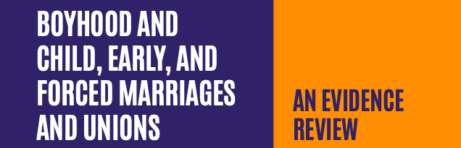
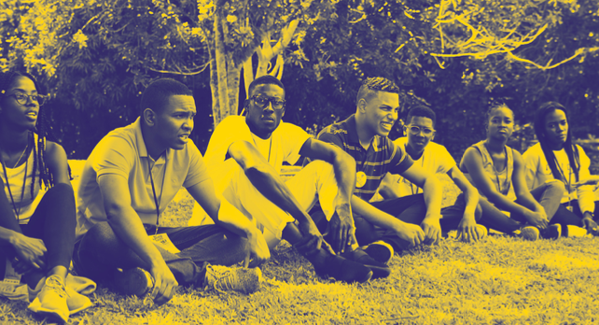


Slide 2

METHODOLOGY
DATABASE CREATION
Programs working with boys on gender inequality via approaches and topics relevant to child marriage
Interviews
Database searches
Screened key organizational websites and relevant bibliographies
CRITERIA
Programs included in our analysis had to:
Work to delay child marriage or support individuals married as children
AND
Engage boys and men
DATA EXTRACTED
Target group
Program information
GT & intersectional aspects
Engagement processes
Socioecological level
CEFMU & SRHR links
Program results, determinants of success
Notes:
This is not a systematic review, as it does not assess the evaluation methodology from a statistical perspective
Gender-transformative programs since 2015 that worked with boys and young men
Showed results on gender inequality or CEFMU
Documented in English or French
Work across more than one level of socioecological framework

Slide 3
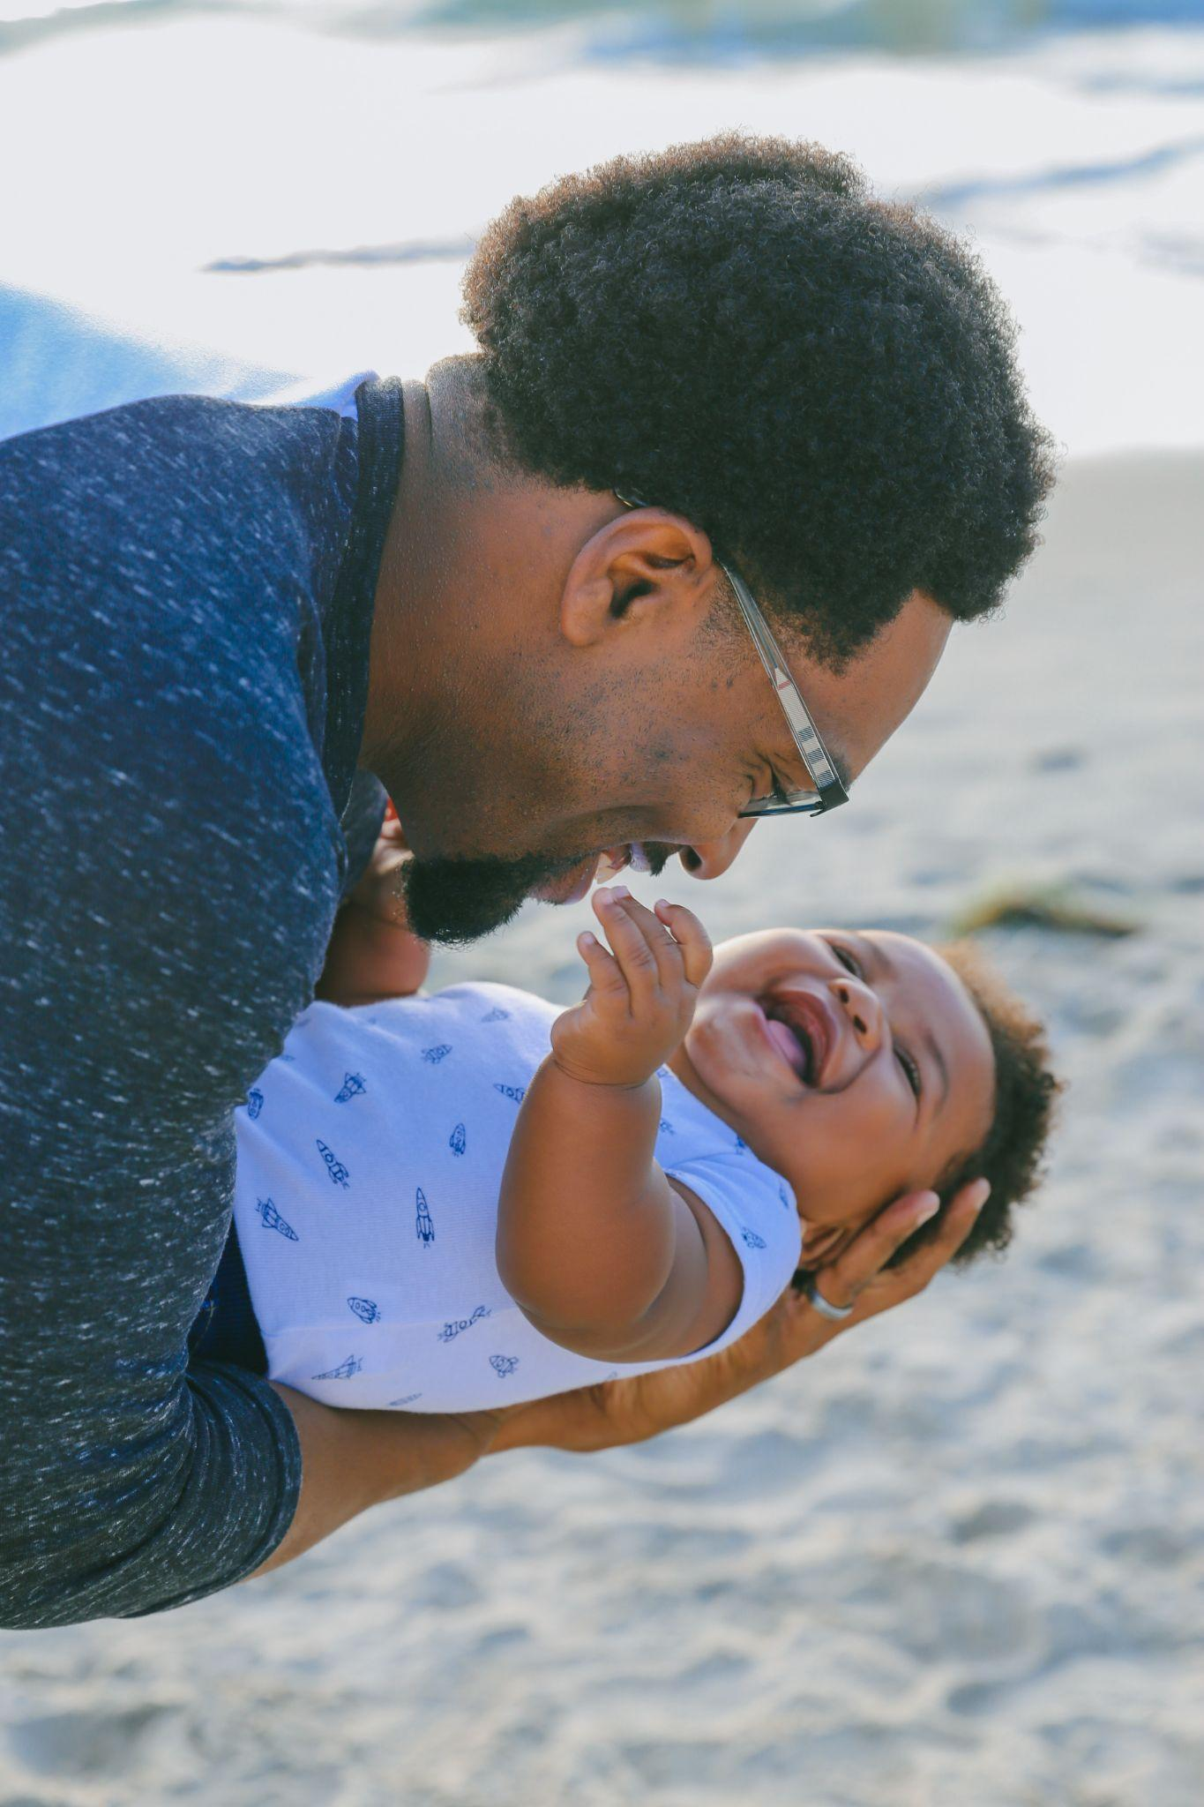
Program review: key themes
There are interventions to learn from!
Institutional level investment is limited
Major topics for gender-transformation get covered but..
More to do around sexuality and reaching consensus
Longer-term and deeper engagement, including for staff, is key
Investing in contextual program design and quality evaluation remains crucial
Notes:
Few programs target boys with strong gender equality emphasis
---------------------
Existing programs concentrated in South Asia and Sub-Saharan Africa
---------------------
No program that works to prevent CEFMU among boys and support child grooms emerged
---------------------
Most programs focus on individual and family or community levels

Slide 4
Promising approaches
Promoting gender-equitable attitudes at scale
Gender Equity Movement in Schools (GEMS); Taaron ki Toli (TKT)
Tailoring programs to boys
Action for Equality; Kishor Varta; Nisikilise Tujengane (NISITU)
Addressing consequences of CEFMU by targeting husbands
REAL Responsible, Engaged and Loving Fathers; Men as Caring Fathers and Partners; Clubs des Maris et des Futurs Maris

Slide 5
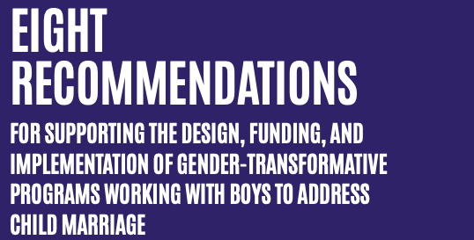
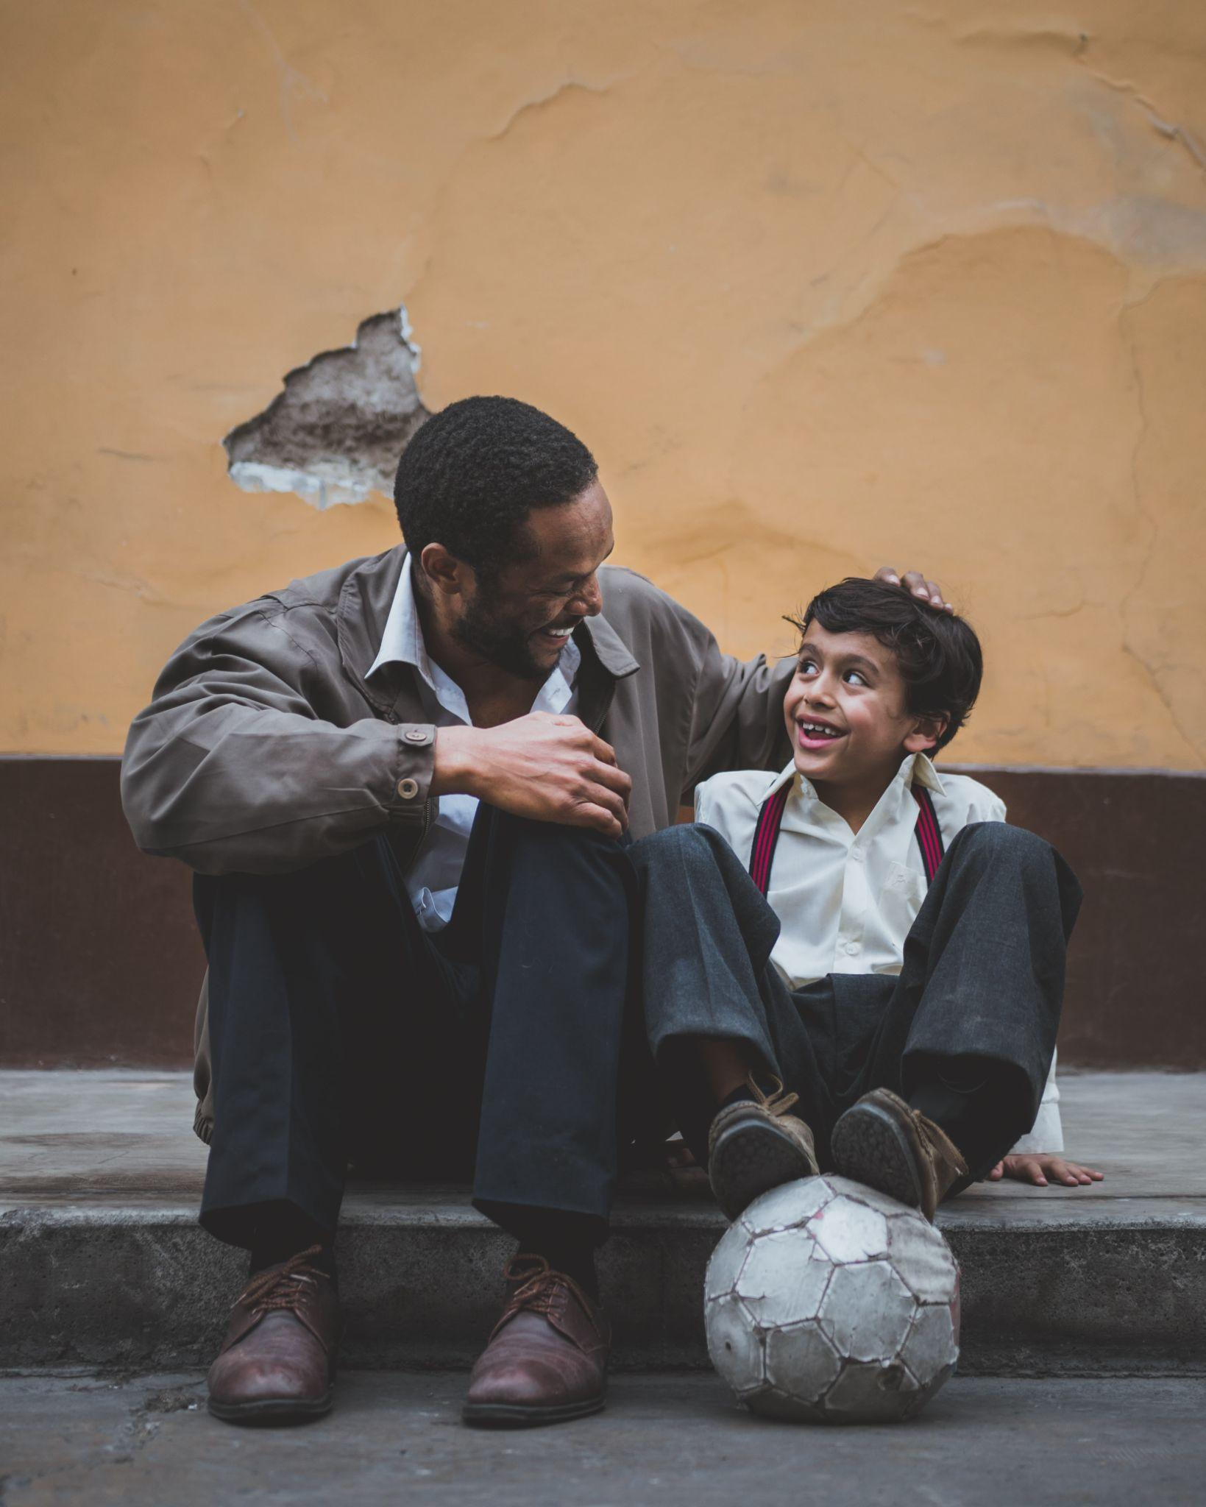






Notes:
Create opportunities for introspection
Favor participatory methodologies that engage participants
Gender-transformative training for 3+ months to facilitators
Sustain efforts across levels of socioecological model
Structure curriculum so that boys and girls have opportunity to meet separately and together
Learn more from Southeast Asia, Latin America, Middle East and the Global North
Review of broader interventions that do not make an explicit connection with CEFMU could also challenge restrictive masculinities among adolescent boys

Slide 6
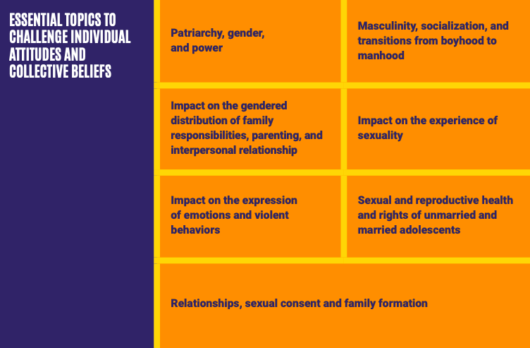
Notes:
Illustration of what can be found in the report for more details

Slide 7
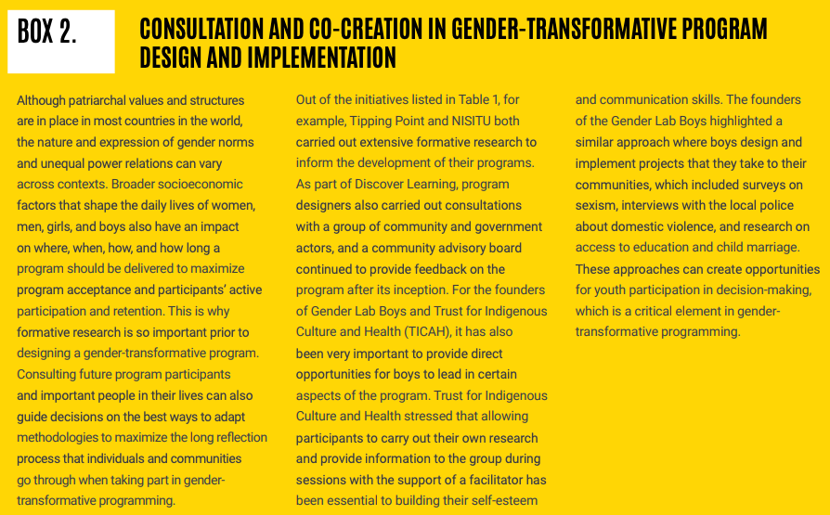
Notes:
Illustration of what can be found in the report for more details

Slide 8
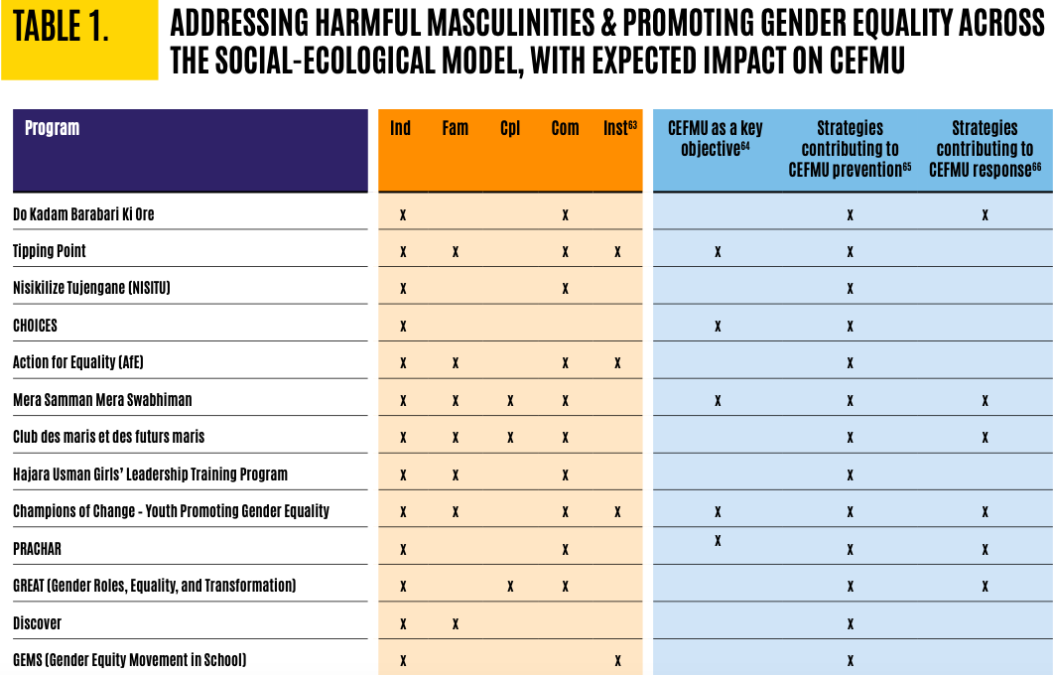

Notes:
Illustration of what can be found in the report for more details - programs across the ecological model

Slide 9
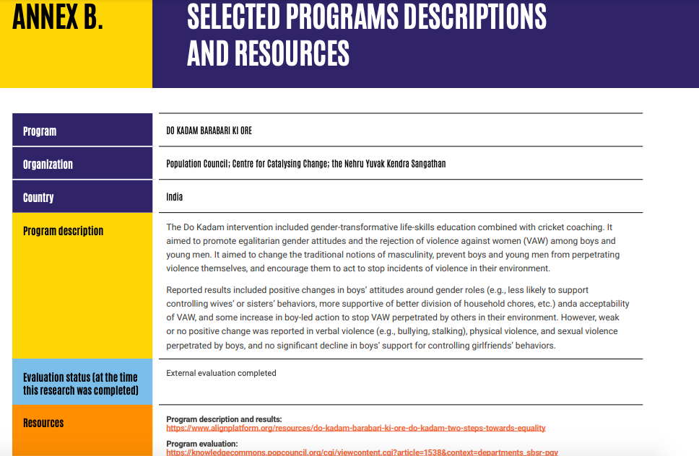
Notes:
Illustration of what can be found in the report for more details

Slide 10

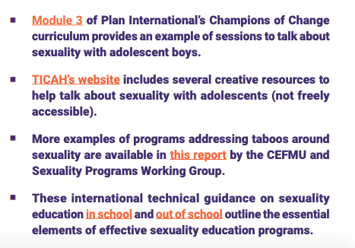
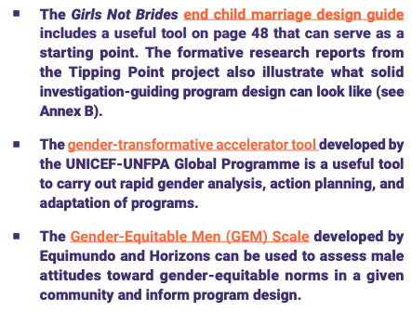

Notes:
Illustration of what can be found in the report for more details

