Slide 1

The Child Marriage Research to Action Network (The CRANK)
This session will have presentations in English. To access simultaneous interpretation, please click on the globe icon at the bottom bar of your screen and select your preferred language (English, Spanish, French, or no interpretation).
Esta sesión tendrá presentaciones en inglés. Para acceder a los servicios de interpretación simultanea, por favor haga clic en el icono del globo que encontrará en la barra inferior de su pantalla, y seleccione su idioma de preferencia (inglés, español, francés o version original).
Cette session comprendra des présentations en anglais. Pour accéder aux services d'interprétation simultanée, veuillez cliquer sur l'icône globe que vous trouverez dans la barre inférieure de votre écran, et sélectionnez votre langue préférée (anglais, espagnol, français ou version originale).
Notes:
Nankali - translation slide:
Translations are available in English, French and Spanish – please chose the channel of your choice clicking on the globe icon at the bottom of the screen.
This session will be recorded and recordings will be shared along with key notes from the session in the follow up resources communication

Slide 2
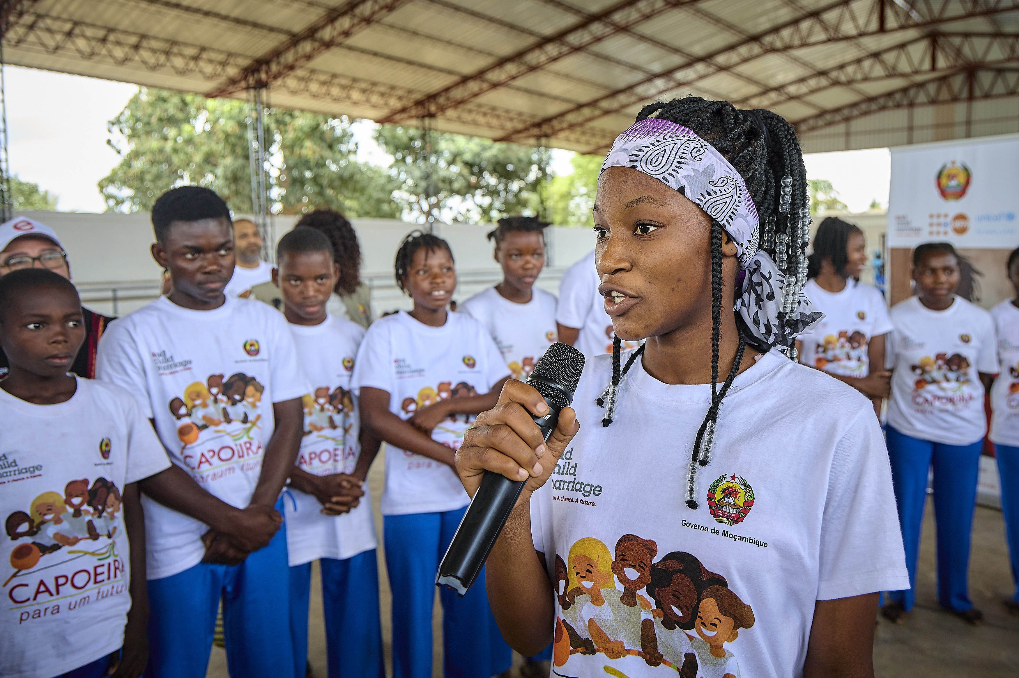
Strengthening evidence-based policy responses to child marriage
The Child Marriage Research to Action Network (The CRANK)
18 October 2023
Notes:
Welcome from Nankali: XXXX
CRANK platform - if you want to refer to any of these points Nankali, but please feel free to take your own approach:
The CRANK - provides a platform for a better coordinated and harmonised global research on child marriage responding to priority needs and gaps of policy makers and practitioners
Promotes Reserach to Action: - encourages uptake of latestest evidence on priority topics by policy makers and practitioners though our quarterly research meetings and resource pages
It is also a knowledge management mechanism - synthesising the latest evidence with key takeaways in our biannual Research Spotlights and through the CRANK Research Tracker facilitating member coordination on research and avoiding duplication of research efforts.
Importance of this topic:- need to accelerate prevention of child marraige at scale if we are to meet our targets etc. You can draw from some of this text if helpful:
Evidence tells us that accelerating progress to end child marriage is possible under the right conditions. Focusing on effective interventions with potential for scale is critical to accelerating large-scale change to end child marriage.
In today’s session we will discuss the evidence from two large scale interventions that have contributed to the prevention of child marriage, in two differing contexts. We will present the success and learnings from two case studies - one from Ethiopia, and the second from the state of West Bengal in India drawing from UNICEF’s recent report Leveraging large scale sectoral programmes to prevent child marriage
Please post your questions and comments in the chat and we will ensure these get picked up for the discussion. A gentle reminder to please use language that is respectful and inclusive.

Slide 3
Agenda
Time (UK) | Discussion
14:00 - 14:03 | Welcome Opening welcome: José-Roberto Luna Manzanero, Technical Specialist Adolescent & Youth, Child Marriage, UNFPA. Moderator: Rachel Yates, Strategic Advocacy Lead, Accelerate Hub
14:03 - 14:50 | Presentations from: Pragya Bhuwania, Fielding School of Public Health, University of California - Impact of Tuition-Free Educatioon Policy on Child Marriage and Ealy Childbearing: Does Secondary Matter More? Karen Austrian, Director, GIRL Center and Senio Associate, Population Council, Kenya; and Mohamed Abdille, WASH and AGI-K Coordinator for the Wajir County Department of Health - Adolescent Girls Initiative Kenya – Population Council Michele Boujikian, Education Researcher, Data Must Speak, Innocenti, UNICEF - Data Must Speak – Positive Deviance Approaches to Learning
14:50 - 15:25 | Q&A and discussion – Rachel Yates
15:25 - 15:40 | CRANK Member research updates Emma Sadd, Girls Not Brides – CEFMU and the Law Dr. Olubukola Omobowale, University of Ibadan – Ending Child Marriage in Nigeria through community-led media series Shannon Thomson, Orchid Project – The FGM/C Research Initiative
15.40 – 15.45 | Key takeaways from today’s session and close – Rachel Yates
Notes:
The agenda will be presented on slide for people to refer to but no need to talk through it, has been sent out in advance.
Welcome Rachel Yates and short intro– bio pending, hand over to Rachel for her 5 minutes on importance of scale.

Slide 4
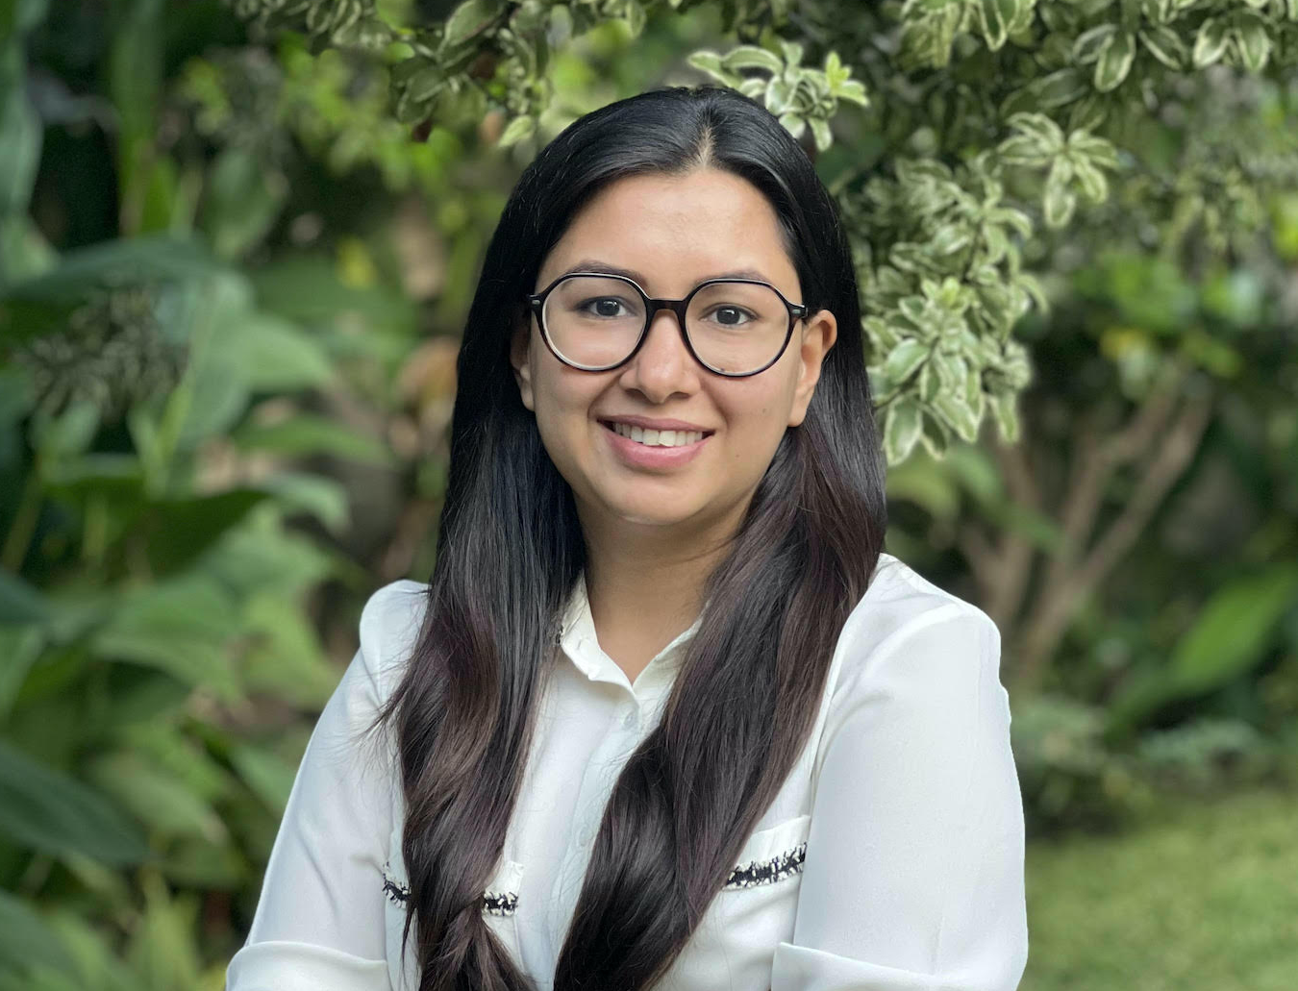
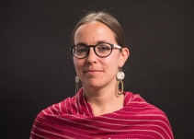
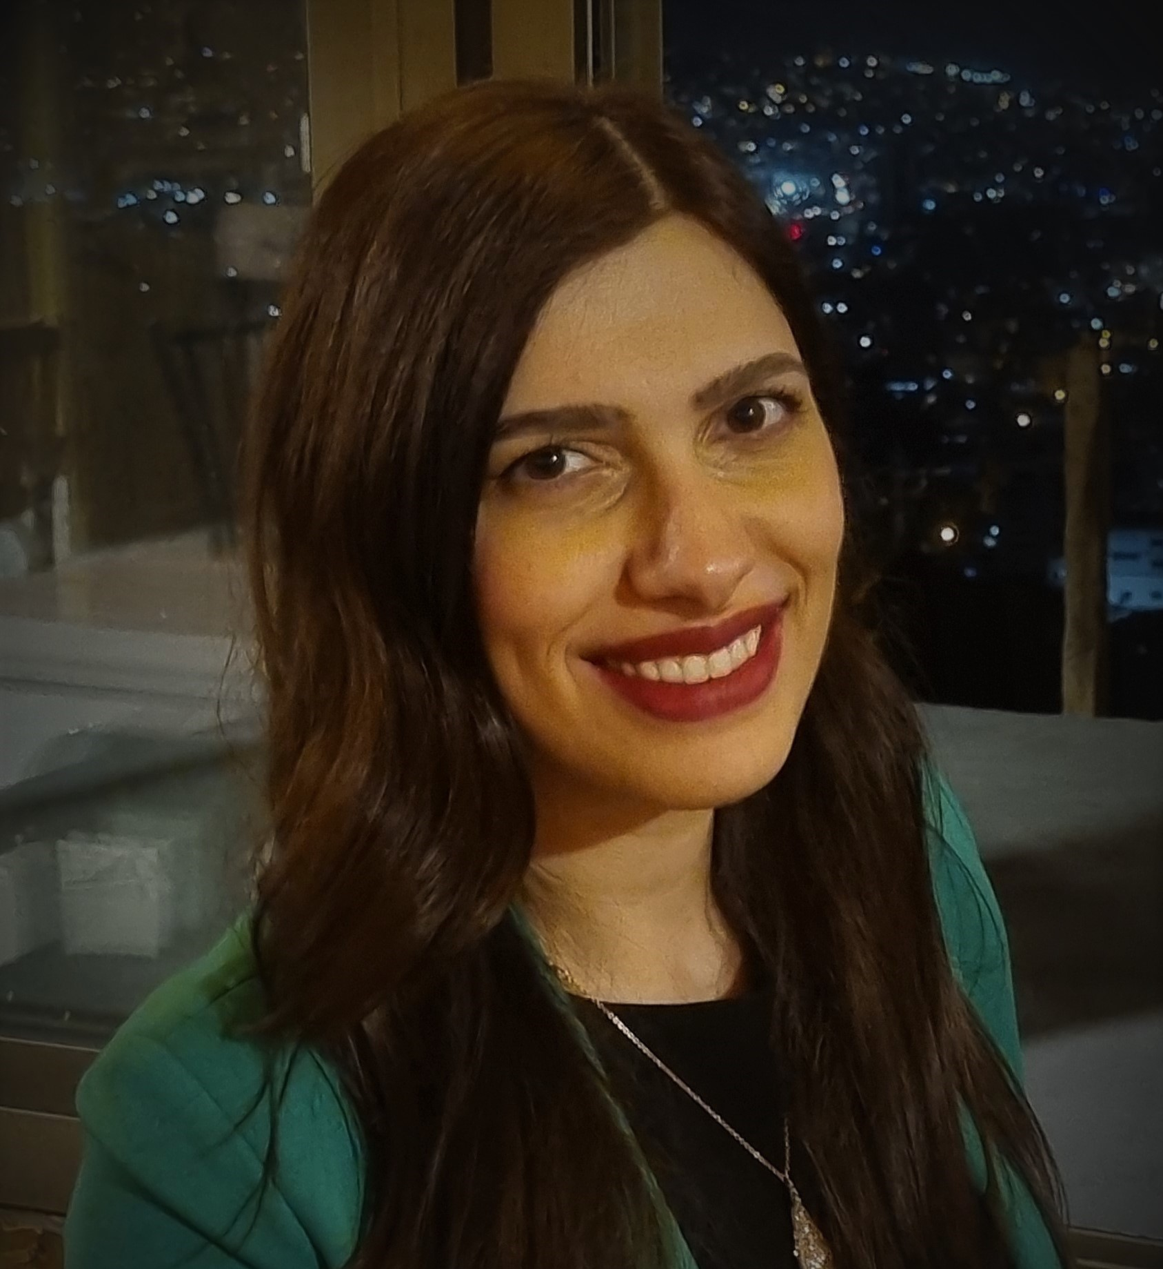
Speakers
Pragya Bhuwania. Pragya's primary research interest lies at the intersection of applied microeconomics, health, gender, and development. She works on evaluating the impact of legislations and programmatic interventions on women and children in developing countries. Previously, she was a Maternal and Child Health Equity (MACHEquity) Fellow, jointly held at McGill Institute for Health & Social Policy and IIM Bangalore.
Dr. Karen Austrian. Based in Kenya, Karen is a globally recognized expert in adolescent health who leads the Council’s Girl Innovation, Research, and Learning (GIRL) Center. Prior to this role Karen led a portfolio of projects designed to empower girls in East and Southern Africa. She is actively involved in ensuring that evidence on adolescence is synthesized and used by global, national and local stakeholders to improve programs and policies that create the opportunity for adolescent girls to live their full potential.
Mohamed Abdille is the WASH and AGI-K Coordinator for the Wajir County Department of Health. He has worked for the country department of health since 2003. He has held several roles prior to this including primary health care coordinator, community health strategy focal person, and sub-county public health officer. He has a BA in environmental health science from Kenyatta University in Nairobi
Michèle Boujikian is an Education Researcher with the Data Must Speak research team at UNICEF Innocenti. She has extensive experience in the design and implementation of research studies and has led projects aiming at informing, evaluating, and developing the Education Programs of various local and international organizations. She has also worked with the International Rescue Committee in Lebanon, on projects related to the evaluation and improvement of education support to refugees.

Slide 5
The impact of tuition-free education policy on child marriage and early childbearing:
Does secondary matter more?
Pragya Bhuwania
WORLD Policy Analysis Center, UCLA
Oct 18, 2023

Slide 6
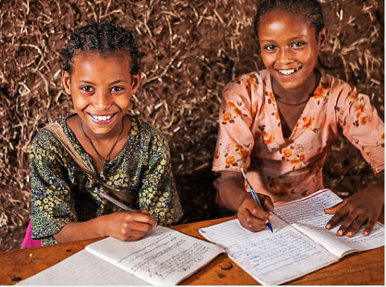
Introduction
Core drivers of child marriage: social norms, poverty, education, employment, agency
Education and marriage: inverse relationship well documented; however, not causal
Small-scale randomized controlled trials (RCTs): provide causal evidence but they are often multi-pronged and not scalable or generalizable
This is the first study to use longitudinal, comparative data to rigorously examine whether abolishing tuition fees at the secondary level in low- and middle-income countries:
  affects child marriage and early childbearing,
  has a greater impact than abolishing tuition at the primary level alone
Credits: hadynyah

Slide 7
Methods
Outcomes data: Demographic and Health Surveys (DHS)
  Pooled data from all available DHS between 1986 – 2016
  Created a longitudinal dataset of individuals born between 1970 – 2001
Policy data: WORLD Policy Analysis Center’s data on tuition-free policies in Africa
  3 treatment countries — Uganda, Liberia, and Tanzania — abolished tuition fees in secondary education long after abolishing tuition in primary education, making it possible to examine separately the impact at each level
  2 comparison countries — Burkina Faso and DRC recently abolished tuition fees such that they did not have free education during the study period
Difference-in-differences (DD) identification strategy: Estimated the effect of girls’ exposure to free secondary education on the probability of marriage and childbearing before ages 15 and 18
  Compares the difference in outcomes before and after an intervention in the treatment group to the difference in outcomes in the control group over the same period
  Captures changes both within- and across- countries

Slide 8
Results
Table 1: Impact of tuition-free policies on child marriage and early childbearing
Outcomes | (1) Primary vs. None Free Policy Effect (95% CI ª) | (2) Secondary vs. None Free Policy Effect (95% CI ª) | (3) Secondary vs. Primary Free Policy Effect (95% CI ª)
Marriage before 15 | −0.75 (−1.51, −0.07) | −4.05 (−4.96, −3.20) | −3.30 (−4.06 ,−2.54)
Marriage before 18 | −2.50 (−4.19, −0.85) | −5.47 (−7.81, −3.23) | −2.97 (−5.16, −0.79)
Child birth before 15 | 0.30 (−0.27, 0.86) | −1.54 (−2.15, −0.83) | −1.84 (−2.40, −1.28)
Child birth before 18 | −3.68 (−5.40, −2.16) | −8.55 (−10.83, −6.34) | −4.87 (−6.91, −2.83)
ª 95% Bias-corrected bootstrapped confidence intervals (CI)
Notes:
In column (1), we compare girls with free primary education to girls without access to free education. We find that free primary reduced child marriage and early childbearing.
In column (2), we compare girls with free secondary to girls without access to free education. We find far greater reductions across all 4 outcomes.
In column (3), we statistically compare the results of columns (1) and (2) and show that the greater impact of secondary is statistically significant across all outcomes.

Slide 9
Results
Pre-policy trends
Figure1: Pre-policy trends in the probability of outcomes across treated and control countries
Notes:
An important assumption of DD models is that the trends in outcomes in the treated countries would have remained similar to that of control countries had they not passed these laws. We cannot test this formally but can be reasonably confident if we see similar trends in outcomes before these laws rolled out.
During the 15 years preceding the adoption of tuition-free policies, we see that the trends remained similar across treatment and comparison groups (except the probability of marriage before 15)

Slide 10
Takeaway
Tuition-free secondary education reduced the probability of child marriage and early childbearing significantly more than tuition-free primary alone
When compared to tuition-free primary alone, secondary education reduced the probability of:
  marriage before 15 by 3.3 percentage points
  marriage before 18 by 3.0 percentage points
  childbearing before 15 by 1.8 percentage points
  childbearing before 18 by 4.9 percentage points
Led to additional years of schooling (0.47 − 0.54); many studies show that abolishing tuition fees leads to significant increases in enrollment, attendance, and educational attainment among girls
Results were robust to alternative model specifications in terms of different treatment definitions and choice of analytical sample
CRC ratification and child marriage laws preceded tuition-free policies in all countries; we do not know of any other related laws or policies adopted at the same time as tuition-free policies, ruling out other competing explanations for our results

Slide 11
Takeaway
Through the Sustainable Development Goals (SDGs), all countries have committed to ensuring:
  Free and equitable education at the primary and secondary levels (SDG 4)
  Realizing gender equality (SDG 5)
As policymakers seek to accelerate progress on these commitments, this study underscores the role of investing in secondary education as a strategy for:
  Reducing child marriage and early childbearing in the long term
  Advancing gender equality in education, alongside a wide range of other health and developmental goals
This study demonstrates that abolishing tuition fees at the secondary level has benefits beyond those produced by abolishing primary tuition alone — an important finding given that free primary has become nearly universal but far fewer countries have fully abolished tuition fees at the secondary level

Slide 12
Discussion
  Plausible pathways of change: Free secondary may be more effective than primary because:
      Girls are more susceptible to child marriage during the years they are supposed to be in secondary school as opposed to primary
      Secondary schooling is more likely to improve labor market prospects
  Geography: Local context matters (social capital, dowry/bride price, norms)
      A study across 44 LMICs shows it matters even after controlling for individual level socioeconomic disadvantage; a few others argue that school-going might change to the extent that it does not conflict with existing gender norms
  Costs and returns to education:
      Other costs (school uniforms, supplies, books): For the poorest 40% households across 9 African countries, tuition fees constituted 36% of their total household education expenditures
      Impact of education policies might be limited in settings where education does not translate to better economic opportunities
  Minimum-age marriage laws:
      Upcoming study from our research group shows greatest impact in countries that have both child marriage laws and tuition-free education policies

Slide 13
References:
Austrian, Karen, Erica Soler-Hampejsek, Beth Kangwana, Nicole Maddox, Maryama Diaw, Yohannes D. Wado, Benta Abuya. et al. 2022. “Impacts of Multisectoral Cash Plus Programs on Marriage and Fertility After 4 Years in Pastoralist Kenya: A Randomized Trial.” Journal of Adolescent Health 70(6): 885–894.
Kalamar, Amanda M., Susan Lee-Rife, and Michelle J. Hindin. 2016. “Interventions to Prevent Child Marriage among Young People in Low-and Middle-Income Countries: A Systematic Review of the Published and Gray Literature.” Journal of Adolescent Health 59(3): S16–S21.
Duflo, Esther, Pascaline Dupas, and Michael Kremer. 2006. Education and HIV/AIDS Prevention: Evidence from a Randomized Evaluation in Western Kenya. Vol. 4024. Washington, DC: World Bank Publications.
Hallfors Denise Dion, Hyunsan Cho, Simbarashe Rusakaniko, John Mapfumo, Bonita Iritani, Lei Zhang, Winnie Luseno, and Ted Miller. 2015. “The Impact of School Subsidies on HIV-Related Outcomes among Adolescent Female Orphans.” Journal of Adolescent Health 56(1): 79–84.
Angrist, Joshua, Eric Bettinger, Erik Bloom, Elizabeth King, and Michael Kremer. 2002. “Vouchers for Private Schooling in Colombia: Evidence from a Randomized Natural Experiment.” American Economic Review 92(5): 1535–1558.
Bentaouet, Raja Kattan. 2006. Implementation of Free Basic Education Policy. No. 47186. Washington, DC: World Bank Group.
Boyle, Siobhan, Andy Brock, John Mace, and Mo Sibbons. 2002. Reaching the Poor: The ‘costs’ of sending children to school: a six country comparative study, synthesis report. No. 666-2016-45490. 2002.
UNESCO Institute for Statistics. 2012. Global Education Digest 2012. Opportunities Lost: The Impact of Grade Repetition and Early School Leaving. Quebec: UNESCO.
Gausman, Jewel, Ana Langer, S. Bryn Austin, and S. V. Subramanian. 2019. “Contextual Variation in Early Adolescent Childbearing: A Multilevel Study from 33,822 Communities in 44 low-and Middle-Income Countries.” Journal of Adolescent Health 64(6): 737–745.
Amin, Sajeda, M. Niaz Asadullah, Sara Hossain, and Zaki Wahhaj. 2017b. “Eradicating Child Marriage in the Commonwealth: Is Investment in Girls’ Education Sufficient?” The Round Table: The Commonwealth Journal of International Affairs 106(2): 221–223.
Psaki, Stephanie R., Andrea J. Melnikas, Eashita Haque, Grace Saul, Christina Misunas, Sangram K. Patel, Thoai Ngo, and Sajeda Amin. 2021. “What Are the Drivers of Child Marriage? A Conceptual Framework to Guide Policies and Programs.” Journal of Adolescent Health 69(6): S13-S22.
Soler-Hampejsek, Erica, Beth Kangwana, Karen Austrian, Sajeda Amin, and Stephanie R. Psaki. 2021. “Education, Child Marriage, and Work Outcomes among Young People in Rural Malawi.” Journal of Adolescent Health 69(6): S57–S64.

Slide 14
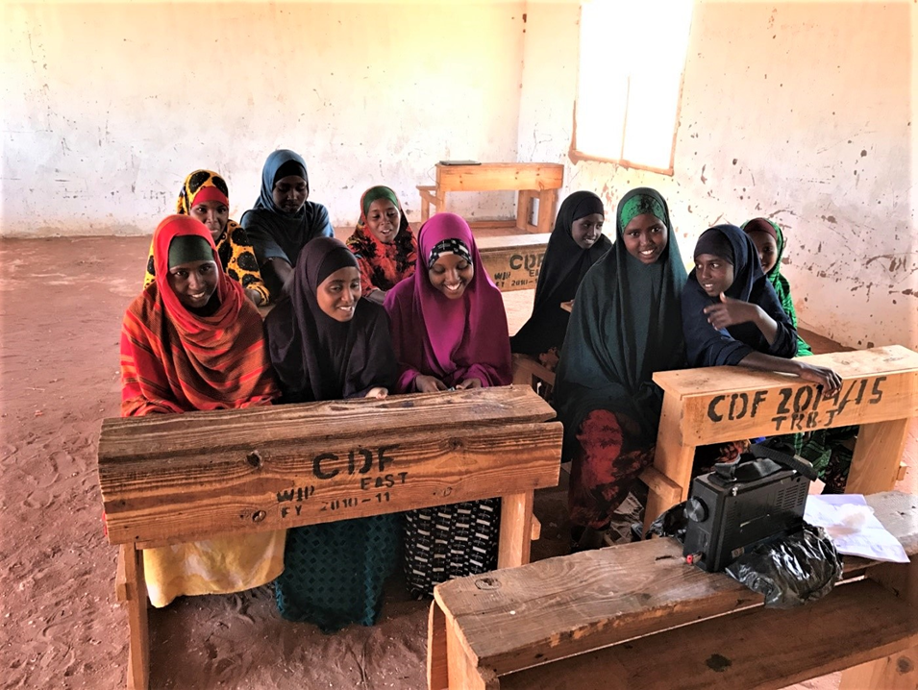
From data to Action: the adolescent girls initiative – Kenya
Karen Austrian, PhD, MPH Mohamed Abdille
Director, GIRL Center AGI-K/WASH Coordinator
Population Council Wajir County MoH
October 18, 2023

Slide 15
About AGI-K
  First phase: a six-year UK aid funded program through DFID-Kenya (2014 – 2020)
    Initial test of the program in the short and medium term
  Extension phase: to conduct an additional round of data collection four years after the end of the program (Funded by Elrha – 2021-22)
    To assess the long-term effects of the program
  Testing for Scale phase: (Funded by CIFF- 2022-2023)
    Identify the most cost-effective version of AGI-K that can be sustainably scaled up by Wajir County Government

Slide 16
What did we want to learn?
What package of multi-sectoral, multi-level interventions has impact for adolescent girls?
Can early interventions improve longer-term outcomes?
Community
Household
Girl
Notes:
The interventions run for 2 years and included a combination of girl-level, household-level and community level interventions from different sectors

Slide 17
Program Packages
PACKAGE 1
Community engagement
PACKAGE 2
Community engagement
+
Education Cash Transfer
PACKAGE 3
Community engagement
Education Cash Transfer
Health/Lifeskills
+
+
PACKAGE 4
Wealth
Community engagement
+
Education Cash Transfer
+
Health/Lifeskills
+
Community engagement
Notes:
The intervention consisted of four different components: a community-based violence prevention program, an education conditional cash transfer (CCT), health focused girl's empowerment clubs and wealth creation for girls via financial education and savings activities.

Slide 18
2 years after the program, there is in school enrollment, in early marriage and pregnancy
*Among out of school girls at baseline
Notes:
Overall, two years after the intervention, findings at the endline survey in 2019 highlighted that in Wajir
-There was sustained school enrollment 16% vs 45% , as well as improved literacy and numeracy for girls who participated in the three intervention arms
For girls who were out of school at baseline (2015), the CCT led to long-term improvements in delayed marriage at 50 % vs 30 % and delayed pregnancy at 34% vs 17%.
Also improvements in literacy (14% of control literate v. 31% of VE/VEH/VEHW)
Also improvement in numeracy (mean score of 4.6 for control v. 8.2 for VE/VEH/VEHW) – out of 20
Green bar is the control - % at endline
Blue bar are the three intervention arms combined - % at endline

Slide 19
4 years after the program, there is still in school enrollment, in early marriage and pregnancy
*Among out of school girls at baseline
Notes:
We see that the impacts from 2019 have largely remained
Girls in the program are now five times more likely to still be enrolled in school, 20 percentage points less likely to be married and thus less likely to have ever been pregnant.
We did look to see if there were effects on the children of the girls from the original AGI-K study. However, we did not see any main differences except that girls in the program were a bit less likely to have had a still birth (3% in VEHW compared to 10% in V-only reporting stillbirth).

Slide 20
SCALING UP OF AGI-K
IN WAJIR

Slide 21
What has happened since…
Discussions with CECs in November 2019 about desire to scale up
Meeting with Governor Wajir in March 2020/county speakers
Numerous meetings with County Health Officials
Donor meetings
Decision to fund a testing phase
Notes:
In November 2019, we had a meeting with the County Executive Committee, where we shared the AGI-K findings and discussed a desire to scale up AGI_K in Wajir County.
In March 2020, just at the start of the pandemic we met with the Governor of Wajir, with county speakers, with the donors and a decision to fund the testing phase was agreed upon.
COVID-19- Leveraged AGI-K cohorts to collect data on COVID-19/Cash transfer for school re-enrollment trial

Slide 22
Overview of Testing Phase
Objective: identify the most cost-effective version of AGI-K that can be sustainably scaled up by Wajir County Government
Key principles for designing the intervention components:
  scale
  government/community structures
  cost
AGI-K will be domiciled the Wajir County Ministry of Health but delivered in coordination with Ministries of Education and Gender
Notes:
New phase to test three adaptation of the original AGI-K model to identify a model that is beset suited for scale up by Wajir County Government vis a vis
1) Scale
2) Feasibility of implementation via government / community systems and structures
3) cost.
We are currently planning to conduct a formative assessment in Dilmanyale village in Wajir South and Adan Masajida village in Wajir West to identify the most cost effective and feasible version of AGI-K that can be sustainably scaled up by Wajir County Government.

Slide 23
What we are testing
PACKAGE 1
(10 villages)
PACKAGE 2
(10 villages)
PACKAGE 3
(10 villages)
COMMUNITY CONVERSATION GROUPS
GIRLS EMPOWERMENT GROUPS
Community level incentive
Household level incentive: cash transfer over four terms with higher amount going to out-of-school girls
Cash incentive (one time) for out of school girls who enroll
Notes:
CC implemented through the existing CHU and through existing monthly community dialogue days, Girls empowered groups for in school and OOS girls being facilitated by CHVs who are part of the CHU
For the Community level incentive Girls who are out of school at baseline will receive a one time cash incentive if they enroll in school during the first term of the 2022 school year. The community will be given four options and asked to select one option either a – two school based and two community-based incentive (e.g. latrines, water storage and water piping) which will be implemented and monitored by the MoH.
All payments will be conditioned on girls being enrolled in school. Enrollment will be verified during the second week of each term and payments made be the end of the month.

Slide 24
Community Conversation & Safe Spaces Groups
Implemented through the Community Health Unit (CHU)
Community conversations
  Facilitated by Community Health Assistants (CHAs)
  Occur once a month (for 12 months)
  Leverage on existing community dialogues
  Engage parents, religious leaders, village elders & chiefs who are important for buy in
  Discuss value for girls' education and other related topics
Safe Space groups
  Facilitated by community health volunteers
  In school groups and out of school groups
Notes:
CHU – Community Health Units
Serve a defined geographical area / location
Average population per CHU is 5000 people / about 1000 households
Each CHU is lead by a Community Health Assistant
Each CHU is served by approximately 10 CHVs, but could be more depending on the population .
A CHV maybe in charge of up to 20 households.
CHA – Community Health Assistant – employed by the county government and are on payroll
Are part of the Community Health Unit Structure
Have an undergraduate degree in relevant field
Their duties include but are not limited to coordinating community health activities ; collating data from the household level; identifying and referring health cases to appropriate health facilities
Community Health Volunteers
Make visits to homes
Initiate dialogue with household members
Deliver key messages and undertake necessary action
They are not under the government payroll but are given incentives based on activity they are involved in. Some counties have enacted the Community Health and Strategy Bill to provide a legal framework to pay CHVs monthly stipend from the county budget.

Slide 25
Policy Support
Needed to create legal framework for AGIK adoption at the county level
  Supported development of the Community Health Services Bill (CHS) which will allow for financing of CHVs
  Supported development of the county development integrated plan (CIDP) → AGIK now embedded in current CIDP (2023-27) under the primary health care program
  Supported development of Annual Development Plan → AGIK now included and CC/SS components financed in 2024 ADP
  Ongoing conversations with county and other stakeholders on best mechanism to deliver the CT component

Slide 26
School enrollment data shows that after one year, HALF of out of school girls in packages with cash incentives returned to school

Slide 27
Endline survey data shows: half of girls in packages with cash incentives returned to school and were still enrolled even after the program ended
* Among girls who were out of school at baseline

Slide 28
Reflections

Slide 29









Thanking our Funders and Partners

Slide 30
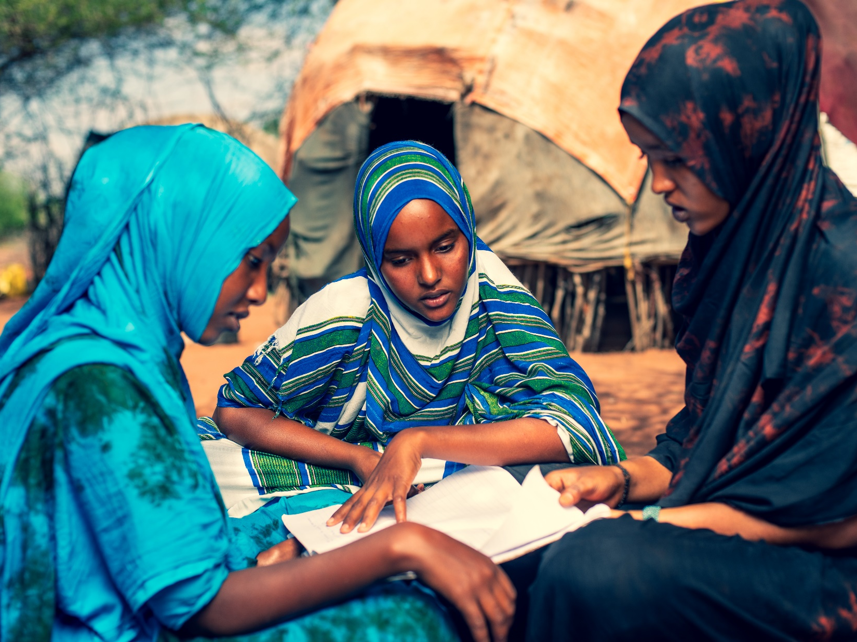
THANK YOU

Slide 31
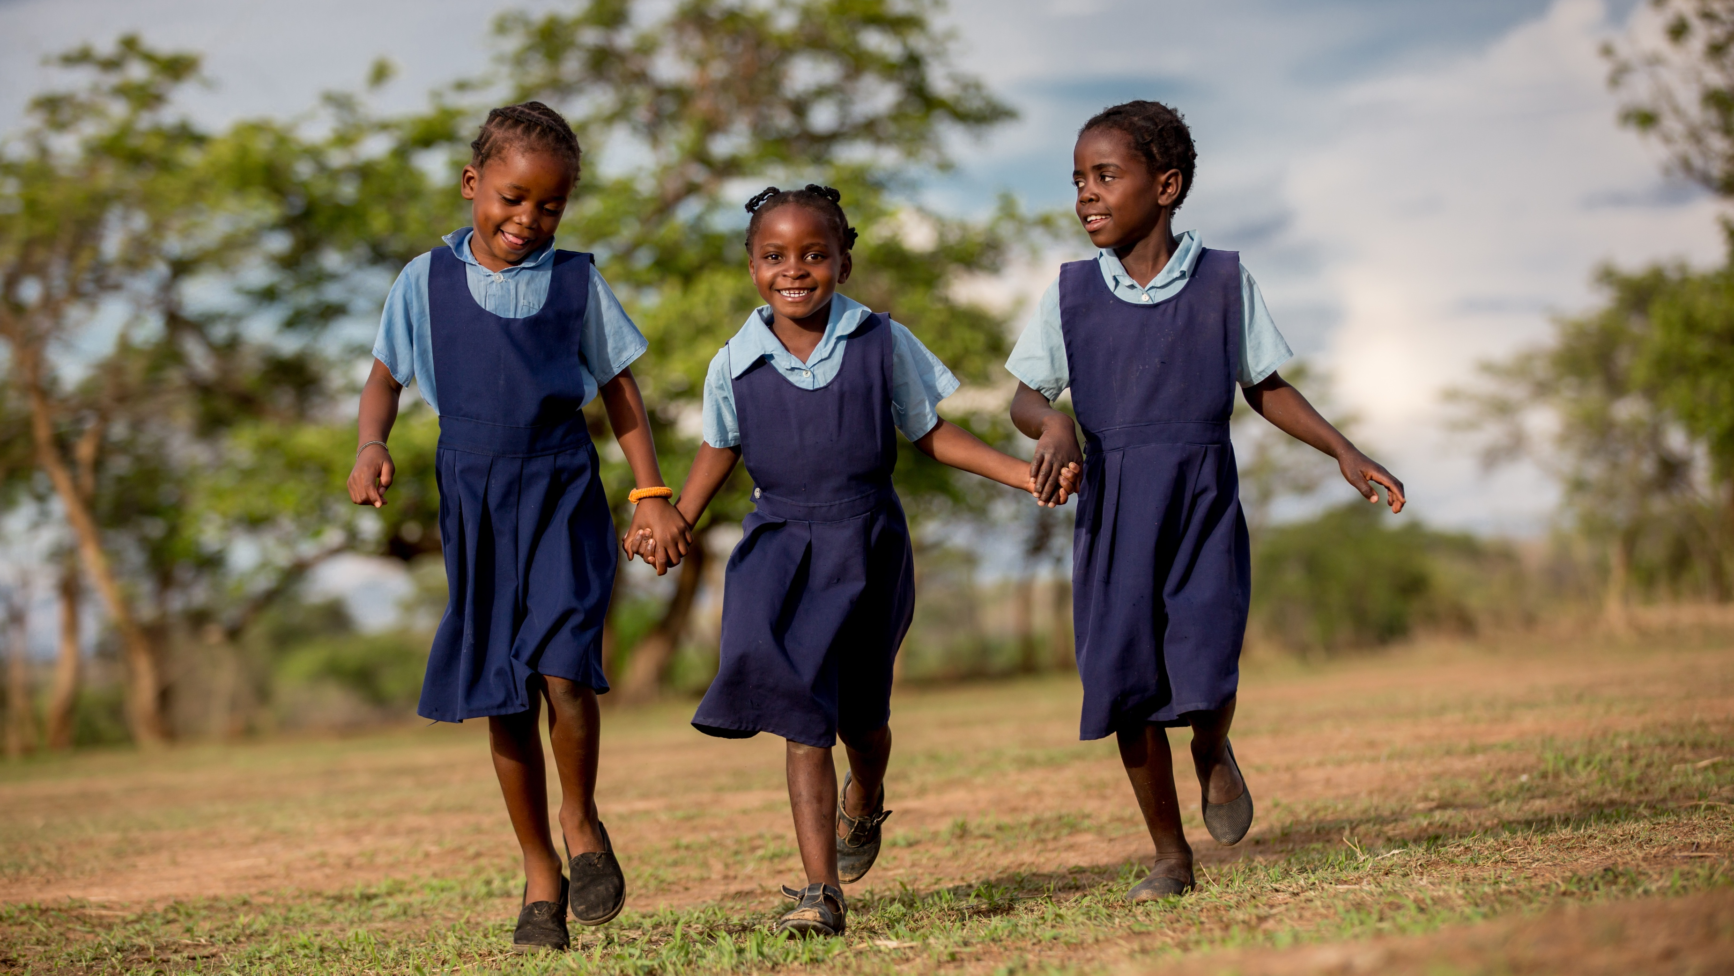



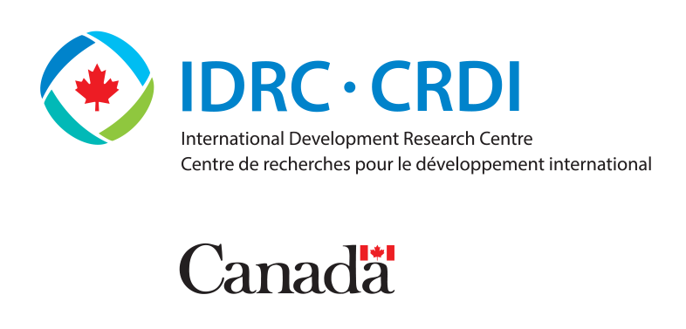
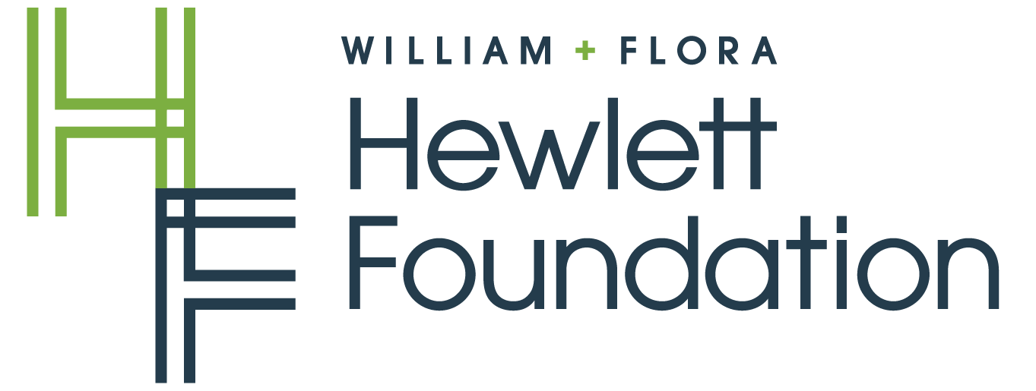



Data Must Speak (DMS)
Positive Deviance Approaches to Learning
Outcomes on Girls & Interlinkages with Child Marriage
UNICEF Innocenti – Global Office of Research and Foresight
CRANK Researching Meeting | October 2023
© UNICEF/UN0145988/Schermbrucker

Slide 32
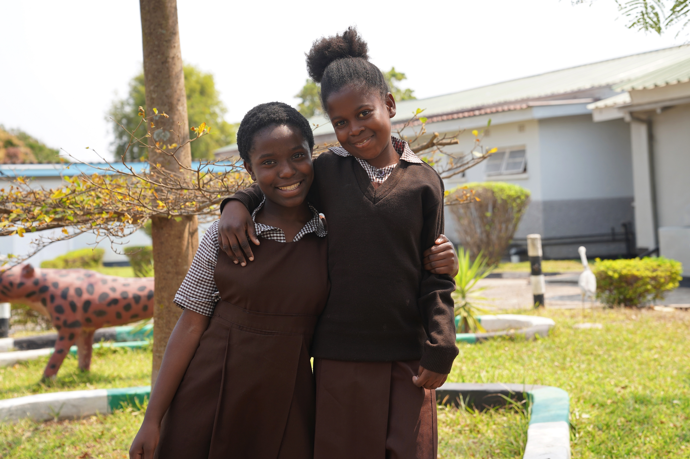
DMS Positive Deviance Research
✓
Objective: Identify and understand positive deviant behaviours/practices in schools performing better than others in similar contexts and ways to scale them up
✓
Approaches & Methodologies: Quantitative Research, Positive Deviance, Behavioural Sciences, Implementation Research & Scaling Science¹
✓
Co-funded by Hewlett Foundation, IDRC/GPE KIX, Jacobs Foundation, Norad, Schools2030, and internal UNICEF resources (global- and country-level)
¹ See DMS Methodological Review: Insights from Positive Deviance, Behavioural Sciences, Implementation Research and Scaling Science.
© UNICEF/UNI297201/Heade

Slide 33






Country-tailored Research Methodology
Stage 0
Global methodological review
Stage 1
Analysis of resources and context associated with school performance
[Quantitative research]
Stage 2
Identification of positive deviant schools and school typology
[Positive deviance]
Stage 3
Understanding school-level positive deviant behaviours and practices
[Behavioural sciences]
Stage 4
Investigating levers for optimum scale
[Participatory implementation research & scaling science]
Stage 5
Country-level knowledge use and global mobilization

Slide 34






How DMS Co-creates and Co-implements the Research
Formation of Advisory Council (internal and external partners) to advise research
Analysis of education ecosystem & buy-in from MoE and in-country partners
Alignment of research with partner countries’ ESA, ESP and GPE Compact processes
Co-creation of research approach & methodology w/ relevant stakeholders (incl. teachers)
Merging & analysis of existing administrative datasets over multiple years
(including EMIS, exam results, etc.)
Sharing & discussing findings w/ teachers & stakeholders (co-writing of reports)

Slide 35
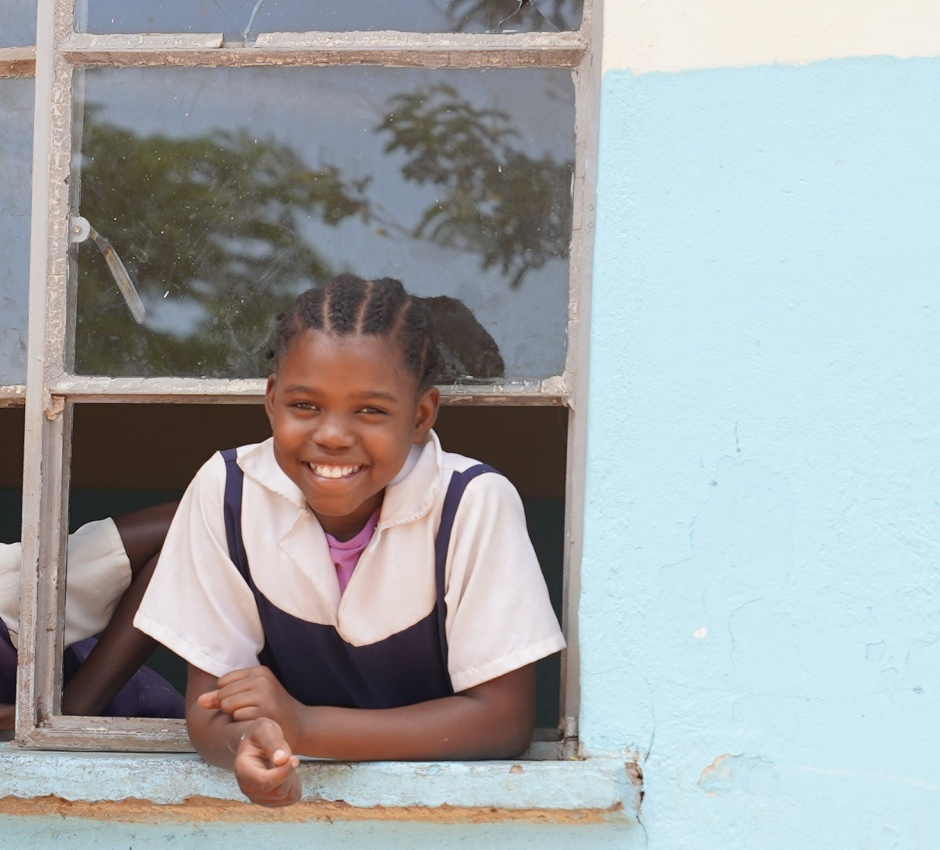
What We Know From Previous Research
✓
Girls' education is a consistent protective factor against child marriage
✓
Girls who drop out of school are significantly more likely to marry early
✓
It is important to work on both the demand and supply side of girls' education
Source: Evidence Review: Child marriage interventions and research from 2020 to 2022 (The CRANK, 2023)
© UNICEF/UN0656741/Muchipa

Slide 36

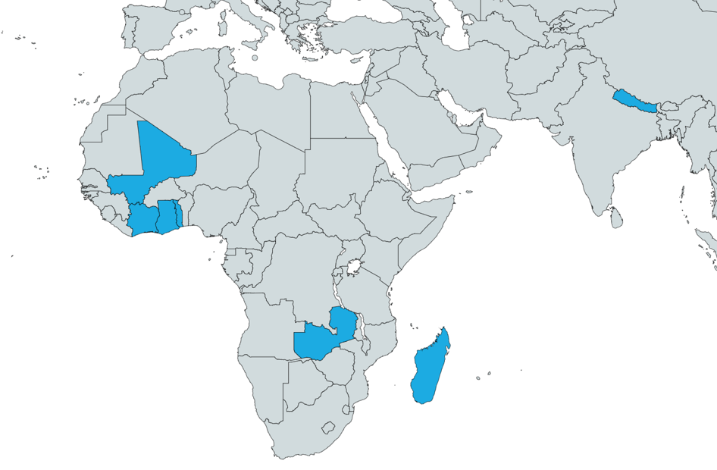


What Is DMS Data Telling Us? Stage 1 Findings
Having a female teacher is associated with a gender gap reduction in promotion, dropout and graduation rates in primary & secondary school
Where is the data coming from?
Having a female head teacher is also associated with better promotion rates and better exam results for girls
The presence of latrines and/or menstrual hygiene changing rooms and products is associated with higher promotion rates for girls, mainly as a result of lower dropout rates
Togo, CIV, Mali, Madagascar, Ghana, Zambia, Nepal

Slide 37
What Is DMS Data Telling Us? Stage 3 Findings
Positive deviant schools in Mali are more likely to have school committees working on raising awareness on girls' education and the prevention of early marriage.
« We (the Association of Students' Mothers) raise [the girls'] awareness on the equality of
opportunity between men and women, to motivate them to constantly study. All honour spots, from the first to the ninth grade, are taken by girls, thanks to our awareness-raising efforts."​
« Some mothers demand from their daugthers to go work to earn money. This causes problems if the girl is still a minor. For the most part, we intervene with mothers to raise awareness."

Slide 38
So What? Moving From Evidence to Action
Stage 1 findings uptake:
DMS Stage 4:
Findings from DMS in Côte d'Ivoire helped guide a number of education policy avenues and identify major priority reforms, including the presence of female principals on learning.
In Togo, the report by the Multiple Indicator Cluster Surveys – Education Analysis for Global Learning and Equity (MICS-EAGLE) includes multiple references to DMS research findings, particularly in discussing specific policy proposals around supporting female teachers.
Use behavioural research, implementation research and scaling science to investigate levers for scale of positive deviant practices
Continue the co-creation with MoEs to prepare scaling plans to improve school performances at national levels

Slide 39
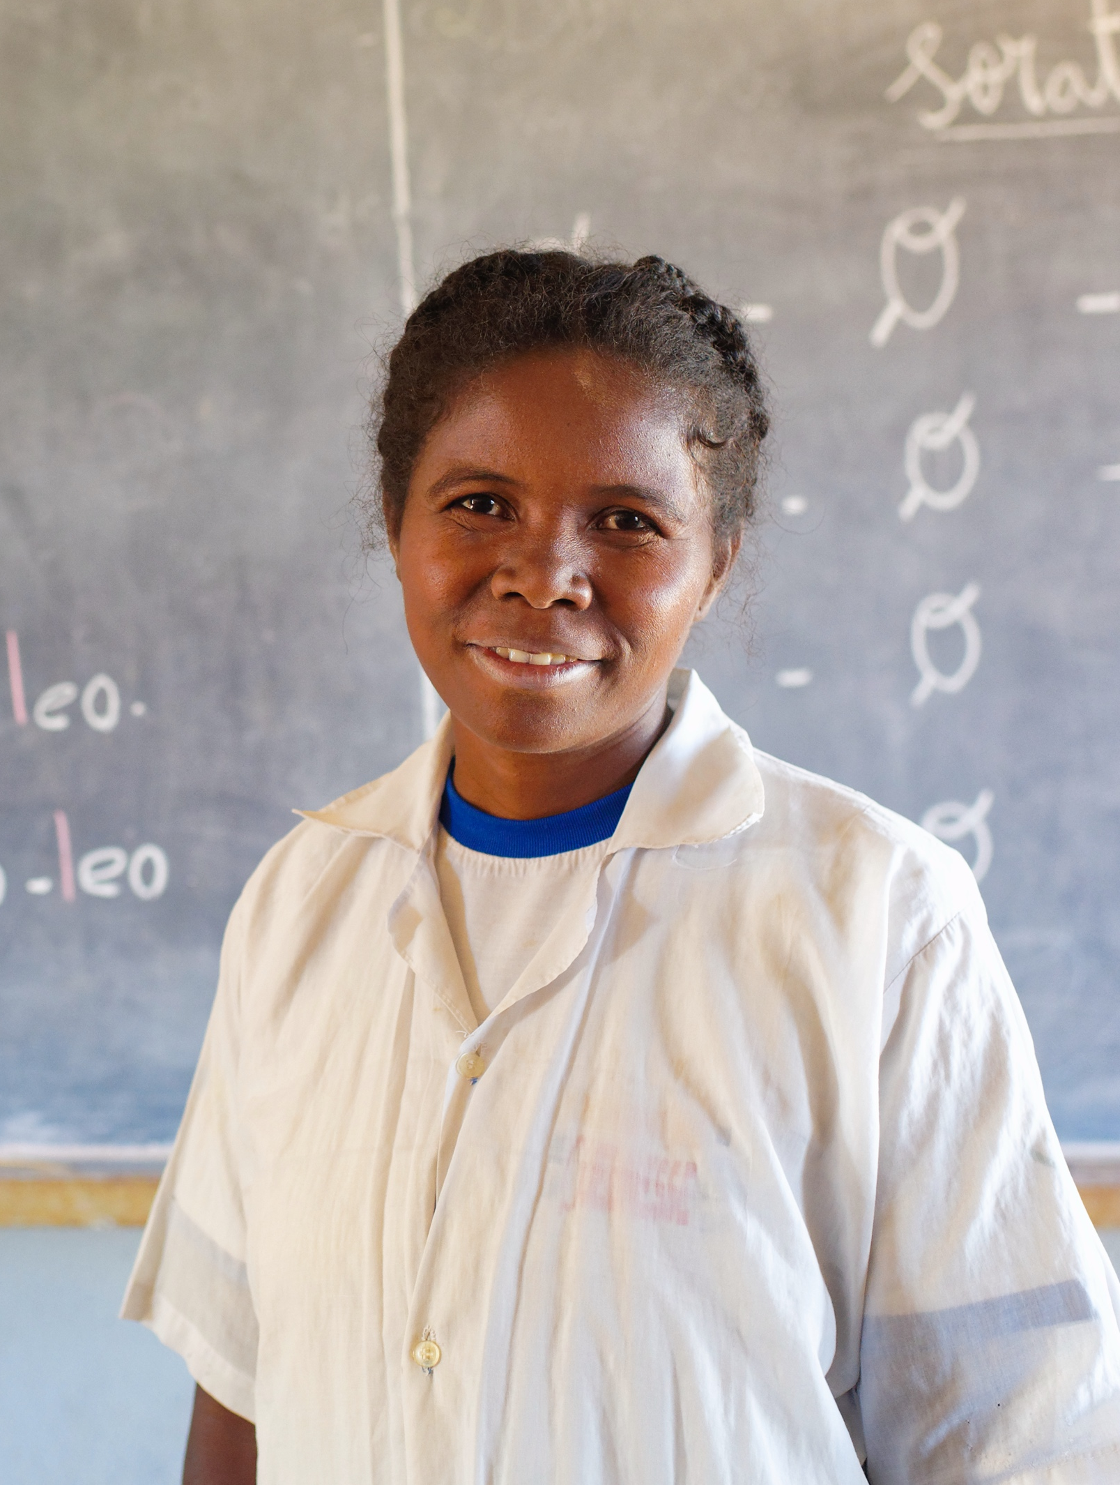
Reflections / Lessons Learned
✓
Make use of the "existing" instead of creating a "new"
✓
Co-creation increases governments' engagement, buy-in and the chance to transition from evidence to policy
✓
Acknowledge challenges related to co-creation, in terms of differences in capacities, priorities, time, etc.
✓
Go for demand-driven, contextually relevant approaches
© UNICEF/UN0508077/Ramasomanana

Slide 40
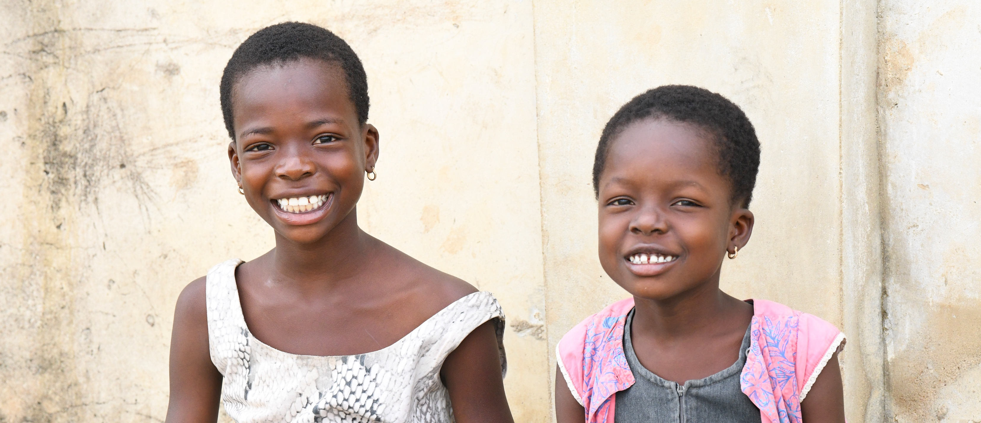
Thank You!
Data Must Speak About Positive Deviance Approaches to Learning
UNICEF Innocenti
CRANK Meeting | October 2023
© UNICEF/UN0231644/Dejongh

Slide 41
Strengthening evidence-based policy responses to child marriage
The Child Marriage Research to Action Network (The CRANK)
18 October 2023
Notes:
Welcome from Nankali: XXXX
CRANK platform - if you want to refer to any of these points Nankali, but please feel free to take your own approach:
The CRANK - provides a platform for a better coordinated and harmonised global research on child marriage responding to priority needs and gaps of policy makers and practitioners
Promotes Reserach to Action: - encourages uptake of latestest evidence on priority topics by policy makers and practitioners though our quarterly research meetings and resource pages
It is also a knowledge management mechanism - synthesising the latest evidence with key takeaways in our biannual Research Spotlights and through the CRANK Research Tracker facilitating member coordination on research and avoiding duplication of research efforts.
Importance of this topic:- need to accelerate prevention of child marraige at scale if we are to meet our targets etc. You can draw from some of this text if helpful:
Evidence tells us that accelerating progress to end child marriage is possible under the right conditions. Focusing on effective interventions with potential for scale is critical to accelerating large-scale change to end child marriage.
In today’s session we will discuss the evidence from two large scale interventions that have contributed to the prevention of child marriage, in two differing contexts. We will present the success and learnings from two case studies - one from Ethiopia, and the second from the state of West Bengal in India drawing from UNICEF’s recent report Leveraging large scale sectoral programmes to prevent child marriage
Please post your questions and comments in the chat and we will ensure these get picked up for the discussion. A gentle reminder to please use language that is respectful and inclusive.

Slide 42
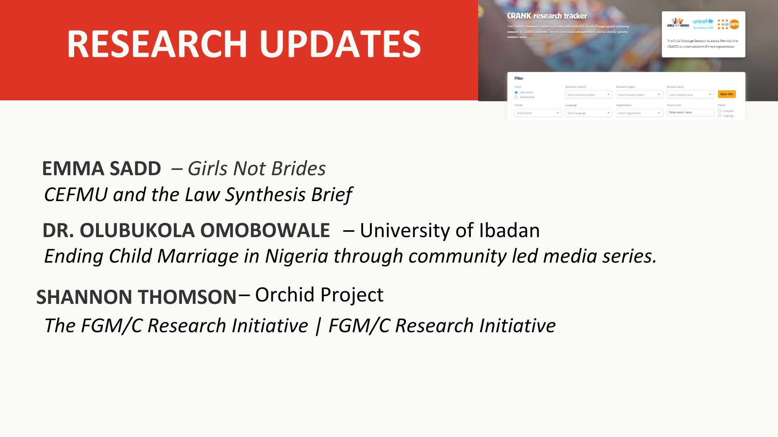

Slide 43
Child, early and forced marriage and unions and the law

Slide 44
Context & scope
Context:
  Recognise laws as important part of holistic approach to addressing CEFMU, BUT…
  Little evidence of impact of these laws
  Concern around shortcomings in laws (implementation, access to justice, pluralist legal systems, punitive approaches)
Literature review on the impact of minimum age of marriage & sexual consent laws on:
  CEFMU prevalence
  Girls’ rights and agency
Looking closer at:
  Informal unions in Latin America and the Caribbean
  Criminalising sex between consenting adolescents
  What is needed for these laws to centre the rights and needs of girls in all their diversity
  Safeguards against laws being used to punish girls and young people
Notes:
Literature review:
- We focused on: Prevalence of CEFMU in different contexts, & girls’ lives, rights and agency – that is, their ability to make and act on their decisions
- Over 90 resources reviewed
- We built this resource list with inputs from Girls Not Brides member organisations
- Priority given to literature focused on showing the experiences of civil society organisations
- Builds on the scoping work and upcoming position statement developed by the CEFMU and Sexuality Working Group (of which we are a member)
Looking closer at:
- Impacts of CEFMU laws on informal unions in LAC
- Impacts of laws that criminalise sex between consenting adolescents on CEFMU prevalence and girls’ lives, rights and agency
- What’s needed for these laws to centre the rights and needs of all girls
- Which safeguards are needed to minimise and mitigate the risks of CEFMU and sexual consent laws being used to punish girls and young people

Slide 45
Outputs & implications
Planned publications:
  Synthesis report summarising the findings of the literature review
  Global brief presenting key findings & implications from the literature review, alongside insights from member organisations
  LAC brief presenting key regional findings, alongside insights from member organisations based in LAC
Findings:
  Not enough evidence showing role of laws in reducing CEFMU prevalence
  Laws can have negative impacts on prevalence and on girls’ rights and agency
Implications for legal advocacy & reform:
  Legal reform can be a catalyst for change to advance girls’ rights and agency
  Application and implementation of the law needs to be differentiated and contextualised, based on girls’ realities
  Need for laws to differentiate between different types of marriage and union
  Need to increase awareness of laws, improve girls’ access to justice systems and state support for survivors
  Civil society is an important partner in ensuring state accountability
Notes:
Publications
- Scheduled for January 2024
- LAC brief – intended as an advocacy tool for member organisations
Implications for legal advocacy and reform:
- Legal reform can be a catalyst for change to advance girls’ rights and agency, but cannot work in isolation - a comprehensive approach is needed to address the complex drivers of CEFMU
- Application and implementation of the law needs to be differentiated and contextualised, based on girls’ realities
- Need for laws to differentiate between different types of marriage and union, with a strong focus on full, free and informed consent and the principle of evolving capacities
- Need to increase awareness of laws, improve girls’ access to justice systems and state support for survivors
- Civil society is important in ensuring state accountability

Slide 46

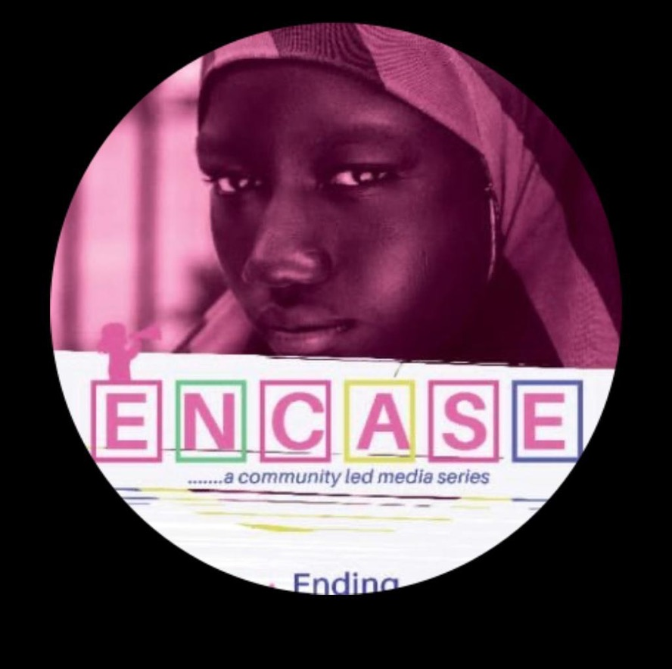
Ending Child Marriage Through Community-Led Media Series
(ENCASE PROJECT)
Olubukola Omobowale ocomobowale@com.ui.edu.ng
Project Overview
CRANK RESEARCH MEETING
18/10/2023

Slide 47
ENCASE Project Overview
The ENCASE project is , a controlled, pre-post intervention study to change attitudes toward child marriage in Southwestern Nigeria using targeted radio programming (drama). It is a collaboration between researchers at the College of Medicine, University of Ibadan and McGill University Canada.
The ENCASE Project is funded by Grand Challenges Canada (Stars in Global Health Award)
We conducted an exploratory sequential mixed-method study in two randomly selected cities in Southwestern Nigeria namely Sabo and Bodija, Ibadan: the intervention site and Sabo and Shasha , Akure: the control site.
A Situation Analysis (qualitative) in depth interviews and focus group discussions with community leaders and stakeholders and these gave insights into the local perceptions about the consequences and drivers of child marriage
Baseline Survey 1600 respondents
Intervention: BURINA radio drama Aired on 3 radio stations over a period of 13 weeks
Endline Survey. 1600 respondents
Find the link to our protocol: https://journals.plos.org/plosone/article?id=10.1371/journal.pone.0285902
Target Population: Hausa/Fulani group residing in the selected communities.

Slide 48
Evidence-Based policy messages
STRATEGIC POLICY COMMUNICATION WORKSHEET
Title: Changing Perception and Attitudes towards Child Marriage in Nigeria
Data/Key Findings | Implications | Recommendations | Audience | Format
Nigeria is home to the largest number of child brides in Africa National Prevalence: 44% (88m) Regional Variation : SW region : 39% (78m) Northern region: 67.6% (7 in 10 girls) Northern states have not signed onto the Child Rights Act. | This implies that a significant proportion of disadvantaged girls are being forced into early marirage. | We recommend health education and awareness of the complications that these girls face. | Community Leaders, Policy makers Ministry of Health, Ministry of Women Affairs and Child welfare | Town hall meeting, Policy brief Infographics
Nigeria has signed into the Child Rights Act but there’s Lack of awareness about the law against CM | This implies that people do not even know about the law, hence the law is not being implemented | Government needs to enforce the implementation | Minister (WACW) House of Assembly Reps, Senators | Position Letter
Consequences of child marriage include: Reproductive, mental health, IPV, stigma and social isolation Disruption of education, hinders development | Victims of CM face reproductive, psychological, violence, stigma and social isolation | We recommend health education and awareness of the complications that these girls face. | Community Members, Leaders and Community Influencers | Town Hall meeting Stakeholder Engagement Radio Drama/Jingles
Drivers of Child Marriage: Poverty, Lack of education, Religion, Culture, values, Perceived promiscuity of female children due to negative influences from the media, Need to prevent family disgrace | CM practice is common due to financial, cultural, religion and traditional reasons. Need to prevent family disgrace and negative influences from the media | We propose substituting negative practices with positive practices that allow girls to grow and go to school.

Slide 49
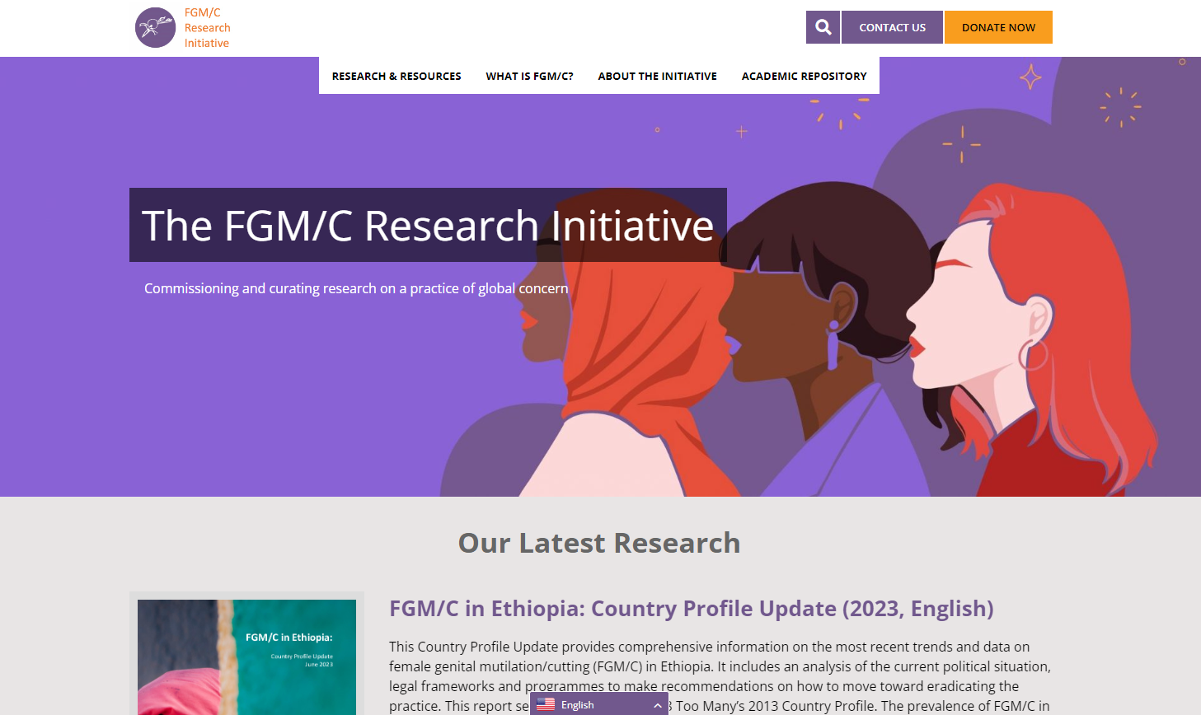
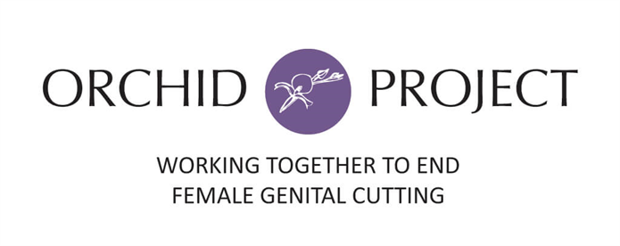
FGM/C Research Initiative

Slide 50
FGM/C Research Initiative
FGM/C Research Initiative (www.fgmcri.org) exists to enhance research efforts related to FGM/C and facilitate the dissemination of accurate and comprehensive information.
By leveraging the resources and expertise of organizations, we aim to close the knowledge gaps surrounding FGM/C and contribute to evidence-based strategies for ending this harmful practice.
The FGM/C Research Initiative is hosted by Orchid Project and builds on the legacy of 28 Too Many
It serves as a portal for evidence and research at a country, regional, and thematic level including grey literature and academic papers
The website is available in English, French and Arabic
Publications are available in the above languages as well as regionally relevant languages (i.e. Somali, Amharic, Sorani, etc.)

Slide 51
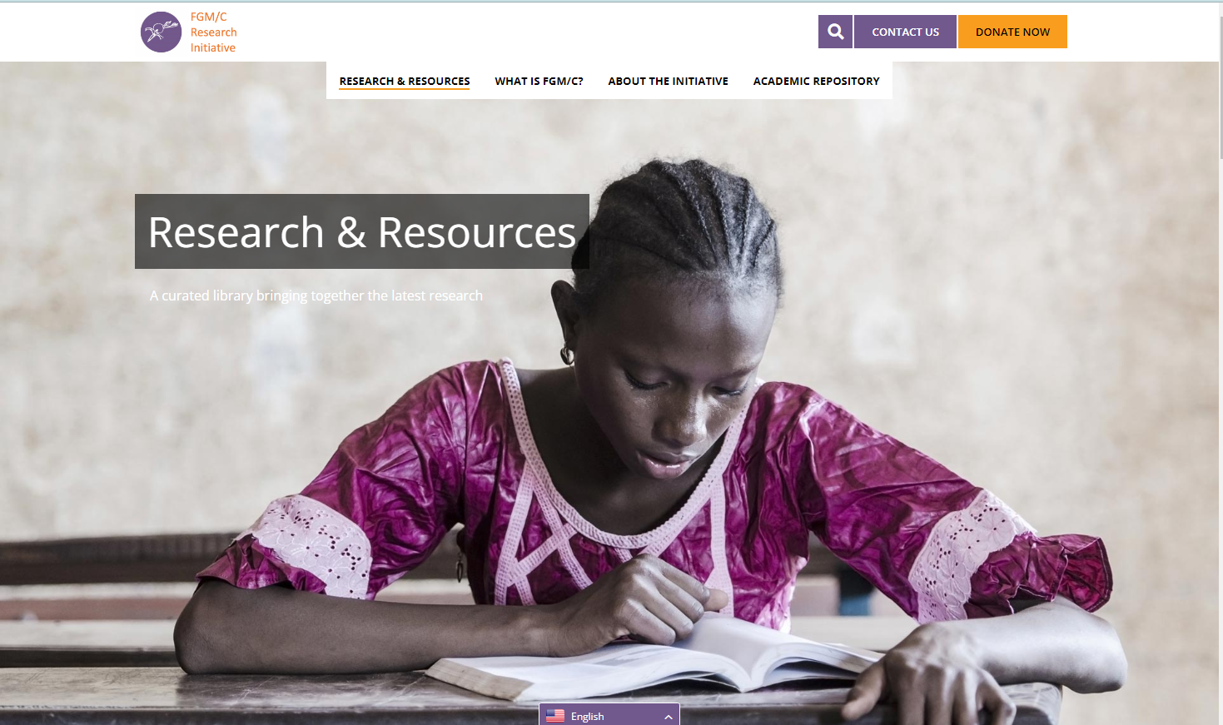

Slide 52
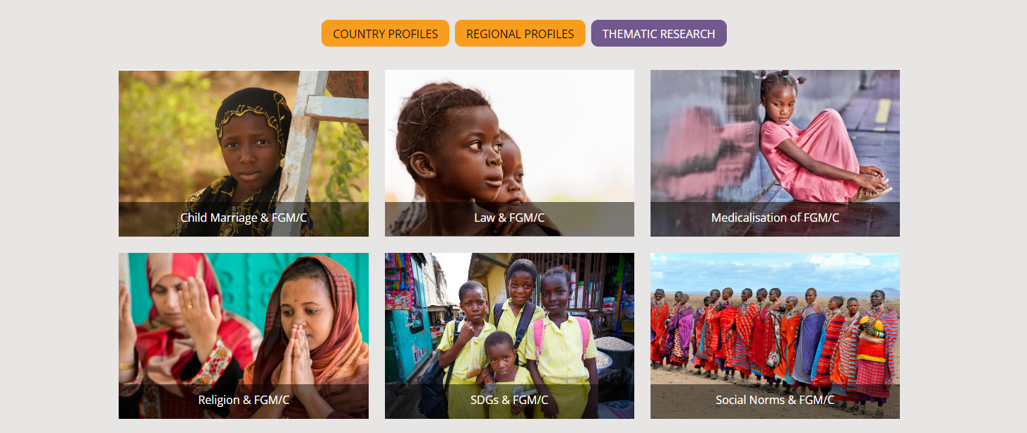

Slide 53


Slide 54
How to get involved
Join us as a founding member – Memorandum of Understanding between Orchid Project as the host of the FGM/C Research Initiative and each founding members
Join our Global or Regional research groups (Horn of Africa and Asia)
Share your research and knowledge products to help us curate available evidence on FGM/C
Join us in identifying the most pressing gaps in evidence and commissioning research to fill those gaps
Join our webinars and dissemination workshops to hear more about our latest research
Share your upcoming events with us and our network to gain a wider reach
Notes:
Although Nigeria has a prevalence rate of 19.4% it represents 10% of the global burden of FGM/C, an estimated 19.9m women and girls

