Slide 1
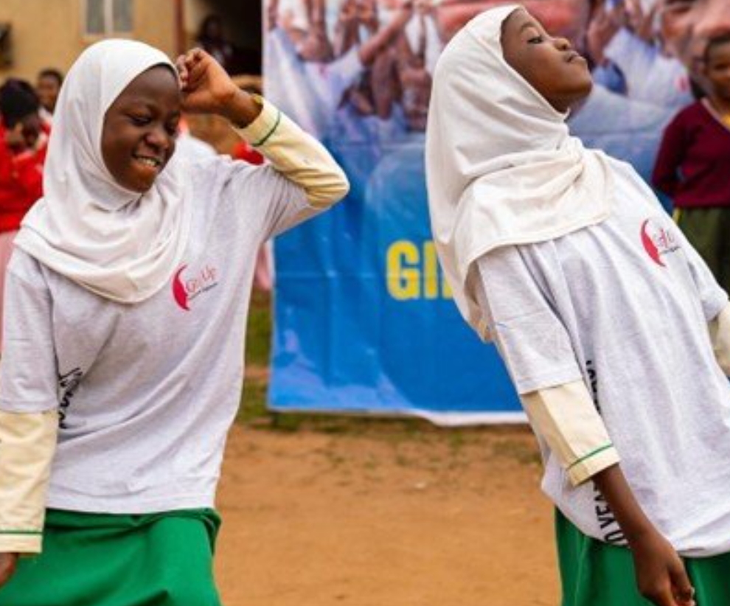
Learning Series
Sharing evidence, learning, new tools and experience to support your work to end child marriage
SIX
SHARED
GOALS
Monthly webinar
February 2024
Photo: Girl Up Initiative, Uganda

Slide 2
Interpretation
ENGLISH - This session will have presentations in English. To access simultaneous interpretation, please click on the globe icon at the bottom bar of your screen and select your preferred language (English, Spanish, French, or no interpretation).
français - Cette session comprendra des présentations en anglais. Pour accéder aux services d'interprétation simultanée, veuillez cliquer sur l'icône globe que vous trouverez dans la barre inférieure de votre écran, et sélectionnez la langue de préférence (anglais, espagnol, français, ou version originale).
Español - Esta sesión tendrá presentaciones en inglés. Para acceder a los servicios de interpretación simultánea, por favor haga clic en el icono del globo que encontrará en la barra inferior de su pantalla, y seleccione su idioma de preferencia (inglés, español, francés, o versión original).
Notes:
Lara or Laia?
Please write in the chat box (preferably in Port, Fr, Sp or English!) if you are having any technical difficulties and a member of our team will be happy to support
Please also use the chat box to post Questions or experience you would like to share. And if you have a question for one of our panellists please do put their name.

Slide 3
THE IMPACT OF AGE OF MARRIAGE AND SEXUAL CONSENT LAWS ON CHILD MARRIAGE AND GIRLS’ RIGHTS
Learning series session FEBRUARY 2024

Slide 4

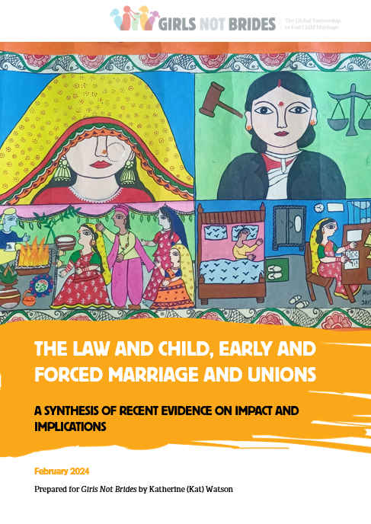
AGENDA
Introduction to the topic
Presentation of global evidence
Implications for national level work
2024 plans

Slide 5

Countries with minimum age of marriage laws
153 of 198 countries have minimum age of marriage 18 laws.
52% countries have 18 no exceptions marriage laws.
38 countries had different minimum age of marriage under the law for women and men.
6 countries did not specify any minimum age at all.
2019

Slide 6



What helps and what hinders to tip the scales in favour of delayed marriage?
Minimum age of marriage laws
Growing support for girls’ education
Growing awareness of the harms of unwanted early pregnancy
Positive normative environment that rejects the practice of child marriage (declarations, resolutions)
Changing hearts and minds by supporting behaviour change among individuals, in communities and society.
Discriminatory norms that hold the practice of child marriage in place and act as roadblocks to laws
Normative counterpoints: exceptions and pluralistic legal systems.
Systems and structures that systematically uphold male privilege and other inequalities and reinforce discriminatory norms.
Adapted from Greene, M. and Stiefvater, E (2019)

Slide 7

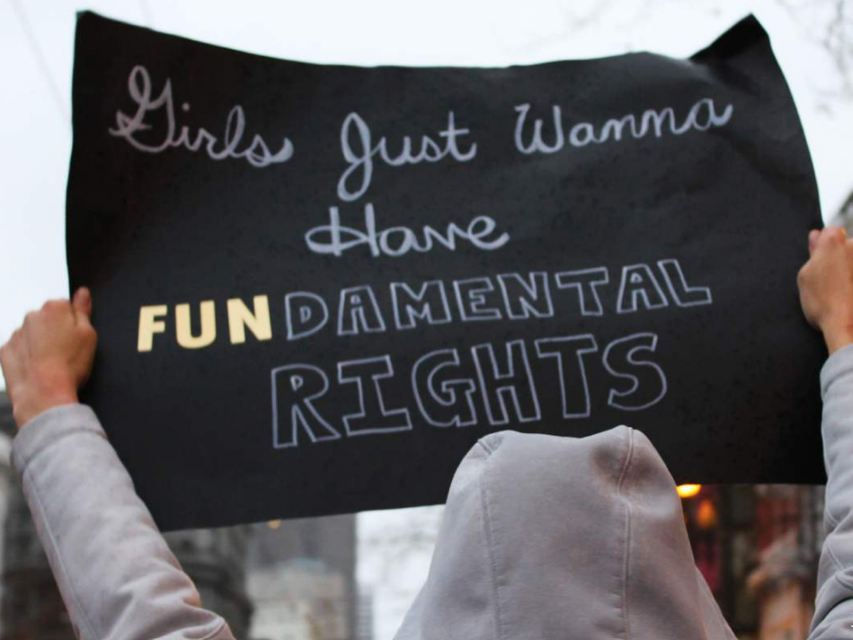
Snapshot of changes to marriage laws around the world
Mexico - threatened criminalisation of “forced cohabitations /unions”
Tanzania – no change despite the 2016 and then 2019 Supreme Court of Appeal ruling in favour of raising the AOM to 18
England and Wales – legal age of marriage increases from 16 to 18
Morocco – proposed reform of the 2004 Family Code to remove judicial dispensation to families to marry girls under legal age of 18.
Spain – in 2022 passed changes to sexual consent law emphasising the need for affirmative consent
Source: GNB Youth Activism Training Manual (2018)

Slide 8

MEET THE PANELLISTS

Slide 9
Recent evidence on the impact and implications of child marriage law
A global synthesis
February 2024

Slide 10
AGENDA
Research questions
Human rights framework
Primary findings
Ways forward
Six things to remember

Slide 11
Research questions

Slide 12


Research questions
What are the impacts of child marriage and sexual consent laws on:
To what extent are laws centring the rights and agency of girls, in all their diversity?
  What are the barriers to this?
Child marriage prevalence
Girls’ rights & agency

Slide 13
The available literature
1
Child marriage law impact literature
Focus on correlation, not causality
Need more socio-legal research
2
Child marriage law literature
National vs international law
3
Child marriage literature
Interventions that:
Reduce prevalence
Support girls’ rights

Slide 14
Human rights framework

Slide 15
History of the minimum age of marriage
1965 – a UN General Assembly resolution calls for 15 years to be the lowest age for marriage
1994 – the CEDAW Committee specifies 18 years as the minimum age of marriage
2004 – Committee on the Rights of Child reiterates 18 years as the minimum age of marriage

Slide 16

Interpretations of the Committee on the Rights of the Child on sexual consent
Set an age of sexual consent
Avoid criminalising consensual sex
Recognise evolving capacities
Presume competence to seek services
Notes:
There is less on sexual consent in international human rights agreements, but here you can see a summary of the positions taken by the CRC on this and related topics.

Slide 17
The law and prevalence

Slide 18

It is hard to isolate the effect of the law and establish a causal link with child marriage prevalence
There is limited evidence
Most studies cannot isolate the impact of the law from other factors (with exceptions)
Most studies do not measure the “before and after” effect of a new law or reform OR analyse how a law is implemented

Slide 19


Laws have had a limited impact on child marriage prevalence but have raised the age of marriage in some contexts
In 60 countries – there was no drop-off in the number of girls marrying just below the age of marriage
In 5 countries – “age at marriage” laws had limited or no impact
In Ethiopia – where the average age of marriage was below 18 before the legal reform:
The probability of marriage under age 16 decreased post-reform
The probability of marriage at age 16 or 17 increased post-reform

Slide 20

Context and identity factors heavily influence the impact of the law and the dynamics of marriage/union
The implementation and impact of the law is affected by:
Rurality
Ethnicity
Experience of crisis
In India & Nepal – laws have contributed to a rise in self-initiated marriages due to stigma and criminalisation around young people’s sexuality
In Mexico – the national ban on marriage under age 18 led to a decrease in formal marriages and a similar increase in informal unions
In Latin America and the Caribbean – laws have not considered contextual drivers of marriage and union

Slide 21
“[T]here is a long way to go before child marriage is eradicated, and changes in legal provisions are playing only a minimal role, if any. This pushes scholars and policymakers to think about alternative policies that might be more effective in curbing early marriage or delaying age at first union.”
Batyra & Pesando, 2021 (emphasis added)

Slide 22
The law and agency & rights

Slide 23

The law does not match adolescents’ realities and their evolving capacities are rarely considered
“Adolescence” is a relatively new legal category
Criminalising adolescent sexuality and/or raising the age of sexual consent does not reflect reality
Judges can apply evolving capacities in their interpretations of individual cases
But reform driven by judicial interpretation rather than lawmakers can lead to slow implementation and uptake

Slide 24
Criminalising adolescent sexuality blocks their access to sexual and reproductive health information and services
Laws interacted with norms in 8 countries to restrict adolescents' access to SRHR information and services
In some countries, there are contradictions between the age of sexual consent and the right to access SRH services in health policy
Providers refuse to offer SRH services to adolescents for fear of legal repercussions

Slide 25
“...many children and young people who are not legally recognised as able to consent to sex are in fact sexually active, and in need of sexual and reproductive health services. This dilemma has given rise to a hodgepodge of confused legal, policy and programmatic measures which place various age-based limitations on children’s decision-making…”
Yarrow et al, 2014 (emphasis added)

Slide 26

The law is weaponised against girls but also not available for those who need access to justice
In El Salvador – communities believe sexual consent laws are intended to prevent young people from being sexually active
In India and Nepal – parents are using the law to break up marriages they disapprove of, including where they are inter-caste
In India – the law is rarely used to support girls who have experienced forced marriage
Notes:
Add references here

Slide 27

The use of punitive approaches has a range of consequences in girls’ lives
In Ethiopia, Malawi and Egypt – punitive legal approaches drive child marriage underground, where girls cannot access services, social support or justice
In Mexico – the criminal law could exacerbate existing marginalisations due to greater penalties when cases involve people of Indigenous or Afro-Mexican descent
Girls can face harassment or emotional abuse by law enforcement officials when they make a complaint, or social stigma from communities
Legal enforcement often replaces efforts to enhance the welfare of girls and young women, and their communities

Slide 28
Barriers to justice for girls

Slide 29
Girls and their allies face barriers to justice
Lack of anonymity in reporting cases of child marriage to the police
Uncertainty due to conflicting laws or discrepancies between formal and informal law
State birth and marriage registration systems are often under-resourced and staff are unprepared
Lack of awareness in communities about laws and policies
Girls cannot access legal systems without a legal adult
Financial barriers due to cost of legal representation

Slide 30
Ways forward

Slide 31
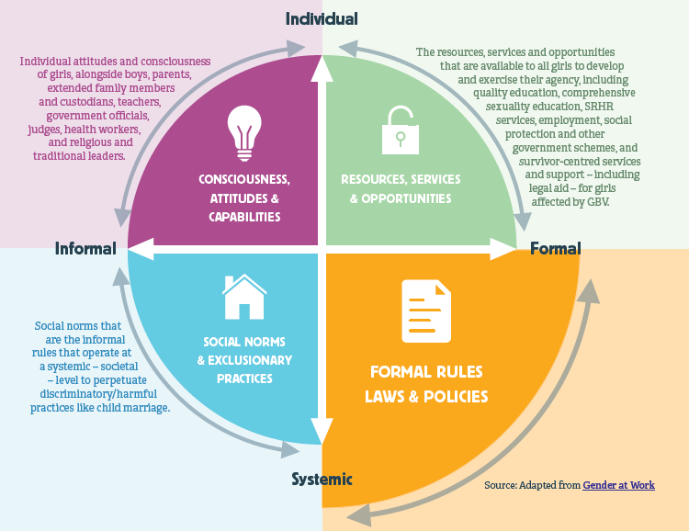
Embed legal advocacy in a comprehensive, gender-transformative approach to gender equality
1

Slide 32

Contextualise, contextualise, contextualise
2
What does this look like?
More research to understand the specificities of how laws impact the whole population, and girls in all their diversity
Legal advocacy informed by deep understandings of evolving capacities in each context
Understanding how (criminal) laws shape and respond to the prevalence of different types of marriage and unions
Notes:
And adolescents’ realities, desires and rights

Slide 33

Address barriers to girls’ access to justice
3
What does this look like?
Legal literacy campaigns for girls and their communities to increase awareness of the law and the rights and protections it offers for girls
Working with girls to understand their needs and advocating with them for changes to address them
Ensuring support services and legal aid are available to girls who have been forced into marriage
Notes:
Without the requirement for parental involvement

Slide 34
Six things to remember
1
Laws seem to have very limited impact on prevalence
Criminalisation & punitive approaches can have negative consequences
Girls facing forced marriage and ever-married girls face barriers to accessing justice
Age of marriage & age of sexual consent should not be combined in law
The principle of evolving capacities is key
Laws are one, if important, part of context-specific, gender-transformative approaches to girls’ rights
2
3
4
5
6

Slide 35
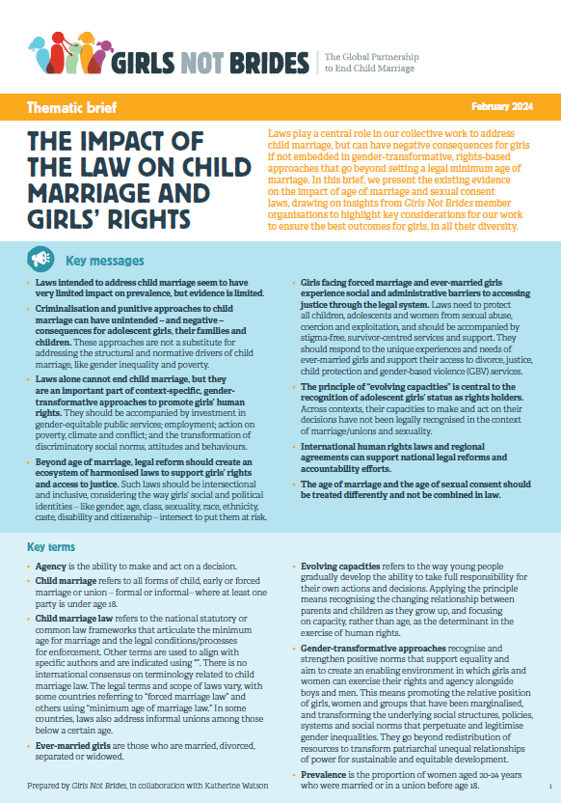
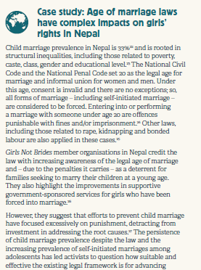
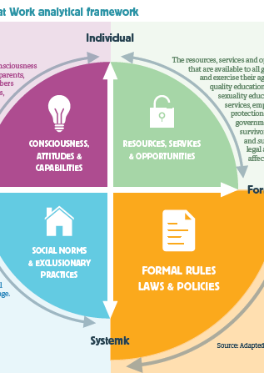
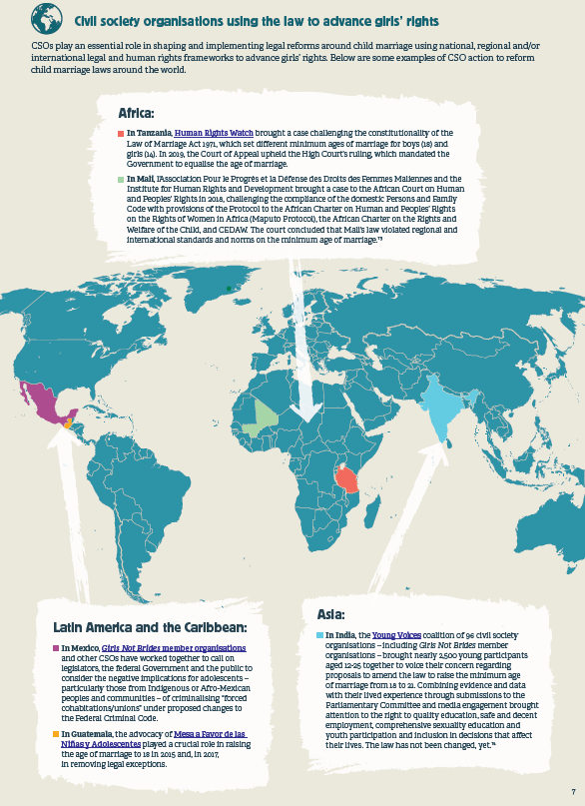

Don’t forget…
Check out the full report and brief for human rights framework, more evidence, case studies, Girls Not Brides member insights and what this means for our work!

Slide 36
Thank you

Slide 37
What this means for advocacy and practice
A country perspective of the implications of this evidence from Nepal and malawi

Slide 38
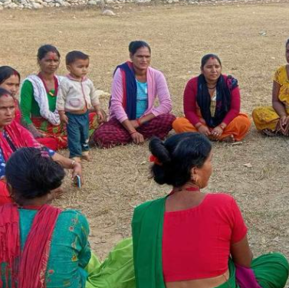

Irada Gautam
Panchapuri Municipality, western Surkhet, Nepal

Slide 39
1. Child marriage in Nepal
Child marriage prevalence in Nepal is 33%
20 is the legal minimum age for marriage and informal union for women and men.
Marriage under the age of 20 – with or without consent - is illegal, void, with no exceptions with fines and / or imprisonment
Self-initiated marriages are on the rise.
Age of marriage has increased from 14/15 to 16-18.
“Where any person has sexual intercourse with a woman without her consent or with a girl child below 18 years of age even with her consent, the person shall be considered to commit rape on such woman or girl child.” National Penal Code, 2017.
Notes:
Child marriage prevalence
Prevalence of child marriage in Nepal has declined over the last 10 years, from 46% in 2009 to 33% in 2019 when the last national data was collected.
33% is the national average. There are 7 provinces in Nepal, and significant differences in levels of child marriage ranging from 20% in province no. 3 to 46% in province no 2. As elsewhere, UNICEF’s data profile for the country shows that girls in Nepal who married or formed union before the age of 18 are most likely: in rural areas (39% compared to 30% in urban areas); from the poorest households (45% compared to 18% in the richest), and without education (66% compared to 26.5% who had secondary or higher education).
The law and child marriage
The National Civil Code and the National Penal Code set 20 as the legal minimum age for marriage and informal union for women and men. The age of sexual consent is 18. All forms of marriage below the age of 20 are considered ‘forced’ as consent given by an individual below the legal age of marriage is considered ‘void’ ab initio. Under Nepalese law all child marriages are considered forced punishable by fines and /or imprisonment. The Constitution of Nepal guarantees children’s fundamental right to be protected from violence, abuse, trafficking and early and forced marriages.
Age-related laws in Nepal
Sex with a girl or woman under the age of 18 under the law is considered rape.
Raping of a girl age 10-14 carries a prison sentence of 18-20 years.
Drivers of child marriage
UNICEF data shows that girls most likely to marry early live in a rural area (39% compared to 30% in urban areas); come from the poorest households (45% compared to 18% in the richest),and have no education (66% compared to 26.5% who had secondary or higher education).
The country is socio‐culturally diverse, with different castes, ethnicities and religions. The caste system divides everybody in society from birth into a particular caste or class which traditionally pre-determines their social status, their occupation and who they can marry.
Nepal is a country with deep-rooted cultural norms of patriarchy which value daughters less than sons and this leads to discrimination against girls in every sphere of life. Girls receive less care and support at every level of society. Typically, in poor households, daughters are not supported to continue their education, and their early marriage is often seen as a way to reduce costs.
The root causes are many, deep and intertwined.
Gender inequality and multiple forms of discrimination and norms related to gender, sexuality, age, ethnicity, caste, sexuality, disability and citizenship all of which intersect with each other place girls at considerable risk of child marriage. Poverty, insecurity and crisis compound these risk factors.
Children and adolescents particularly in rural communities are not well-informed about the age of sexual consent. Sexuality and sex is not discussed in the family. In schools XXXX . Sex before marriage is a taboo. Adolescent pregnancy and/or parental fear that it will happen is a very powerful driver for self-initiated and arranged marriages.

Slide 40
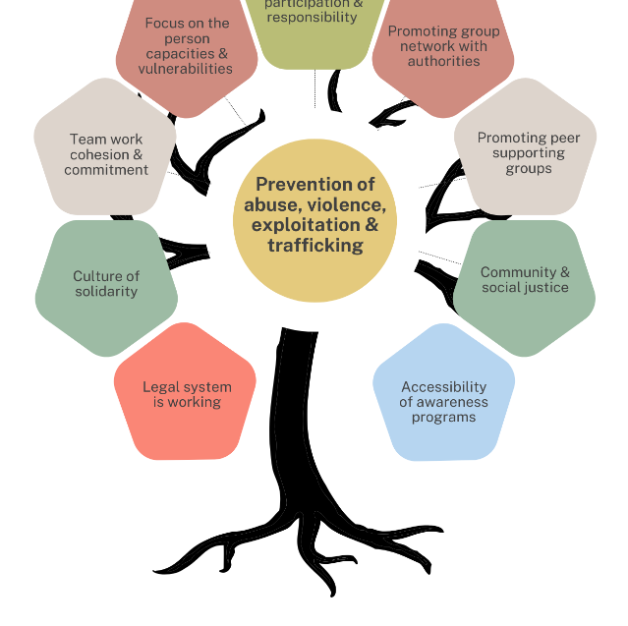

2. AAWAAJ: justice and empowerment
Breaking the silence on sexual abuse and exploitation through social mobilization;
Child protection, child helpline and child friendly spaces;
Community support mechanism against gender-based violence;
Temporary shelter support centre and social integration for women and children;
Community and family mediation;
Counselling, care and support;
Lobbying, advocacy and campaigning against gender-based violence, child sexual abuse, exploitation and trafficking;
Strengthening local governance and community development;
Key aspects for good practices in the prevention of Violence, Abuse, Exploitation & Trafficking (AAWAAJ)

Slide 41


3. AAWAAJ experience with child marriage law
AAWAAJ experience:
Unsuccessful elopements put girls in situations of even greater vulnerability in Nepal.
Selective use of child marriage law (inter-caste).
Under-reporting: stigma & shame; lack of anonymity; economic dependency.
Many do not register births and marriages.
The evidence from Nepal says:
Child marriage and sexual consent laws have contributed to a rise in self-initiated marriages among adolescents below the legal minimum age.
Ample evidence of parents using the law to break up marriages they disapprove of, including where they are inter-caste
Having the age of marriage set at 20 and the legal age of majority as 18 creates confusion for advocates and young people.
Notes:
Ample evidence of parents using the law to break up marriages they disapprove of, including where they are inter-caste (Pandey and Shrestha, 2020)

Slide 42
4. AAWAAJ experience with child marriage law
AAWAAJ experience:
High costs and long-drawn out legal processes.
Insensitive officials.
Lack of support for survivors due to under-funding and discriminatory norms.
The evidence from Nepal says:
Age-at-marriage laws have limited impact on CEFMU prevalence.
No evidence of causal link between age of sexual consent law and CEFMU prevalence among adolescents.
Stigmatisation of adolescent relationships linked to self-initiated marriages (interviews).
Complicity of officials contributes to under-reporting.
Inaccessible legal services and courts.
Laws used to break up consensual adolescent marriages than to protect girls from forced marriage.
Global synthesis report
Notes:
Ewa Batyra and Luca Maria Pesando, 2021, Trends in child marriage and new evidence on the selective impact of changes in age-at-marriage laws on early marriage (re no causal link btwn sexual consent law and increased CEFMU prevalence amongst Nepali adols)
Binita Pandey and Sumeera Shrestha, 2020, Redefining the early and child marriage and reconsidering its elimination in Nepal, through absolute criminalisation (re findings from qualitative research to show that self-initiated marriages are on the rise and one reason is stigmatisation of adol relationships)

Slide 43
5. Implications of the evidence for AAWAAJ
AAWAAJ work around CM law:
Evidence-based recommendations
Sensitisation of law enforcement officers.
Learning lessons from community-police partnerships.
Advocate for research into drivers of self-initiated marriages.
Advocate for improved government registration of births and marriages.
Dialogue on legal contradictions – ‘child’.
‘Consent’ to be central to any review of sexual consent law.
Government support for survivors.
“Conditional criminalisation” approach in Nepal that determines the forms of CEFMU that should be punished through criminal law and those that should not.
Nepal, GNB Global Synthesis Report
More data and evidence need to show changes in nature and trends in child marriage given rise in self-initiated marriages.
Amend existing civil laws to protect the survivors of child marriage.

Slide 44
6. Implications of the evidence for AAWAAJ
AAWAAJ work CM and GBV:
In our social norms work, more attention to norms around adolescent sexuality linked to rise in self-initiated marriages, and low levels of reporting;
Continue delaying the age of marriage in our work with Children’s, Youth and Women’s Groups to whom planned or real underage marriages are reported, or self-reported by adolescent couples.
Continue with counselling, support & information to enable couples to delay marriage to 20 years.
Evidence-based recommendations
“Conditional criminalisation” approach in Nepal that determines the forms of CEFMU that should be punished through criminal law and those that should not.
Nepal, GNB Global Synthesis Report
More data and evidence need to show changes in nature and trends in child marriage given rise in self-initiated marriages.
Amend existing civil laws to protect the survivors of child marriage.
Notes:
Pandey and Shrestha : A “conditional criminalisation” approach in Nepal that determines the forms of CEFMU that should be punished through criminal law and those that should not

Slide 45
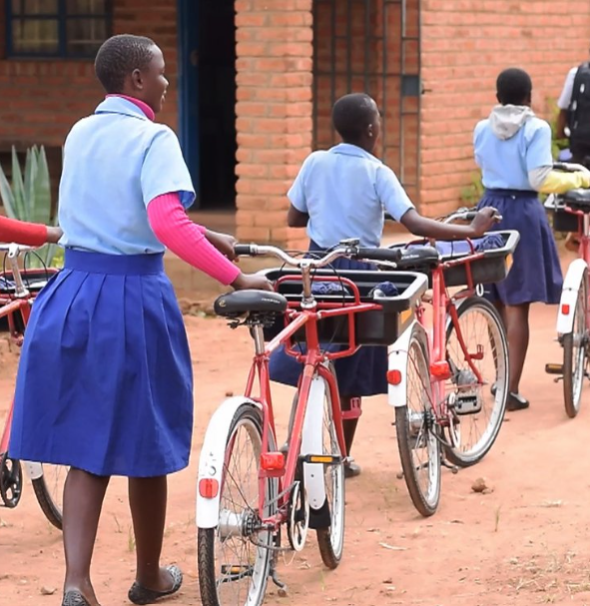

James Gondwe
Enukweni Community Day Secondary School, Malawi

Slide 46
1. Child marriage in Malawi
Child marriage prevalence in Malawi is 38%: 41% rural/ 22% urban; 49% poorest / 19% richest; 52% no schooling;
Most marriages are formal but there are a significant number of informal unions.
18 is the legal minimum age for marriage and sexual consent.
2017 Constitutional amendment removed marriage with parental consent for 15-18 year olds.
Community by-laws and customary law common.
2023 Penal Code Amendment decriminalises consensual adolescent sex providing age difference less than 2 years
Notes:
Drivers and consequences of child marriage
Girls who are poorest, least educated and living in rural areas are the most likely to marry early in Malawi .
Most 15-17 year old married girls are not in school unlike their unmarried peers - although there are also unmarried girls who are not in school.
61 % of secondary school dropouts were girls in 2021/2022. Nearly 16 % of girls who discontinued their schooling said it was due to pregnancy with high rates of adolescent pregnancy and an unmet need for contraception.
More than 60% of girls who married before 18 had their first child before 18 compared to around 10% of girls who married after 18.
Discriminatory attitudes, social norms, high rates of poverty and gender-based violence are all drivers of child marriage , compounded by the impact of climate crisis.
‘Nobody forced me to get married, but I felt I needed to because I needed help with the basic necessities of life’. Married at 13.
Possibly for PPT.
2023 Penal Code Amendment Act No 8, new Section 138
Age of sexual consent is 18
The 2023 amendment decriminalises consensual sex between adolescents providing the age difference is less than 2 years and it is consensual
But sex between an adult (over 18 years) and a child (anybody under 18 years) is always a criminal offence punishable by life imprisonment

Slide 47
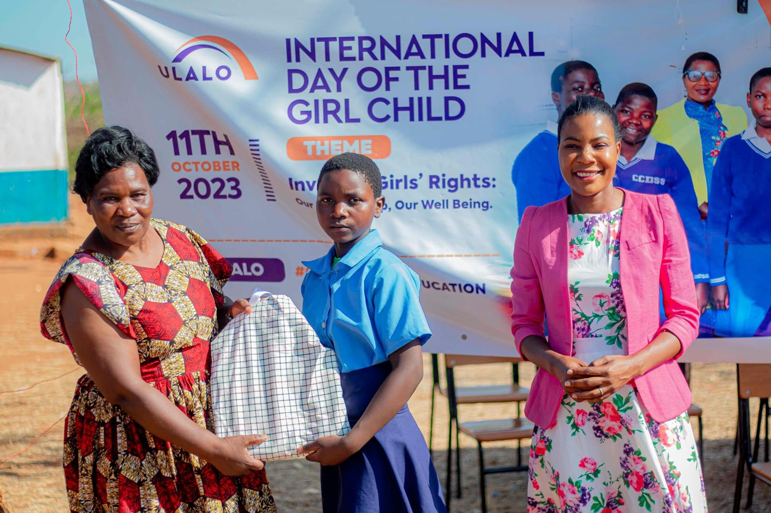
2. Ulalo
Education: strategic partnerships with schools, communities and governments to design and deliver targeted solutions
Social norms change: dialogue with girls, parents, communities to prioritise education over early marriages and to promote gender equality
School to work transition: supporting further education, secure employment and new business for young people to break free from the cycle of poverty

Slide 48
3. Ulalo experience with child marriage law
Ulalo experience:
Low awareness of the law .
Selective use of the law, rather than universal right.
Inaccessibility of the law and justice: economic dependence; stigma; influence.
Evidence from Malawi says:
Child marriage has decreased but little evidence to suggest link with changes in the law.
Contradictions in laws compromises rights of girls: age of marriage higher than age of majority; child protection law defines child as below 16.
Laws relating to sexuality and marriage - alongside norms that impact their implementation - restricted adolescents' access to information and services around their sexual and reproductive health and rights.
Notes:
Evidence base
Contradictions in laws – Equality Now
Laws relating to sexuality and marriage - Yarrow et al. See also country studies completed in Senegal, El Salvador, UK, Malaysia, Philippines, India, Nepal, and Sri Lanka

Slide 49
4. Ulalo experience with child marriage law
Ulalo experience:
Under-investment in government services reduces reporting and recourse to the law.
Low capacity to prosecute
Social norms are powerful roadblocks to justice and use of the law.
Evidence from Malawi says:
Fines do not end the practice but drive it underground making it harder for girls to access justice and support.
The practice of “marriage withdrawal”, where the community intervenes when a child marriage has taken place to force the girl to return to her natal home, viewed more favourably by adults than adolescents and may disadvantage children of that marriage.
In West, Central, East and Southern Africa, 57% of girls had their sexual debut before this age. Marriage withdrawal does little to address adolescent pregnancy.
Notes:
Evidence base:
Driving the practice underground - Perceptions of minimum age at marriage laws and their enforcement: qualitative evidence from Malawi. BMC Public Health, Vol 21, p 1350. https://doi.org/10.1186/s12889-021-11434-z, Melnikas, A.J., Mulauzi, N., Mkandawire, J. et al., 2021,
Marriage withdrawal – (as above) Melnikas et al for More than Brides Alliance
West, Central, ESA – sexual debut Melesse, D.Y., Cane, R.M., Mangombe, A. et al., 2021, Inequalities in early marriage, childbearing and sexual debut among adolescents in sub-Saharan Africa. Reproductive Health, Vol 18 (Suppl 1), p 117. https://doi.org/10.1186/s12978-021-01125-8

Slide 50
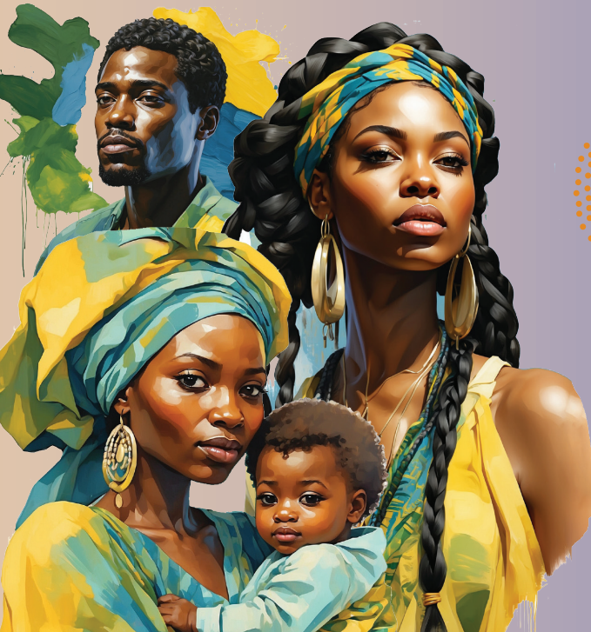
5. Implications of the evidence for Ulalo
Ulalo and the National Partnership:
Advocate and hold government accountable for commitments to:
Harmonise all relevant laws including customary to 18 minimum age no exceptions for marriage and in line with SADC - Southern Africa Development Community -Model Law;
Call on government to strengthen birth registration systems.
Raise awareness of laws and rights in partnership with government, including hard-to-reach areas and frontline service providers.
Advocate for government funds for National Children’s Commission, (Community) Victim Support Units and other services.
SADC Model Law on Eradicating Child Marriage and Protecting Children Already in Marriage achievements include:
Defining GBV and Child Marriage;
Legal protections for Survivors;
Support Services;
Prevention and Education;
Minimum Age 18 no exceptions;
Data collection and monitoring;
2023 A Year in Review, UNFPA

Slide 51
6. Implications of the evidence for Ulalo
Evidence-based recommendations
Focus on addressing the root causes – for example adolescent pregnancy is a powerful driver of child marriage.
Ensure minimum ‘package of support’ in the case of marriage withdrawals.
In educating communities about the law, focus on the reason for the law (e.g., value of girls).
Remove fines associated with child marriage that may encourage practices like withdrawal or drive the practice underground.
Population Council /More than Brides Alliance
Ulalo and the National Partnership
Strengthen work to transform discriminatory social norms that perpetuate child marriage, hinder access to justice, reduce reporting and implementation,
Dialogue with church and traditional leaders;
Self and collective reflection on attitudes and norms around adolescent SRHR; Positive Parenting; Inter-Generational Dialogue

Slide 52
2024 Plans
Notes:
Kola

Slide 53
2024 Plans
Now! FAQ – Frequently Asked Questions (with Answers!) and publications
March CSW side-event
April Webinar led by the CEFMU and Sexuality Working Group (SWG)
May LAC Primer and member-led advocacy messages
And, CRANK quarterly call
August SADC Model Law convening with Plan International
Ongoing Global Campaign for Equality in Family Law; Clooney Foundation for Justice; SWG collective advocacy.

Slide 54

NEW! Publications
Global thematic brief, The impact of the law on child marriage and girls’ rights, GNB (2024)
Report, The law and CEFMU: A synthesis of recent evidence on impact and implications, GNB (2024)

Slide 55




FOLLOW GIRLS NOT BRIDES ON SOCIAL MEDIA TO LEARN MORE
GLOBAL CHANNELS
LATIN AMERICA AND CARIBBEAN
instagram.com/girlsnotbrides_
instagram.com/gnblac
twitter.com/GirlsNotBrides
twitter.com/GNB_LAC
facebook.com/GirlsNotBrides
facebook.com/GNBLAC/
Girls Not Brides: The Global Partnership to End Child Marriage

Slide 56
THANK YOU

