Slide 1
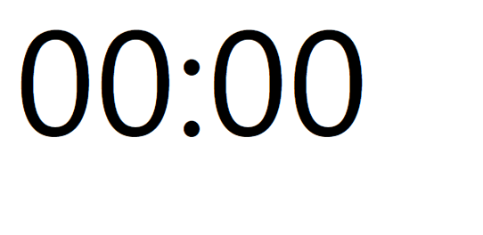
Please, bear with us while the people in the room find their seats.
What’s Known and What’s Next: Charting Future Action on the Mental Health Consequences of Child Marriage

Slide 2
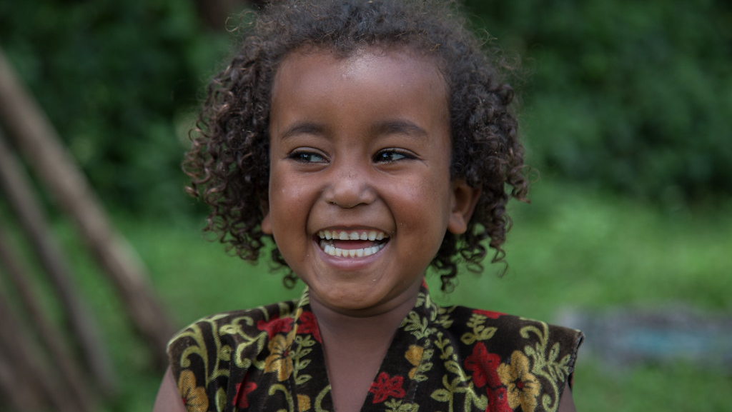
WHAT'S KNOWN AND WHAT'S NEXT:
CHARTING FUTURE ACTION ON
THE MENTAL HEALTH
CONSEQUENCES OF CHILD MARRIAGE
The UCL Global Network on Mental Health and Child Marriage, in collaboration with Girls Not Brides and the Child Marriage Research to Action Network (the CRANK)
20th March, 2024
London/Online
© UNICEF, 2018
This Photo by Unknown Author is licensed under CC BY-NC-ND

Slide 3

Welcome
LANGUAGE PREFERENCES:
ENGLISH – MAIN LANGUAGE
ES – CANAL ESPAÑOL
FR – CHAÎNE FRANÇAISE
And: tell us where in the world you’re joining from today!
WWW.MENTI.COM
Code: 6571 6781
Notes:
Housekeeping:
A warm welcome to people joining us from all around the world – we have around 400 people registered, which underscorces the importance of this event, and we are so greatful for the opportunity to be here together this afternoon.
We are recording today’s event
Self care notice – we may discuss topics, subjects and experiences that people may find triggering, we ask that you please feel free to do what is needed for your wellbeing, which may include taking breaks, and coming back to proceedings at another time.
For those in the room: No planned fire alarms

Slide 4
Order of events
Session 1:
Research
Emerging work from African settings
Emerging work from humanitarian settings
Session 2: Practice
Case studies: creative methods
Case studies: Other interventions
Session 3:
Policy and practice:
Advancing mental health within wider CM efforts

Slide 5
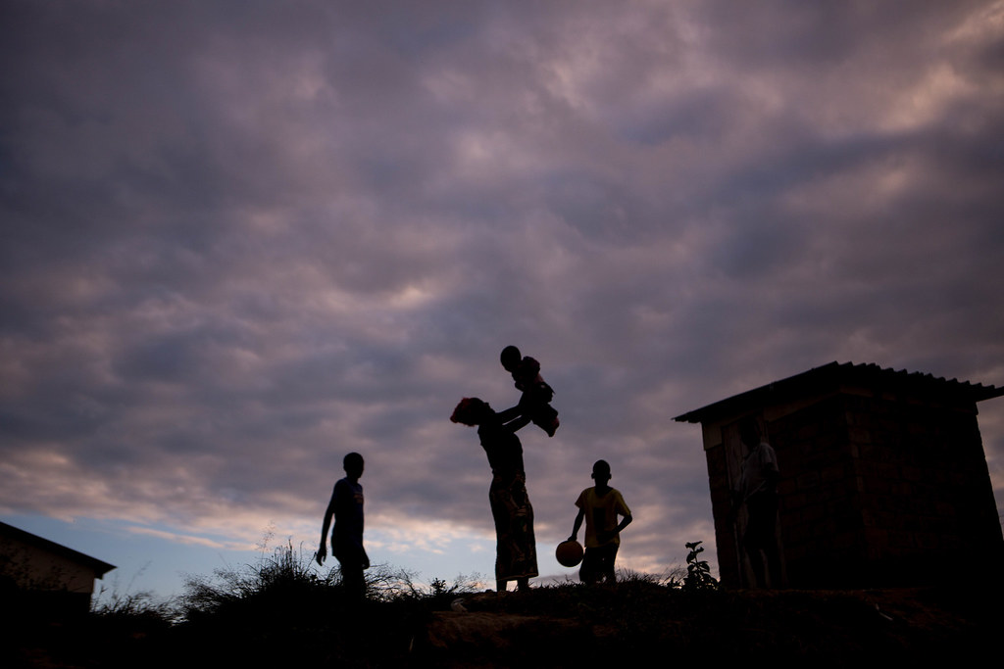
What’s known: Mental health consequence of early, child & forced marriage
©UNICEF, 2019

Slide 6
What’s known?
Child Marriage
Poverty
IPV & Sexual violence
Poor reproductive health
Gender norms & lack of power
Child, early and forced marriage and unions are associated with a range of negative social and health outcomes
MENTAL HEALTH
Social factors driving child marriage have independent and interactive associations with negative mental health outcomes
Notes:
Poverty is continually linked to increased risk of early unions globally – meaning that social shocks, such as the pandemic which increased risk of poverty, were paired with increased rates of child marriage.
We also know that CEFM is supported by what can be deeply embedded gender, and other social norms about women and girls, increased exposure and experience of interpersonal and other forms of violence, and poorer reproductive health outcomes, typically linked to child birth at a young age.
(advance slide – replace middle circle with mental health)
What is less mentioned, is that these same factors are also continually associated with poorer mental health outcomes in communities globally. Consistent evidence links poverty to poorer mental health outcomes that once established, are often very hard to address given the cyclical nature of this relationship.

Slide 7
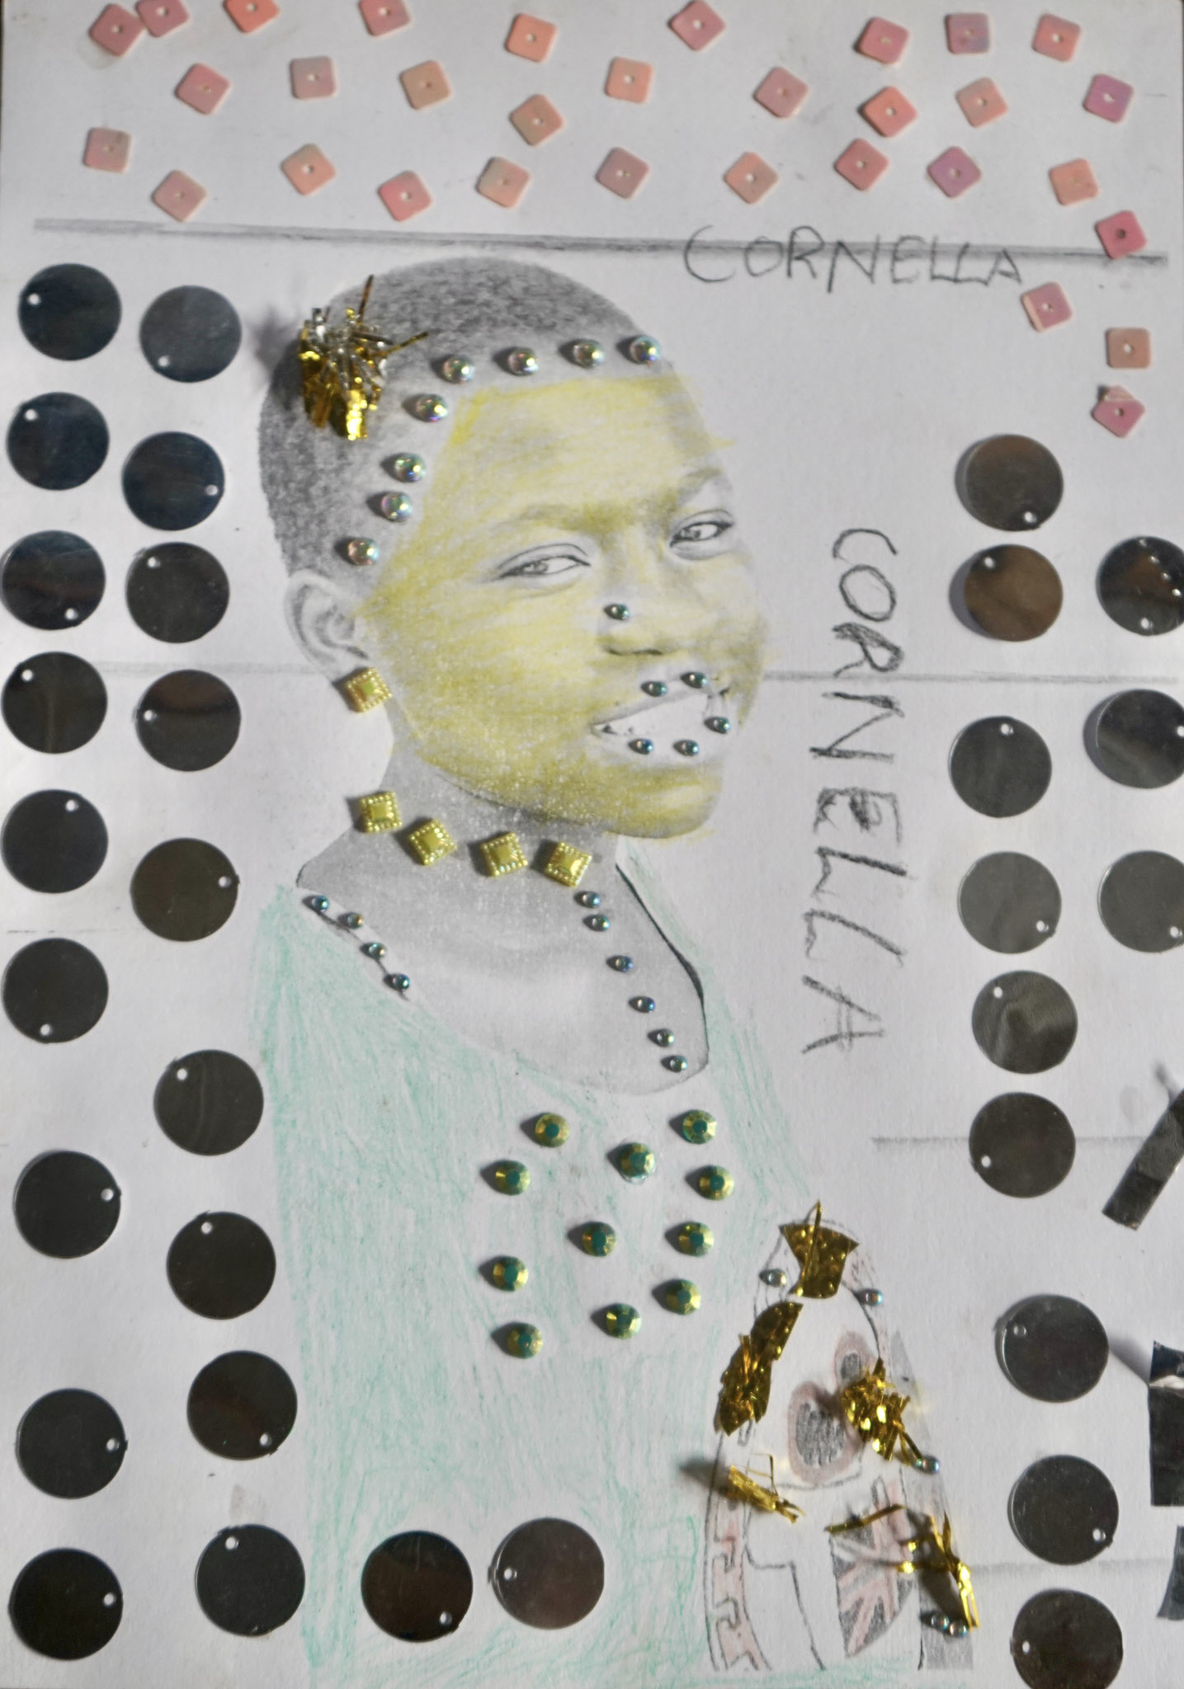
CHILD MARRIAGE DRIVES POORER MENTAL HEALTH OUTCOMES
Evidence highlights mental health conditions commonly associated with child marriage include: depression, anxiety, substance misuse and poor wellbeing (Burgess et al, 2022
Acute mental health crises include higher odds of suicidality among married girls, or girls promised in marriage (Gage et al, 2013)
Girls married at age 12 or earlier, score worse on psychological wellbeing - in Ethiopia 5 points lower ; in Niger, 7 points lower (ICRW, ND)
Odds of depression are higher for newly married girls (Aggarwal et al., 2023)
©COLORS OF CONNECTION
Notes:
A quick snapshot of the available evidence on the issue highlights that child marriage drives poorer mental health outcomes, with specific mental health conditions appearing more frequently – including depresion, anxiety, and suicidality. Early studies show that these impacts are longterm, with earlier work completed by ICRW showing among very early married girls, we have psycholgical distress connected to increased burden linked to marital resonsibilities, sexual demands, and child rearing responsibilities – which encapsulates the emotional burden of the loss of childhood that is associated with early or forced unions among young girls.

Slide 8
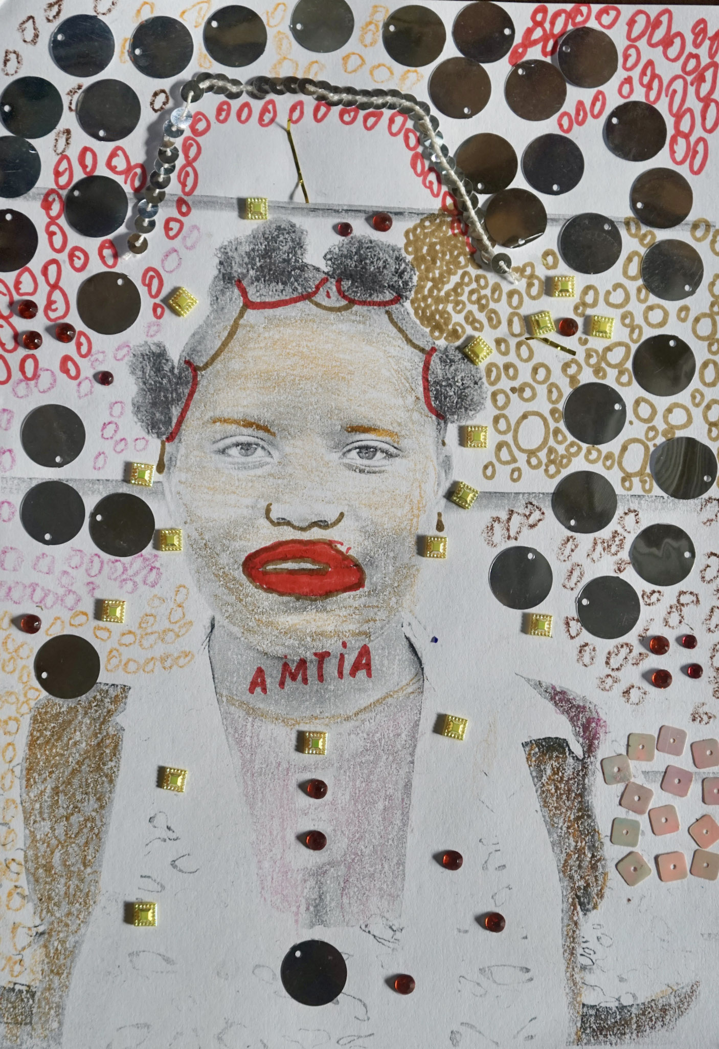
LONG TERM IMPLICATIONS FOR GIRLS, FAMILIES AND COMMUNITIES
Long term exposure to emotional distress across the life course linked to child marriage: fears, trauma linked to associated IPV, isolation and denial of education
Intergenerational impacts: Impacts on parenting and child development among young mothers in early marriages or unions
Long term impacts: married before the age of 18 had overall lifetime rates of psychiatric disorders that were higher than those married after 18 (Le Stratt et al., 2011)
People with severe mental illness or learning disabilities are at risk of forced unions – documented in HIC (Rauf et al., 2018)
©COLORS OF CONNECTION
Notes:
The development of mental health conditions stems from experiences of emotional distress which compound and are experienced across the life course – includign well documented experiences of trauma, isolation and exclusion, violence, loss of educational opportunities, and experiences of IPV.

Slide 9
THE INTERVENTION LANDSCAPE
Health-focused interventions predominate the evidence base
Less attention to nutrition and mental health outcomes (Elnakib et al., 2022)
In African Settings: most evidence has been produced on interventions related to health, empowerment, and laws and policies – only a handful of mental health interventions (Green, 2023)
Some evidence of: Interventions focusing on psychosocial support, delivered by peers, to married adolescents and adolescent mothers (Greene, 2023)
The need: Complex interventions that combine mental health support with social development (Burgess et al, 2022)
©COLORS OF CONNECTION
Notes:
In the past few years there have been a few reviews exploring the intervention landscape around child marriage, looking to identify what support was availble to young women.
Shatha Elnakib (2022/3???)
Systematic scoping review of interventions that address the health and social needs of child brides - found that:
1. Health-focused interventions predominate the evidence base
SRH outcomes most commonly investigated
Less attention to nutrition and mental health outcomes
2. Fewer interventions address social and economic outcomes.
Dearth of interventions that address the needs of divorced girls
Margaret Greene: https://bmjopen.bmj.com/content/13/5/e061315
Systematic scoping review of interventions to prevent and respond to child marriage across Africa: progress, gaps and priorities 2023
Mental health represents another area of sparse intervention research. The non-clinical psychosocial Child Resilience Programme in rural Ethiopia, focused on building children’s positive coping strategies and developing their resilience under different shocks and stresses.25 Working with schoolchildren, parents, teachers and the community, it documented improvements in psychosocial well-being and problem-solving skills, including intervening in early marriage and avoiding physical violence. Mental health can be a casualty of child marriage, which puts girls at greater risk of sexual, physical and emotional violence,49 and interventions support married adolescents and adolescent mothers by addressing stigma and social isolation. A peer support intervention for adolescent mothers in Zimbabwe documented improvements in girls’ mental health, social support, knowledge sharing and skills building.50 The TESFA programme for married girls in Amhara, Ethiopia was not explicitly designed to address mental health but documented improvements among participating girls.29
Recent research highlights the potential for technology to be leveraged as an affordable and user-friendly platform to share information in empowerment-based child marriage interventions. For example, in a recent study to assess a community-based peer support intervention addressing the mental health needs of adolescent mothers, the use of WhatsApp Messenger to support intervention efforts was welcomed by study participants.50
Our analysis reveals that most evidence has been produced on interventions related to health, empowerment, and laws and policies, with some evolution over the years. The health focus reflects an early emphasis in the field on adolescent sexual and reproductive health and unintended pregnancy. The breadth of health-related research has evolved over the past 20 years, expanding to include mental health, which the COVID-19 pandemic has highlighted the importance of prioritising intervention design.74 Our analysis identifies the need for a more holistic approach to addressing all aspects of girls’ health, and more research on the links between pregnancy prevention and child marriage in the African continent.

Slide 10
Where to from here?
Child Marriage & Mental health
Geographical and population silences
Intervention and response gaps
Political will and funding
Complex settings
Limited evidence base: Largely East African and Asian studies (Burgess et al., 2022)
Little evidence on boys or LGBTQI communities in early or forced unions
Interventions specifically targeting mental health or psychosocial wellbeing are few and far between (Green et al., 2022)
Notes:
Poverty is continually linked to increased risk of early unions globally – meaning that social shocks, such as the pandemic which increased risk of poverty, were paired with increased rates of child marriage.
We also know that CEFM is supported by what can be deeply embedded gender, and other social norms about women and girls, increased exposure and experience of interpersonal and other forms of violence, and poorer reproductive health outcomes, typically linked to child birth at a young age.
(advance slide – replace middle circle with mental health)
What is less mentioned, is that these same factors are also continually associated with poorer mental health outcomes in communities globally. Consistent evidence links poverty to poorer mental health outcomes that once established, are often very hard to address given the cyclical nature of this relationship.

Slide 11
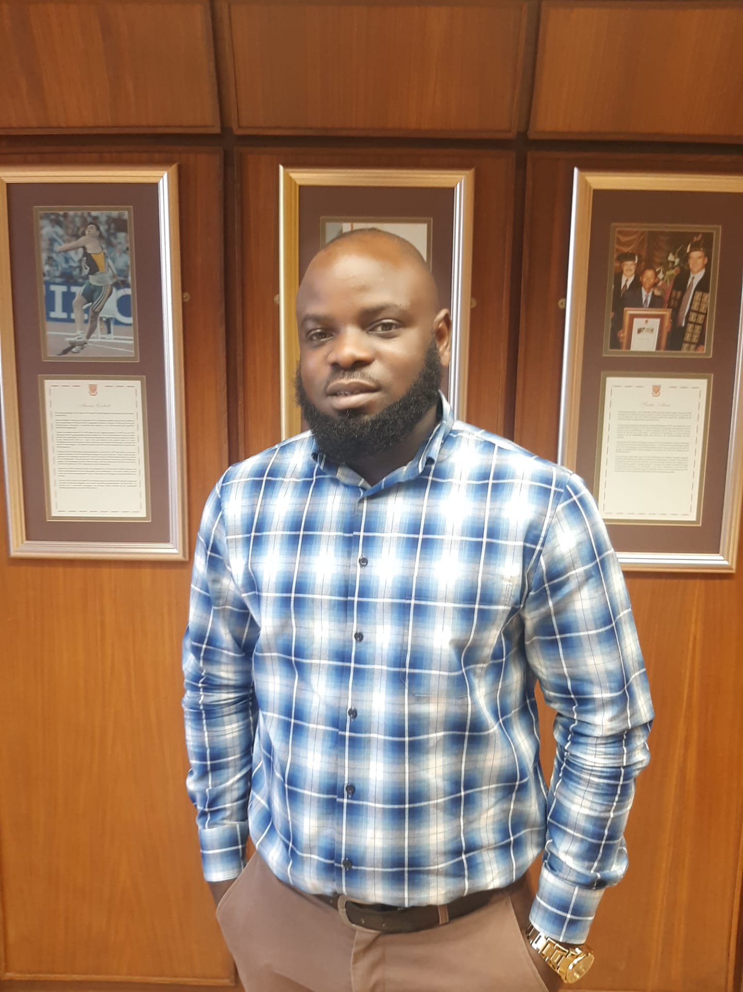


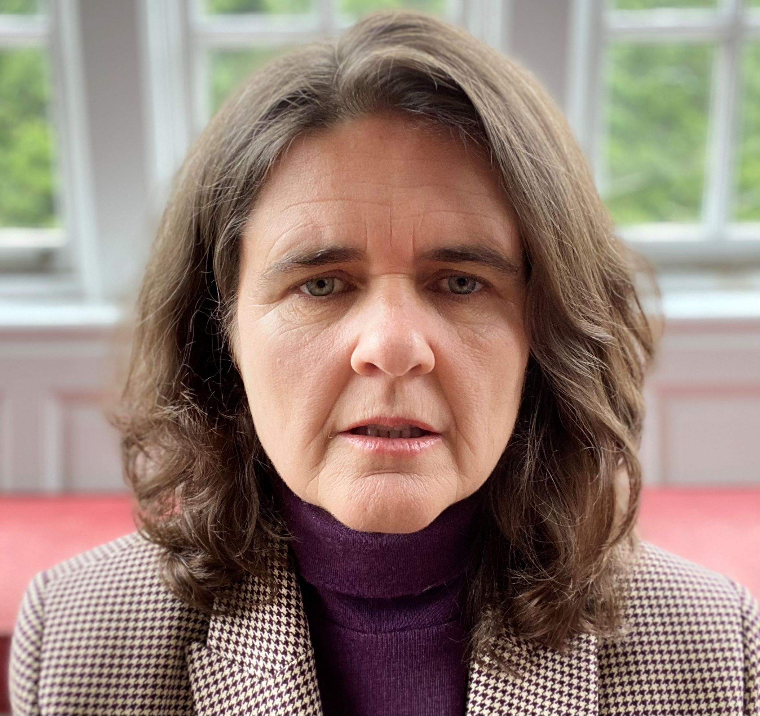
Session 1 overview
Child marriage and mental
distress: A multi-country analysis of the violence against children and youth survey
DR. OLOLADE JULIUS BARUWA, ACCELERATOR HUB
Initial findings from a mixed-methods study exploring the mental health consequences of child marriage
MS. FARIRAI GUMBONZVANDA
RMT/MARCH-ZIM
Mental health and psychosocial support (MHPSS) of female youth in
Displacement in Northern Iraq
DR. KIMBERLY HOWE, TUFTS
Child Marriage and psychosocial wellbeing: Evidence from GAGE
DR. NICOLA JONES, ODI & Director, GAGE

Slide 12
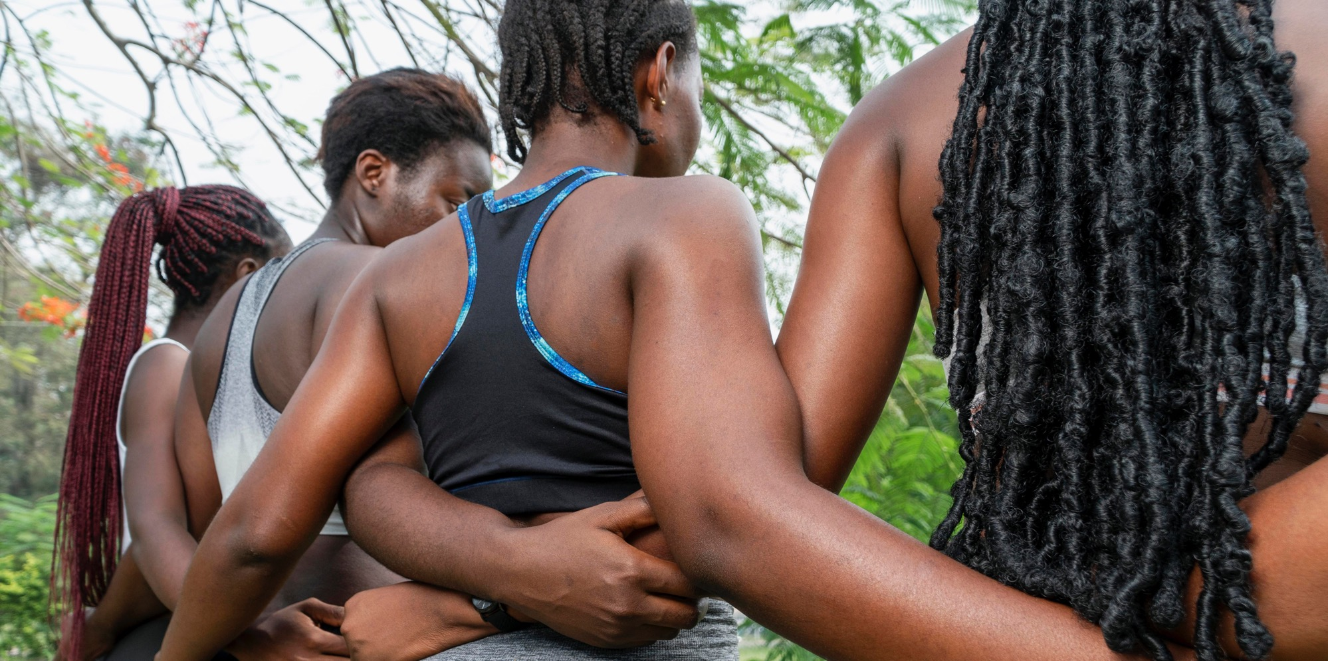



CHILD MARRIAGE
AND MENTAL DISTRESS
Multi-country analysis of Violence
Against Children and Youth Surveys
20 March 2024
OLOLADE JULIUS BARUWA, PHD
Post-doctoral Research Fellow, University of Cape Town, with A/Prof Elona Toska, Dr Bolade Banougnin & Dr Rachel Yates
Julius.Baruwa@acceleratehub.org, Elona.Toska@uct.act.ca & rachel.yates@acceleratehub.org

Slide 13
RESEARCH QUESTION
What is the relationship between child marriage and mental distress in young women (18-24 years) in Lesotho, Namibia, and Zimbabwe?
METHODS
Sample: 18-24-year-old young women, responding to VACS in Lesotho, Namibia, and Zimbabwe
Outcome: mental distress in the past month (measured using Kessler Psychological Distress Scale).
Independent variable: Child marriage (<18), Marriage 18+, never married
Analyses
Multivariable logistic regression
Child marriage and mental distress, adjusting for covariates
Estimate predicted probabilities of mental distress by marital status (3 groups)
Country - year | # Young women
Lesotho 2018 | 3. 690
Namibia 2019 | 2,434
Zimbabwe 2017 | 4,511
Total | 10, 635
References: Burgess et al PLoS ONE 2022. VACS Reports:
Child marriage, affecting 12 million young women annually, results in mental health challenges, emphasizing the need for comprehensive research and interventions across diverse populations and humanitarian settings

Slide 14
PRELIMINARY FINDINGS
 |  | Mental distress
 | % among all AGYW | OR | P-value | 95% CI
MARITAL STATUS Never married Married 18+ Child Marriage (<18) | 12.0% 18.2% 23.7% | 1 1.06 1.30 | 0.521 0.029 | 0.88-1.28 1.17-1.85*
Motherhood No Yes | 14.5% 15.5% | 1 0.89 | 0.247 | 0.75-1.08
Country Lesotho Namibia Zimbabwe | 16.4% 3.5% 23.2% | 1 0.18 1.62 | <0.000 <0.000 | 0.12-0.26* 1.37-1.93*
School enrolment Enrolled Not enrolled | 11.6% 16.43% | 1 0.95 | 0.573 | 0.79-1.14
Orphan No Yes | 13.7% 16.3% | 1 1.09 | 0.124 | 0.97-1.28
Sexual violence No Yes | 13.4% 26.4% | 1 2.66 | <0.000 | 2.19-3.23*
Age (continuous) |  | 1.05 | 0.006 | 1.01-1.09*
Baruwa, Toska, et al.

Slide 15
PRELIMINARY FINDINGS
Young women experiencing childhood sexual violence → greater odds of mental distress
Child marriage (<18) → greater odds of mental distress
Young women who experienced both were at the highest risk of mental distress
Notes:
Never-married & no sexual violence = 8.5%
Married 18+ & no sexual violence = 8.9%
Married before 18 years & no sexual violence = 10.7%
Never-married & sexual violence = 19.7%
Married 18+ & sexual violence = 20.7%
Married before 18 years & sexual violence = 24.2%

Slide 16
KEY IMPLICATIONS
One in every four young women who have experienced child marriage (<18) and childhood sexual violence experienced mental distress in the last month.
Marriage is associated with mental distress in the past month, with adolescent girls and young women who married early reporting higher levels.
A history of sexual violence increases the risk of mental distress by >2.5 times.
Context matters: Mental distress, child marriage, and motherhood rates varied by country.

Slide 17
KEY RECOMMENDATIONS FOR THE FIELD
Tailor health programming to integrate mental health screening for AGYW who are married <18.
Investigate the effects of poor mental health and childhood sexual violence among women experiencing child marriage.
Map trends across countries and contexts.
Identify potential packages of support for adolescent girls and young women who are married <18, incorporating post-violence care.

Slide 18
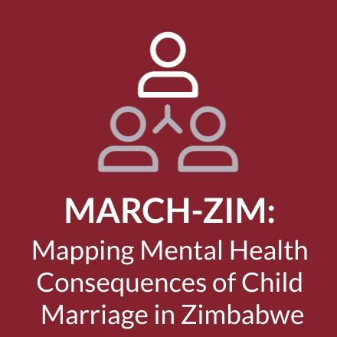
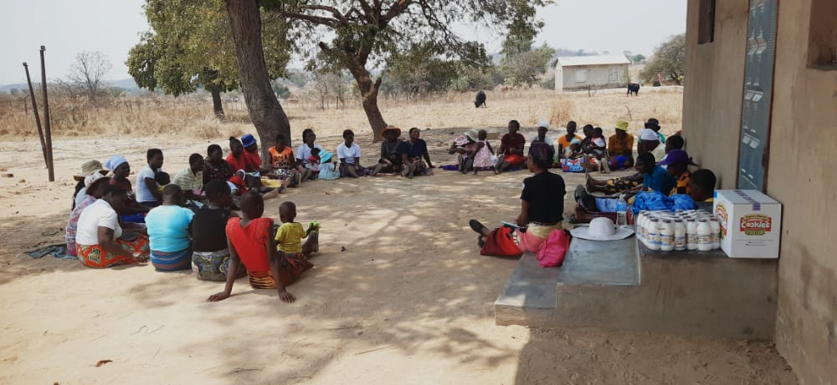




Initial findings from a mixed-methods study exploring the mental health consequences of child marriage
March 2024
Farirai Gumbonzvanda
Research Associate
Notes:
An average of 40,000 children and young women under the age of 18 are married every day. This is around 15 million each year. More than 60% of child brides in developing countries have no formal education. Today, there are more than 700 million women alive who were married before their 18th birthday. This is the equivalent of one in 10 of the world’s population. If we do not accelerate efforts to protect girls, there will be 950 million girls and women who will have been affected by child marriage by 2030.
While there has been alot of work being done globally around protecting those at risk and providing support for survivors, there have been few interventions which focus particularly at the mental health aspect.
In Zimbabwe, common mental disorders such as depression and anxiety are widespread among women and youth who live in contexts of poverty . The average number of mental health professionals in LMICs per 100,000 is 6. Poverty is clearly linked to poorer mental health outcomes, especially in relation to common mental disorders such as depression
Global burden of disease data estimates that in Zimbabwe, around 12% of the population Estimates place the prevalence of mental health in primary care settings, 30 percent prevalence of common mental disorders such as anxiety and depression
A review of 21 articles showed that psychological wellbeing, stress, suicidality, substance misuse and other mental disorders have been associated with child marriage, and depression was the most common mental health consequence.
The conversation around psycho social support mechanisms is a emerging area of focus and little has been done especially in the research arena. It is with this context that the MarchZim Project was formed . It is first known study to investigate the mental health consequences of child marriage in the Southern African Development Community
The march-zim project is a collaborative project between UCL , RMT and WUA . over the last three years we have been working with 100 women in Mashonaland west to map the mental health consequensces of child marriage
The primary aim is to map and assess pathways of risk, resilience and coping for mental health conditions for women and families, in communities where the occurrence of child marriage is high
This study is being conducted in Mashonaland Central province, Zimbabwe, which is known to have the highest number of CM and young childbearing women in the country (United Nations, 2018)
This presentation will give a brief overview of some of the findings from the survey and emerging issues which have arised from the initial analysis and of life and family history interviews.

Slide 19
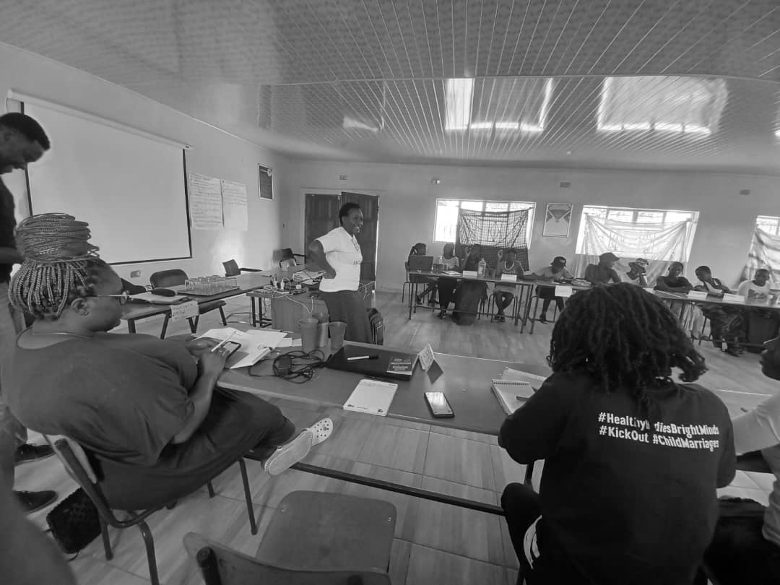
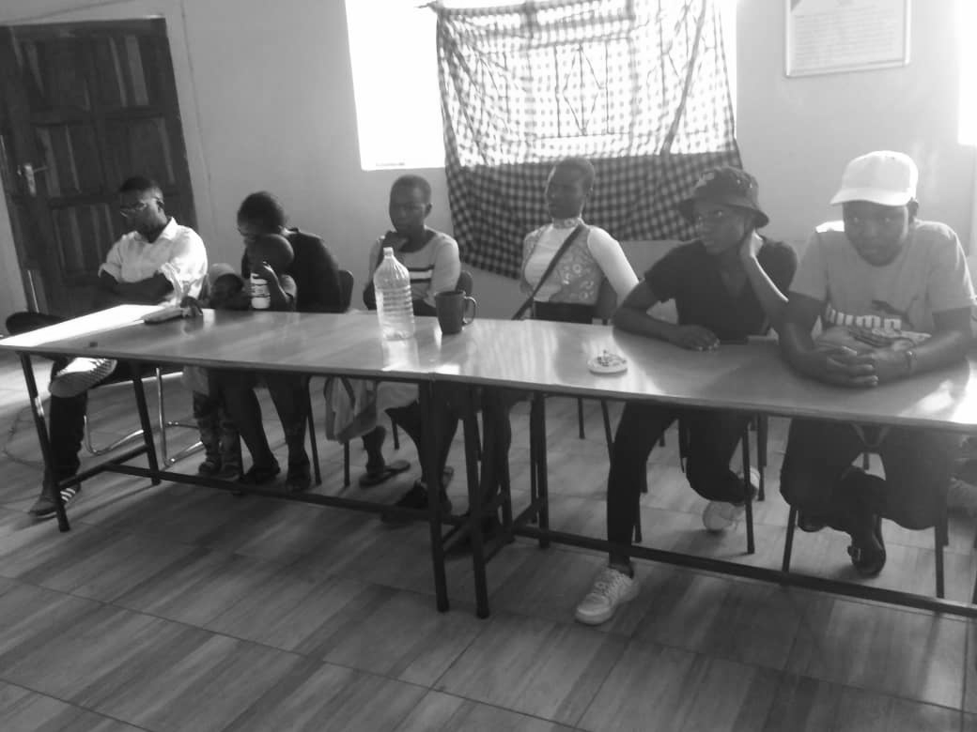
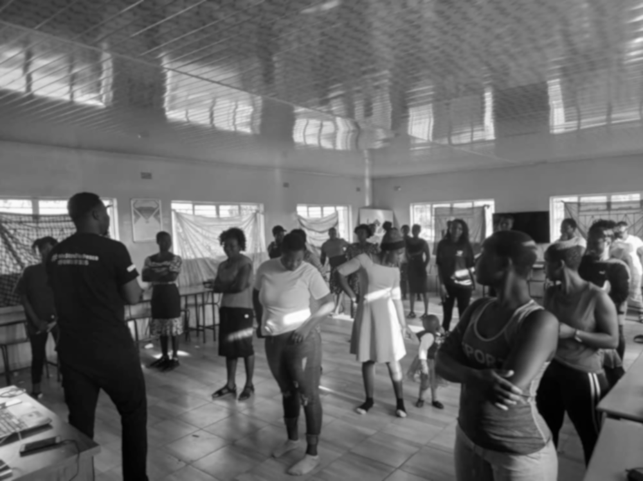
MARCH ZIM- Study design
MENTAL HEALTH IMPACT
IMPACT ON WOMEN'S LIVES
PROCESS & CHANGE
Survey: SSQ + PHQ9
Life history Interviews
Community conversations
Interviews with 35 women, and + 3 members of their family discussing histories, experiences of & perspectives on child marriage
Group sessions with survivors, teachers, men/traditional leaders, and health practitioners to explore perceptions of child marriage, associations with mental health and possible interventions
Random sample from RMT database (n =100)
Notes:
The survey was conducted by 100 women from shamva all survivors of child marriage. With participants from 17 to over 50 the median age of the respondents was 26
Life History Interviews: Using interviews with child marriage survivors and conversations with stakeholders in the wider community such as teachers and cultural leaders, we identied the elements which explain how child marriage and the socioeconomic challenges which Zimbabweans face, can affect mental ill-health.
Our aim was also to look at how child marriage contributes to poorer mental health outcomes, not only among women and girls, but also their families and wider communities. The family history interviews allowed us to do this. Each main participant would nominate 3 candidates to have an interview with.
Community Conversations culminated in a theory of change workshop which was conducted earlier this year.

Slide 20
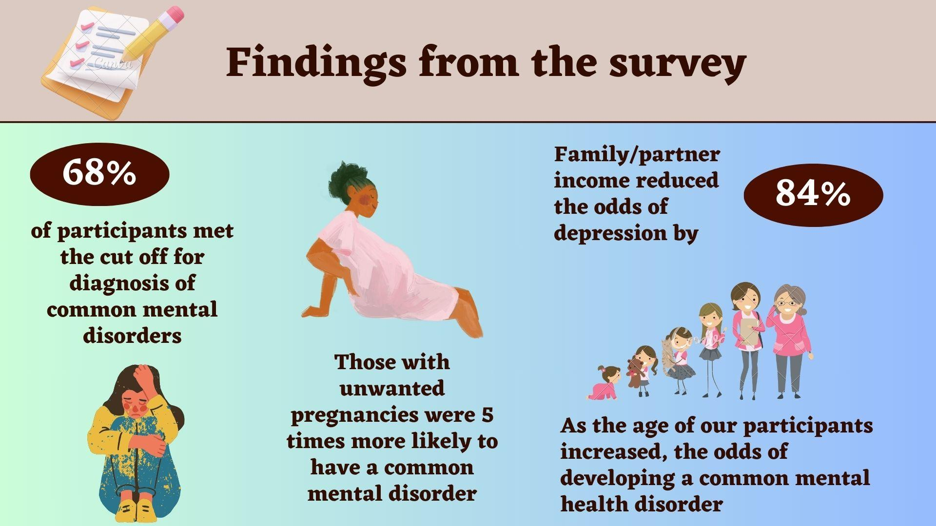
Notes:
68% of participants met the cut off for diagnosis of common mental disorders (CMD) basedn the SSQ.
We found that those with unwanted pregnancies were 5 times more likely to have a CMD (p < 0.01, CI= 1.82, 13.85), in comparison with those who had wanted pregnancies.
family/partner income reduced the odds of depression by 84% (AOR= 0.16, p < 0.04, CI= 0.03, 0.90), in comparison with those with no income or had selected ‘own business/self’ as their main income source.
As the age of our participants increased, the odds of developing a common mental health disorder (SSQ) also increased. Given the associations between child marriage and other forms of violence that are related to poorer mental health, such as interpersonal and sexual violence
Note that although it was a Quantitative survey the women showed interest in telling their stories. The survey was done in person and even with the Yes/no answers women were keen to give a narrative.

Slide 21
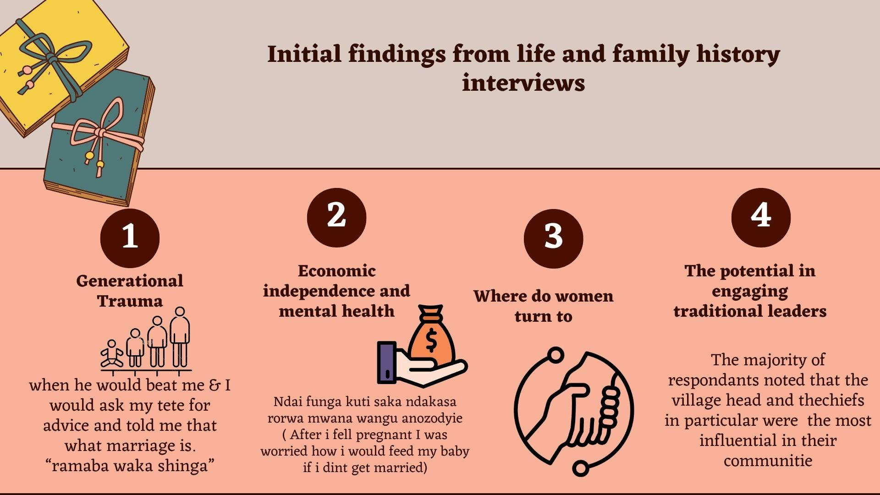
Notes:
Generational trauma
Women with mothers and aunts who had experiences child marriage were common
Women who witnessed GBV in their childhoods expressed they were acclimatised to seeing intimate partner violence as norm. Often seeking advice from elders and being told to “hang in there” as this was merely “the nature of all marriages”
Economic independence
This was also true even in cases women were the major breadwinner but did not have decision making power over finances
There was however a contradiction with the information from the survey which found that family/partner income reduced the odds of depression
Where women turn to:
Majority of referrals were of women who have similar experiences
Faith and the church also emerged as a key source of refuge and mental health support
the role of the “tete” the sister in law recognised as a key mediator.

Slide 22
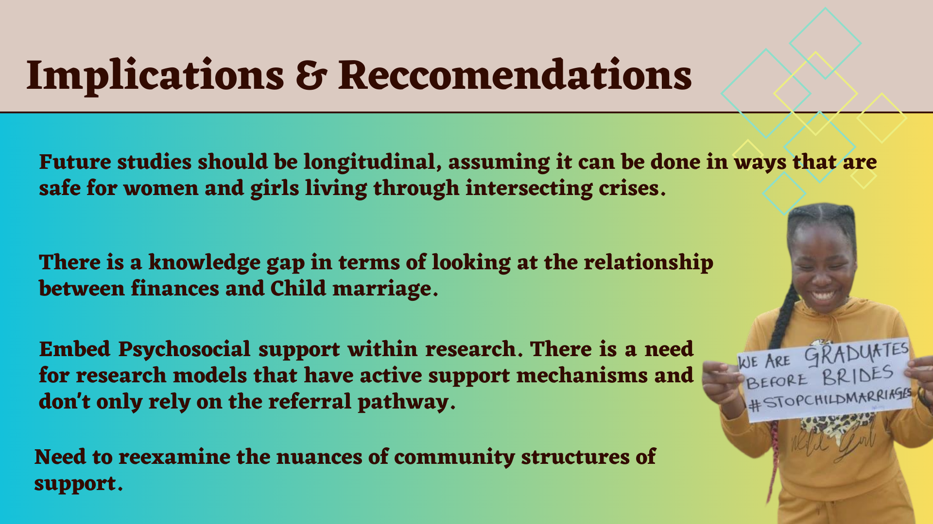
Notes:
future studies should be longitudinal, assuming it can be done in ways that are safe for women and girls living through intersecting crises
This will also give access and opportunity to look at intergenerational
The contradictory findings around income need to be further examined. There is a gap in knowledge of terms of understanding the intersection between child marriages , financial circumstances and mental health

Slide 23

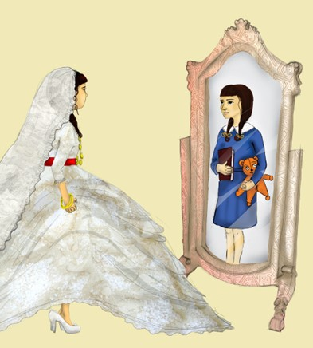




Early Marriage among Female Youth in Displacement
Early Marriage and Well-being of
Displaced Female Youth
in The Kurdistan Region of Iraq & South Sudan
Access reports here
Or follow this link
Kimberly Howe
Elizabeth Stites, Meg Moran,
& Anastasia Marshak
Khalat Ahmed Hammada & Shilan Sulaiman
Tabitha Nyaleel Maguek & Nyachar Lony
This project has received funding from the European Union’s Horizon 2020 research and innovation programme under the Marie Sklodowska-Curie grant agreement No. 786064
This project has received funding from the European Union’s Horizon 2020 research and innovation programme under the Marie Sklodowska-Curie grant agreement No. 786064
Notes:
https://fic.tufts.edu/research-item/child-marriage-in-humanitarian-settings/

Slide 24
Research Questions
What are the holistic experiences, challenges, opportunities and constraints of female youth (14-24) displaced by conflict?
How does each differ by marital status (unmarried, married, divorced, widowed, motherhood status)?
Site: Kurdistan Region of Iraq and South Sudan

Slide 25
Sample and Methods
2 year longitudinal cohort study with 140 female youth displaced by conflict
Internally displaced Yazidis, Syrian refugees, returned Arabs, interally displaced South Sudanese
Interviewers from affected communities
650 interviews: semi-un structured interviews, photography, drawing, CYRM, SDQ, trauma checklist
89% of those married in sample were <18 at time of marriage

Slide 26

Findings
14 types of traumatic events experienced by female youth in the sample
Inverse statistical relationship found between resilience and traumatic events
After early marriage, well-being spanned a wide continuum,
but also depended on degree of force and age
Divorced and separated youth: often lost custody of children, faced stigmatism and had poor mental health. Many experienced extreme domestic violence
Widowed youth faced inheritance (South Sudan), economic hardship, difficulty with in-laws, harassment and exploitation.
Early motherhood also impacts well-being: mixed effects

Slide 27



Marital Status Forecasts Well-Being
Divorced
Widowed
Married
Unmarried

Slide 28
Implications & Recommendations
There are remarkable difference in well-being and mental health needs depending on early marriage and motherhood status
Many female youth describe their suffering in terms of conflict, and patriarchical systems
Longitudinal research design has positive impacts on well-being and is beneficial to study adaptation, coping and life in crisis settings
Programs should target all four levels of the MHPSS pyramid and cross-sectoral approaches should be considered
More research needed on the well-being of children born to females in early marriages/early motherhood.
More research needed on the role of males, cases of positive deviance, coping in crisis, and normative change.
.

Slide 29
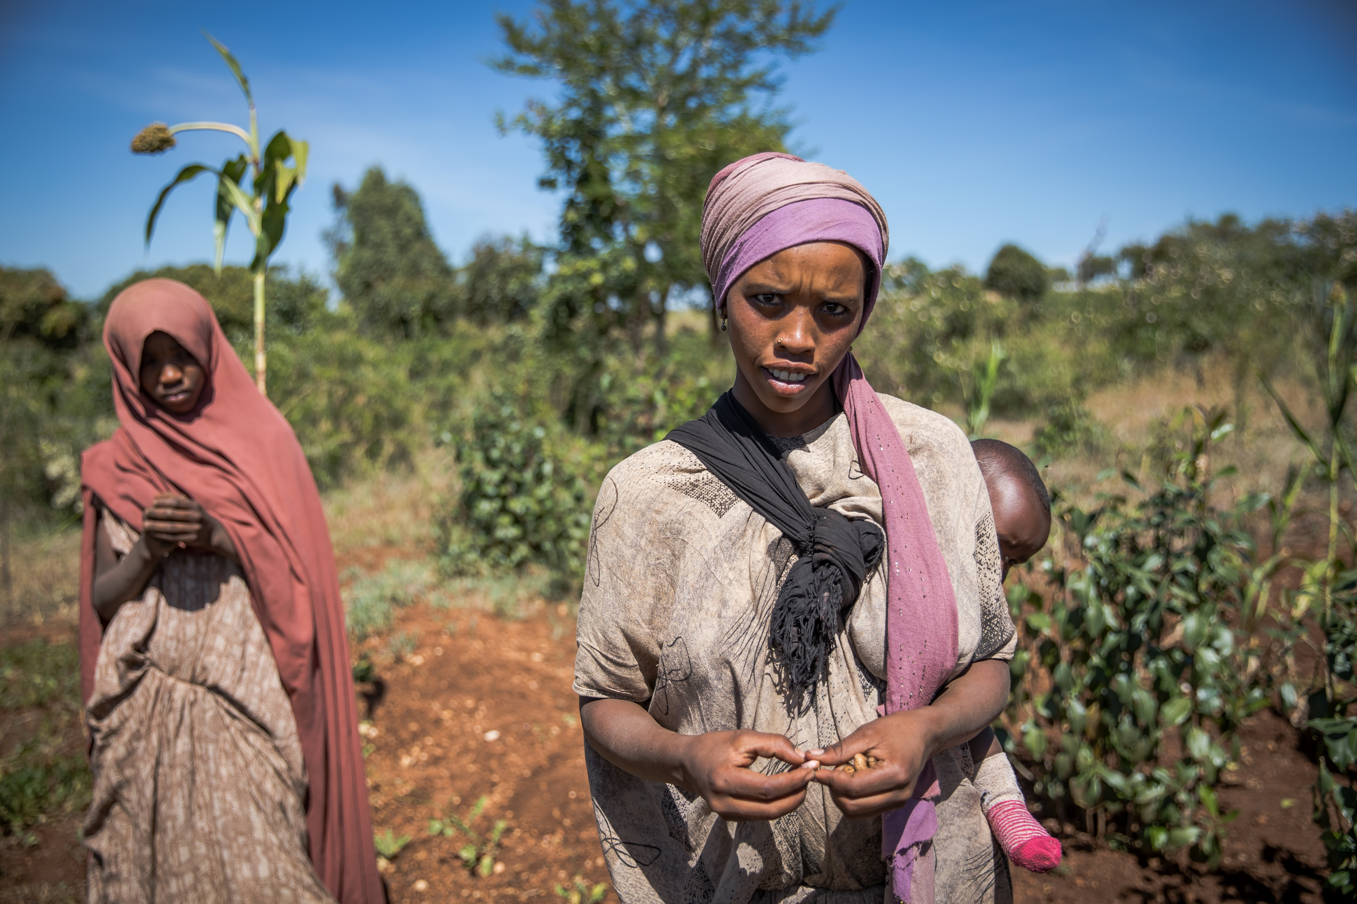
Child marriage and psychosocial well-being: Evidence from GAGE
Dr Nicola Jones, ODI Principal Research Fellow + GAGE Director, March 2024

Slide 30
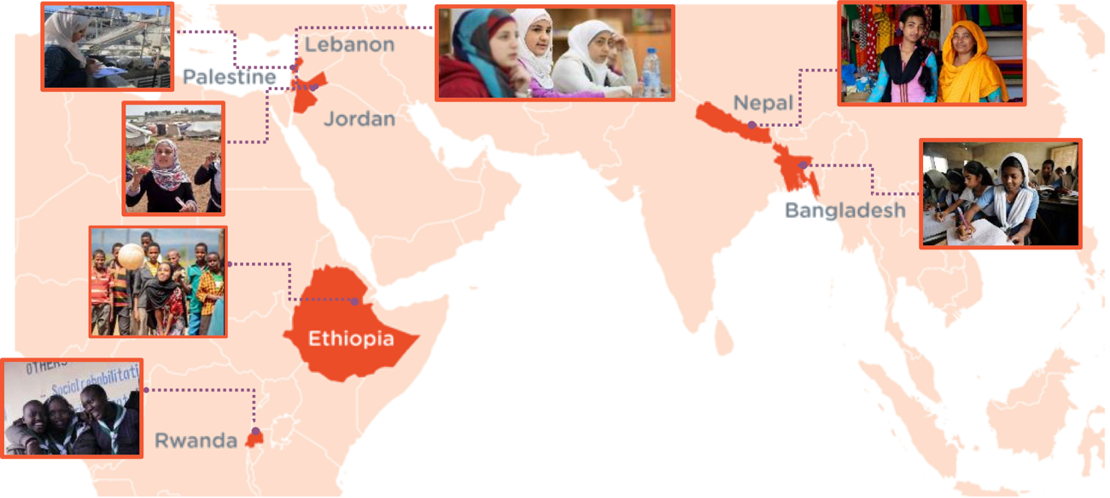
Gender and Adolescence: Global Evidence (GAGE): A longitudinal research programme following 20,000 adolescent girls + boys across six LMICs (2016-26)
Mixed methods research involving:
Surveys with adolescents + caregivers;
In-depth qualitative interviews with adolescents + husbands + parents + in-laws; service providers
Participatory research with married girls including PhotoVoice + peer-to-peer and inter-generational interviews
Within the GAGE adolescent cohort, 1158 are married girls (and young women who married as girls) in Bangladesh (118), Ethiopia (814), and Jordan (226)
Notes:
Gender and Adolescence: Global Evidence (GAGE) is a ten-year mixed-methods longitudinal research programme exploring the gendered experiences of young people as they move through adolescence and into young adulthood.
GAGE aims to generate new evidence on ‘what works’ to transform the lives of adolescent girls and boys to enable them to move out of poverty and exclusion, and fast-track social change.
GAGE research involves the most vulnerable adolescents, including those who were married as children.

Slide 31
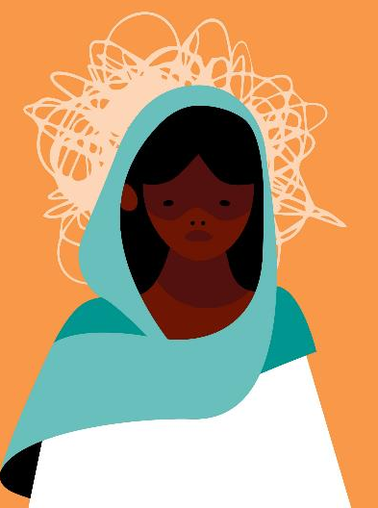
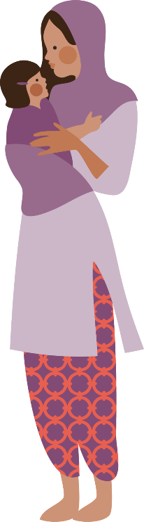
Findings: Child marriage amplifies stressors
Child brides have high rates of emotional distress (as measured by the GHQ-12). In Bangladesh, 28% of ever-married girls were distressed, compared to 20% of their never-married peers.
Child brides have high rates of depression (as measured by the PHQ-9). In Ethiopia, young women married < 18 were twice as likely to be mildly depressed and four times as likely to be moderately to severely depressed, compared to their never-married peers.
Child brides are less resilient (as measured by the CYRM). In Ethiopia, young women married < 18 were nearly three times as likely to have low resilience and one-quarter as likely to have high resilience, compared to the never-married peers.
Child brides are more likely to believe that wives should always obey their husbands and that IPV is acceptable and private. In Jordan, 39% of young wives believe that IPV is private, compared to 26% of their never-married peers.
‘I was happy before marriage. Now everything is stressful.’
(19-year-old mother, Ethiopia)
‘I used to be proud of myself, but now I am not. All I need is to go back to being single, or to go out to a place where there is no one, or to die.’
(18-year-old Palestinian refugee young woman, Jordan)
Physical demands are unrelenting—especially once girls have children.
Emotional demands are complex and overwhelming.
Intimate partner violence is endemic—and violence from in-laws is common.
‘Since I got married I am often busy with different household jobs, which is very tiresome… I am now getting skinny because of the work burden at home.’
(16-year-old girl, Ethiopia)
‘I was shocked. There were many things that changed… I was unable to deal with the problems, to deal with my husband or to deal with my mother-in-law.’
(18-year-old Syrian who married at 14, Jordan)
‘One of my sisters-in-law came here during Eid and brought many things. My husband beat me up with a stick for not eating the foods she brought.’
(16-year-old Rohingya girl, Bangladesh)

Slide 32
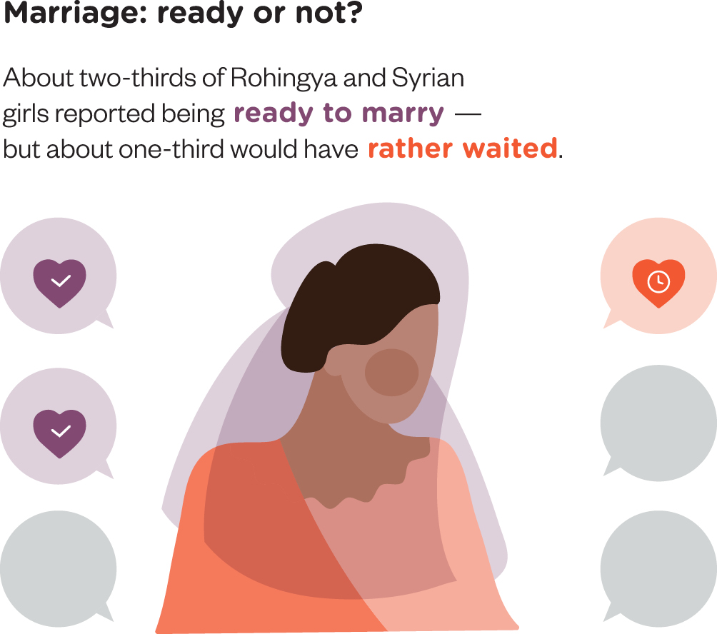
Findings: Child marriage reduces socio-emotional support
Child brides often do not have a trusted friend. In Bangladesh, only 60% of young wives had a friend,
compared to 76% of their never-married peers.
Child brides often do not have a trusted adult in their lives. In Jordan, figures were 71% versus 79%.
Child brides have limited mobility. Only 28% of young wives in Jordan had left their home every day in the past week—compared to 61% of their never-married peers, reducing access to services + information.
Child brides have extremely limited access to school and the relationships with peers and adults that it affords.
In Ethiopia, only 20% of ever-married girls were enrolled, compared to 81% of their never-married peers.
Some young wives are emotionally isolated.
Young wives’ friendships are often bounded.
Many young wives cannot depend on their parents.
Few young wives have close relationships with their husbands.
‘After we marry, we have a husband and a home to take care of….You are all alone after you get married.’
(15 -year-old married girl, Ethiopia)
‘I do not tell them about home secrets and private life… It is true that they are my friends, but marriage changes things.’
(20-year-old Syrian mother, Jordan)
‘I told my daughter, you should obey your husband, all your brothers-in-law… your mother-in-law and you shouldn’t tell me anything that happens at your house.’ (Syrian mother, Jordan)
‘Hahahahaha! We don’t talk much… I didn’t count how many times I beat her.’
(18-year-old husband, Ethiopia)

Slide 33

Implications for programming and policy priorities
Young wives need opportunities to spend time with peers and friends in safe spaces that also afford them access to caring adults.
  Programming should educate girls about their rights and strengthen their self-confidence and communication skills.
  Programming must engage with girls’ gatekeepers (e.g. husbands and in-laws) and provide the practical supports that facilitate participation (e.g. childcare, transport, skills building opportunities or social protection support).
  Young wives need tailored pathways that support their access to school and/or income-generating opportunities.
Married girls need more support from their mother-in-law.
Broader parenting education courses could be used to build knowledge of adolescent development among mothers (and mothers-in-law) – and to help women think through how they want their own daughters to be treated after marriage, and how this might affect how they themselves treat their daughters-in-law.
Young wives need to be supported to develop better communication and a stronger emotional relationship with their husbands through:
Couples counselling delivered during engagement or soon after marriage.
  Topics could include (1) active listening and communication styles; (2) interrogating gender norms and how they shape beliefs (e.g. about girls’ mobility); and (3) how to manage tensions and stress.
Concomitant programming should be provided to new husbands, (e.g. through sports groups or faith institutions), to allow them to explore alternative masculinities that do not revolve around control and violence.
Young wives who are experiencing violence need access to one-stop centres that provide health, legal, social protection and psycho-social support and referrals, as well as psycho-emotional support from their parents--who need to be encouraged to stand up for their daughters’ rights to bodily integrity

Slide 34

Recommendations for the evidence base
Rigorously evaluate programming to ascertain what works in diverse contexts (esp. humanitarian and developmental + for different marriage types)
Pilot evidence-informed promising approaches
Invest in routinely disaggregated data (by marital status + age) on pss + related stressors

Slide 35

Contact Us
About GAGE:
Gender and Adolescence: Global Evidence (GAGE) is a decade-long (2016-2026) mixed-methods longitudinal research programme focused on what works to support adolescent girls’ and boys’ capabilities in the second decade of life and beyond.
We are following the lives of 20,000 adolescents in six focal countries in Africa, Asia and the Middle East.
WEBSITE
www.gage.odi.org
TWITTER
@GAGE_programme
FACEBOOK
GenderandAdolescence

Slide 36
What’s known: Mental health consequences of early, child & forced marriage
Q&A session
©UNICEF, 2019
Notes:
Holding slide

Slide 37
COMFORT BREAK AND QUESTION
What stands out most to you from these studies ?​
GO TO WWW.MENTI.COM
ENTER CODE: 6571 6781

Slide 38
What’s Working: Examples of programmes addressing mental health needs across contexts
©UNICEF, 2019

Slide 39

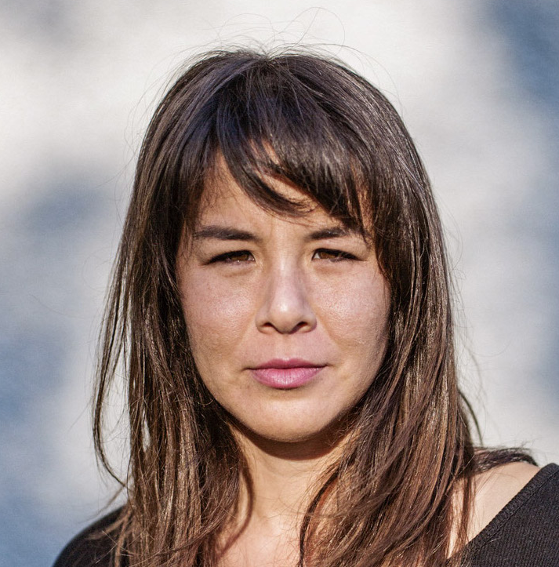
Speakers
Ending Child Marriage in Nigeria through Community-Led Media Series
OLUBOKA OMOBOWALE
ENCASE PROJECT
The Girl Awakening Program in Goma, Democratic Republic of the Congo
CHRISTINA MALLIE
COLOURS OF CONNECTION

Slide 40
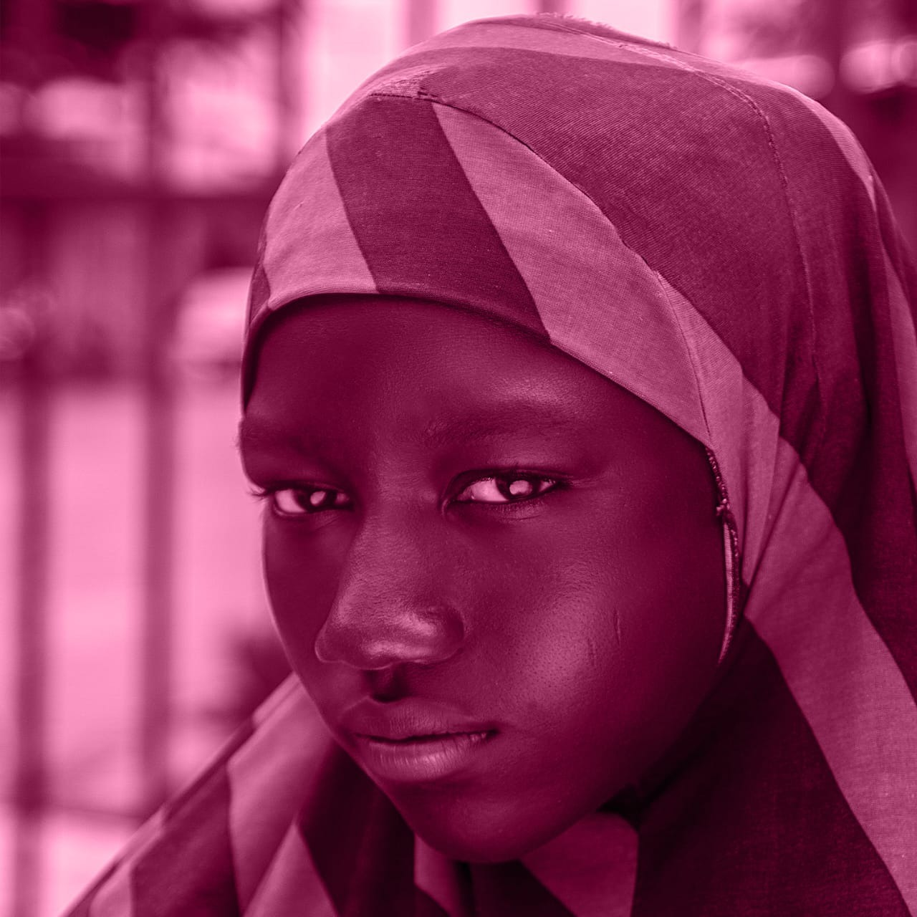




Olubukola Omobowale
MBBS, MPH, FWACP
ENDING CHILD MARRIAGE IN NIGERIA THROUGH COMMUNITY-LED MEDIA SERIES
(ENCASE PROJECT)

Slide 41









The who (with who)
Partners
Target Population
married girls
Older women
Community leaders and Influencers
Nigeria is Home to the highest number of child brides (>23 million married girls)
Child Marriage is prevalent among the Hausa Fulani communities (73.6%)
Decisions to get married are usually taken by older members of the household
Context
Notes:
Nigeria, is home to the highest number of child brides with over 23 million young married girls living n Nigeria (UNICEF, 2023)
Regional Variations 54.8% -NorthWest 52%- NorthEast with Bauchi having up to 73.8%

Slide 42
ENCASE Project Phases
A quasi-experimental study in two cities (Ibadan & Akure ),
Situation Analysis
Baseline Survey
Intervention
(“BURINA”
Radio Drama)
Endline Survey
-Using FGDs & KIIs ,an initial SA was conducted, to gain valuable insights into the local
perceptions and the sociocultural norms that drive CM
-Emerging themes from the Qualitative study were used to develop key messages for the radio drama and the survey questionnaire
-We conducted a total of 1600 survey interviews at baseline (800 in Ibadan and 800 in Akure)
-Survey questions included: ideal age for a girl /boy to marry , knowledge of adverse consequences of CM, knowledge of local laws against CM and willingness to object to CM in their family.
-The radio drama ‘‘BURINA” was coproduced with community members and the Local Advisory Committee
- 13 episodes of radio drama were aired on 3 local radio stations in Ibadan(IS) for a period of 13 weeks
-Listenership was encouraged through
weekly quizzes on the drama content
-We took the same survey among the same 1600 partipants in the two sites.
-We compared the findings to determine whether the radio playlets caused a change in people’s percetions
Notes:
10 interviews were conducted, 5 Focus Group Discussions and 5 Key Informant Interviews
Focus Group Discussions were held with community dwelling older men and women (>45years)
Younger men and women (<45 years)
Child brides(< 18years)
Key informant interviews were held with, women leader, community leader, religious leaders, and a child bride
These themes were more recurrent among the FGDs with older women who married as girls and child brides.
LAC gave valuable contributions to the culturally sensitive contents of the radio drama.

Slide 43
The So What
Mental Health Experiences associated with CM in 3 domains
Psychological Experiences af Child Marriage Victims
Loneliness
Sad
Hopeless
Anxiety
Suicidal Thoughts
Low Self Esteem
Scale Up on 2 counts : Geographically and Contextually
What Comes Next: Co-produce and pilot a Community-based Mental Health and Psychosocial Support Intervention for Child Marriage Victims in Ibadan, Nigeria.
A multiphase Mixed Method Pre –Post Intervention for Child Marriage Victims which aims to map and assess the pathways of risk, factors and coping for mental health consequences of CM ( n= 45)
Will leverage lived experiences of CMV (using digital story telling, FGDs, KIIs,free listing etc)
Notes:
Girls at risk , ever married , married girls.

Slide 44



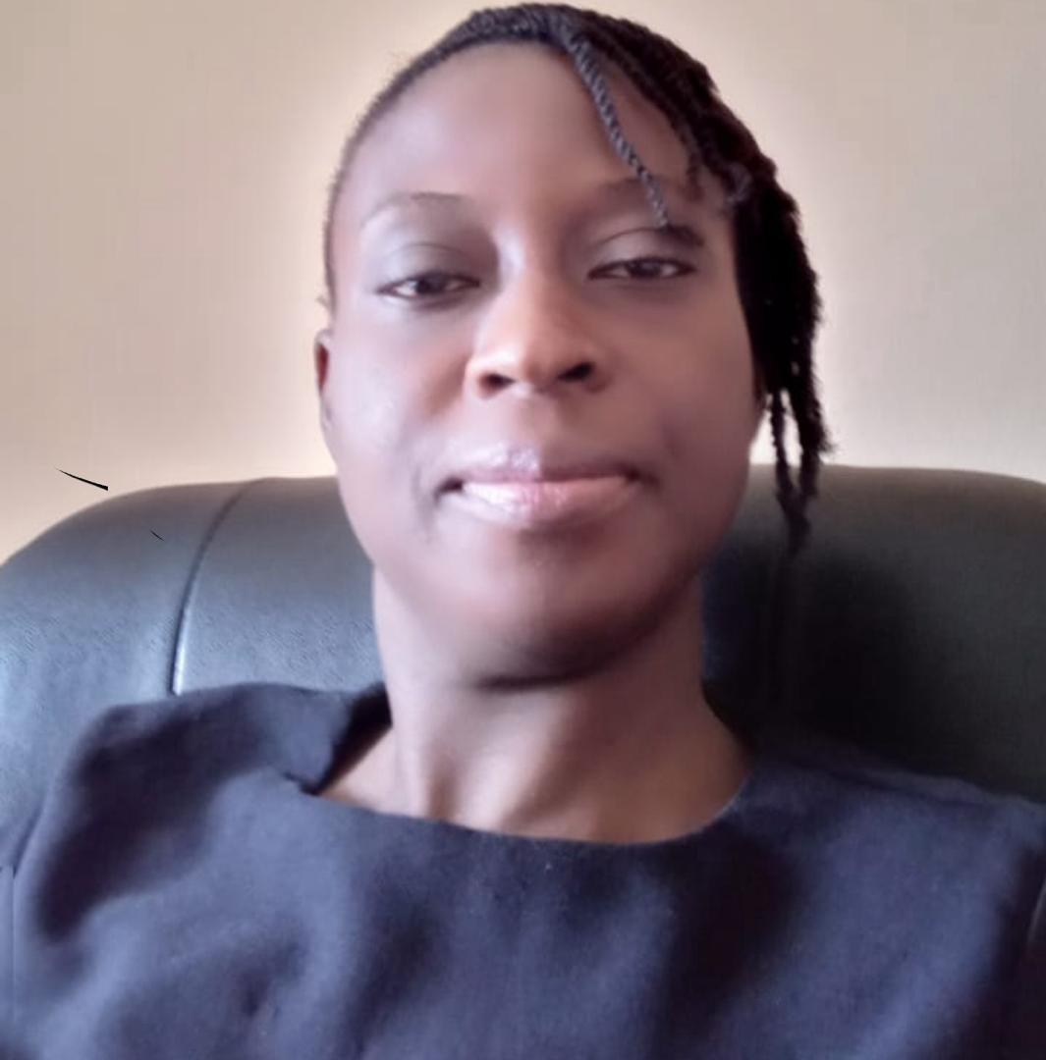
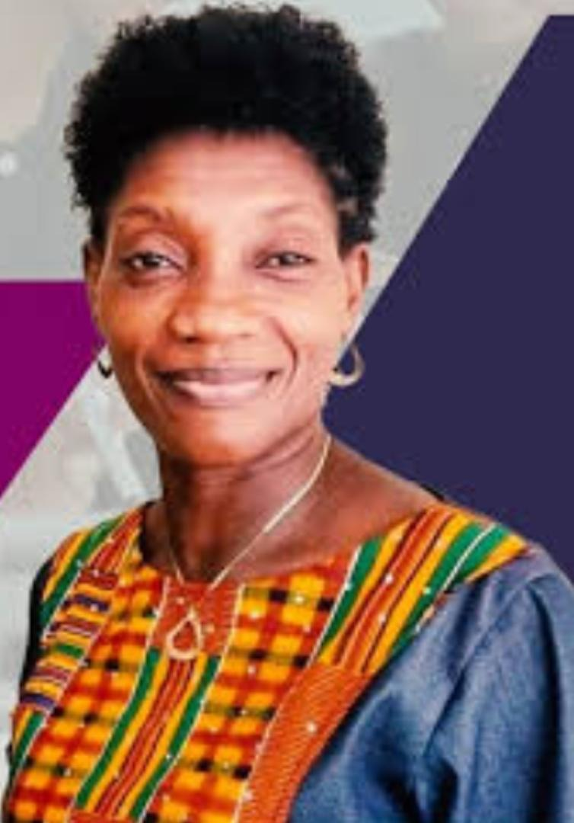
ENCASE Project Team
Project Co-Leads
Project Advisor
Project Manager
Dr. Olubukola Omobowale
Prof. Alissa Koski
Project Media Team
Prof. Olayinka Omigbodun
Ms Halimat Olaniyan
Mrs Bidemi Nelson
Dr. Olayinka Egbokhare

Slide 45
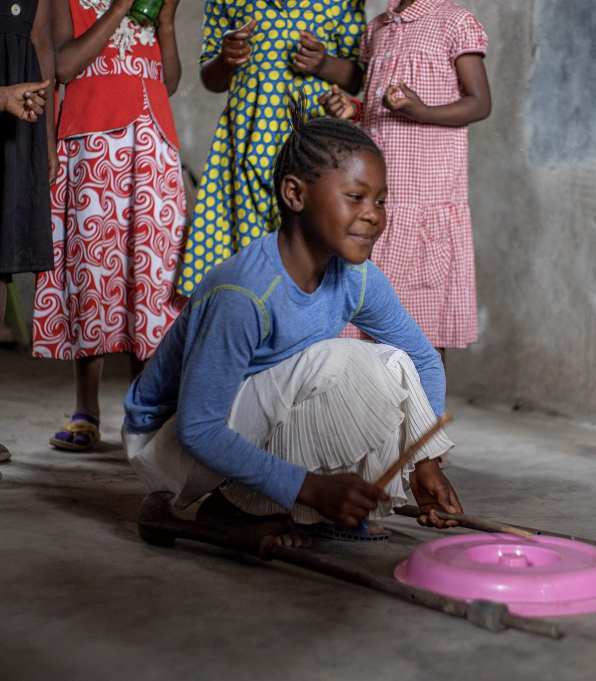




Girl Awakening
Fostering Scalable Resilience
with the Rising Generation of Girls
Through Creative Safe Spaces
and Mentorship
Democratic Republic of the Congo
with our Local Partner
Created with support from
Case studies

Slide 46
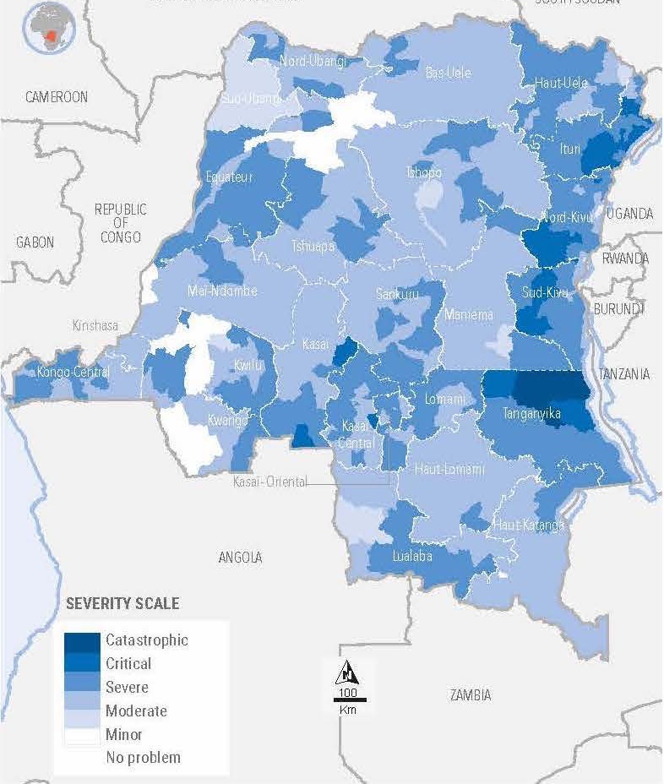
WHO
Young adolescent girls
The onset of puberty inflicts radical and multiple level blows to girls’ well-being
and chance of a healthy and productive life.
Insecure urban hot spots
Prioritizing hot spots to reach highest numbers of girls and populations facing catastrophic need levels.
By age 18
43% will be child brides
52% will have had sex
30% will be young mothers
Source: The Adolescent Experience In-Depth: Using Data to Identify and Reach the Most Vulnerable Young People: Democratic Republic of Congo 2007.” New York: Population Council, 2009.
Source OCHA Clusters, CMP, HNO/HRP 2023

Slide 47
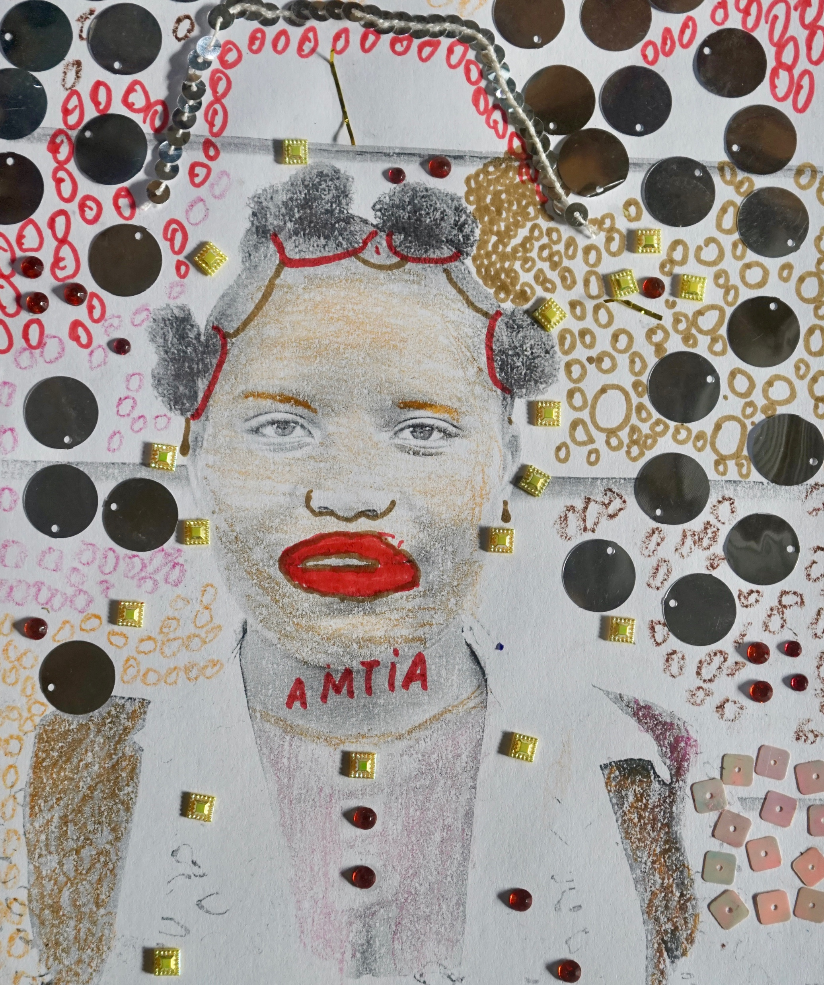
WHAT
Safe spaces and mentorship with
creative and foundational life skills.
Direct Reach: 300 girls, 8 mentors, 150 parents, 30 community leaders.
WHY
Unreached high risk young adolescent girls.
Critical age with the right resources.
Preventing further trauma, lifelong poverty for themselves and their families, poor mental and physical health.
High unmet need for mental health support.
HOW
Expressive activities from range of mediums delivered by mentors.
Notes:
Overall we are making critical investments in the poorest girls in the poorest communities
The poorest girls in the poorest communities are our clients
because these girls have rights to basic guarantees and protections and by extension by serving them: their families, households and wider communities.
to achieve demographic, health, and development goals – of DRC
We have a scalable investment plan for high risk girls in Goma – investing in the right places in the right girls.
For example 600 who are very similar to – xx number of girls in Goma - or other location?? How big ?

Slide 48

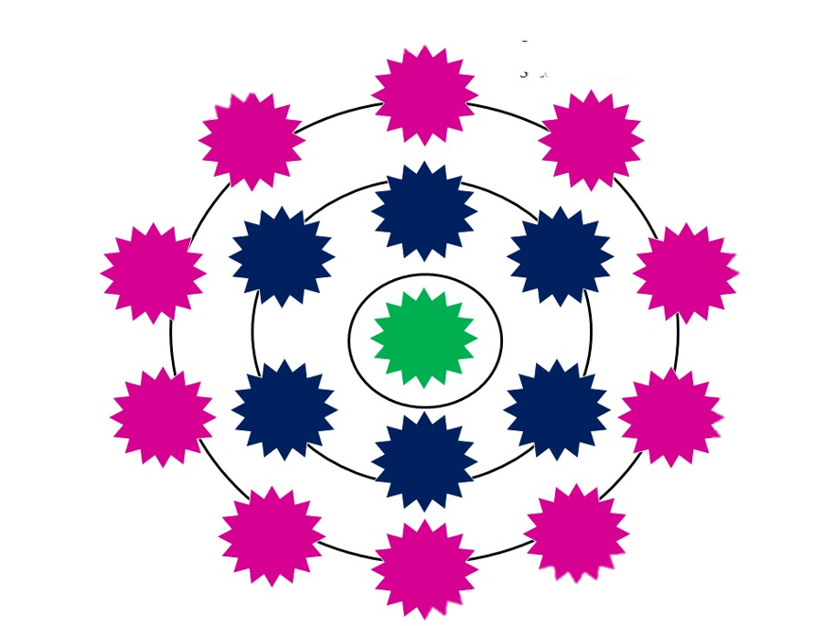
OUTCOMES
LEARNINGS
WHAT’S
NEXT?
Creativity Builds 4 Key Mental Health Assets
Imagining different futures beyond restrictive gender roles
Emotional expression
Self soothing
Connection, attunement and attachment with others
Potential to Meet Mental Health Gap
Contextually appropriate
Trauma-informed
Feasible for resource - poor environments
Inclusive of illiterate populations
Group-based
3-year scaling plan to reach 4,700 girls
Further research and building on the evidence base

Slide 49

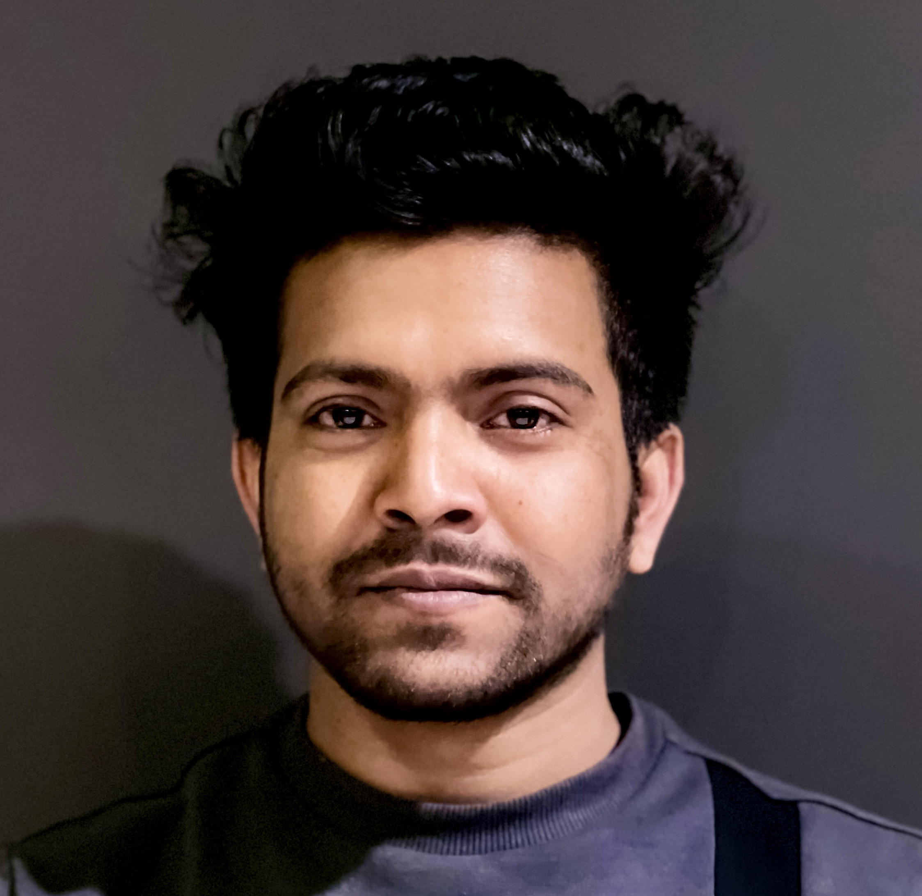
Speakers
Integration of MHPSS into education programming through the Interpersonal Psychotherapy Group
SAM MUHUMUZA
WINDLE INTERNATIONAL UGANDA
Community-based mental health and psychosocial support for survivors of GBV and Harmful Practices in Bangladesh
ABU NASER
UNFP BANGLADESH

Slide 50

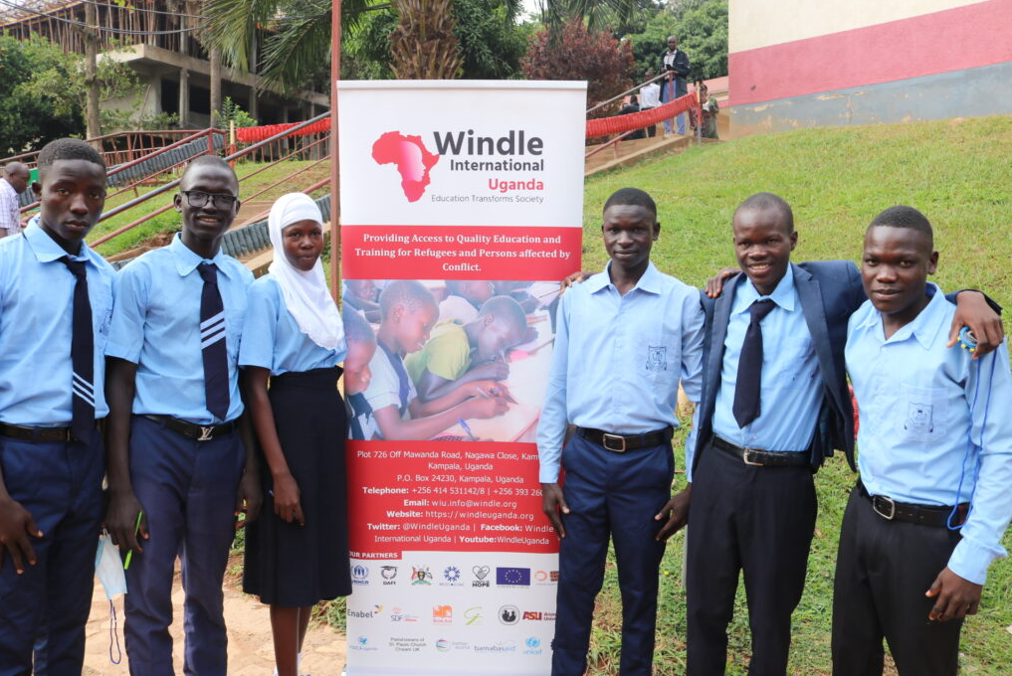
Sam Muhumuza
Research, Institutional Dev’t & Innovations Manager
Windle International Uganda

Slide 51


The who (with who)
Organization and partners:
Windle International Uganda (WIU), an international organization is the lead education partner for Education in Emergencies in Uganda. In partnership with Strong Minds Uganda and UNHCR we deliver mental health and psychosocial support (MHPSS) through the Building Resilience and Emotional Wellbeing (BREW) project.
Target population: Refugee and host communities children, youth and girls in and out of school including girls at risk of marriage, those married and young adolescent mothers
Context: There are high needs for MHPSS amongst our target groups due to rampant SGBV including early marriages, teenage pregnancies, domestic violence, trauma experienced during displacement, alcohol and drug abuse; factors that contribute to high rate of suicidal tendencies within their communities.

Slide 52

The what
What did you do: To address the MPHSS needs of these vulnerable children, youth and girls, WIU adopted the Interpersonal Psychotherapy Group (IPT-G); a cost-effective model recommended by WHO for treatment of depression.
Why was it needed: IPT-G model delivers MHPSS easily in resource constrained settings. Our accelerated education program (AEP) which targets children whose education was interrupted by different circumstances face different challenges in their everyday lives, which leads to depression, thereby negatively impacting their retention in school and learning outcomes. MPHSS has succeeded in improving this situation.
How did you do it: These MHPSS interventions are delivered by use of teachers, through school clubs. Results of the intervention show improved retention in school and better results of learners.
We further used results of our intervention to advocated with the Ministry of Education and Sports (MoES) in Uganda to roll out MHPSS in schools. The MoES has now issued a circular to all schools in Uganda to dedicate an hour on their weekly time tables to MHPSS activities. This will significantly contribute to improved MHPSS in Uganda.

Slide 53

The so what
What was the outcome: this intervention has contributed to improved mental wellbeing for teachers and learners leading to better education outcomes.
What did you learn: It is important to plan interventions to provide MHPSS needs because they lead to improved education and general wellbeing
What comes next: Scaling up the integration of MHPSS into all education institutions and communities. Efforts will also be put into awareness raising to address stigma and discrimination of people with mental health issues

Slide 54
Thank You

Slide 55
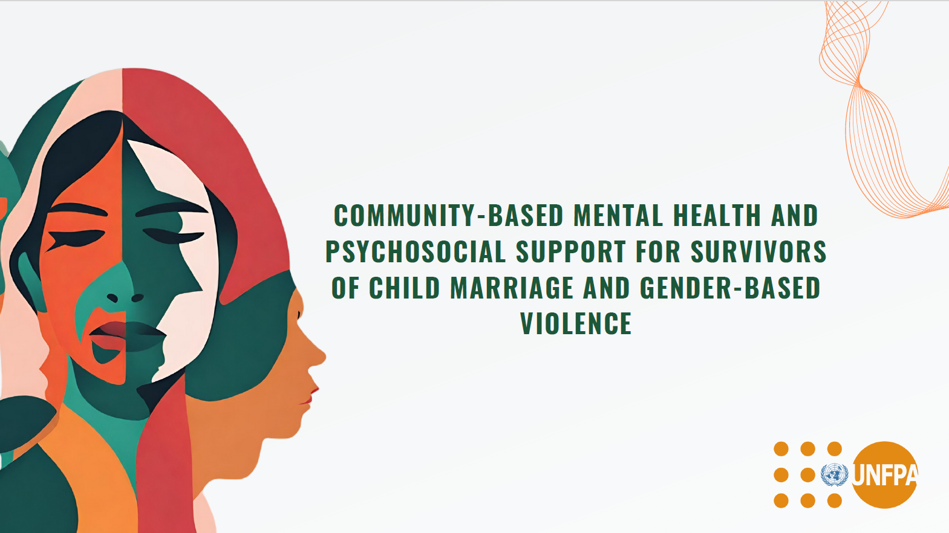

Slide 56
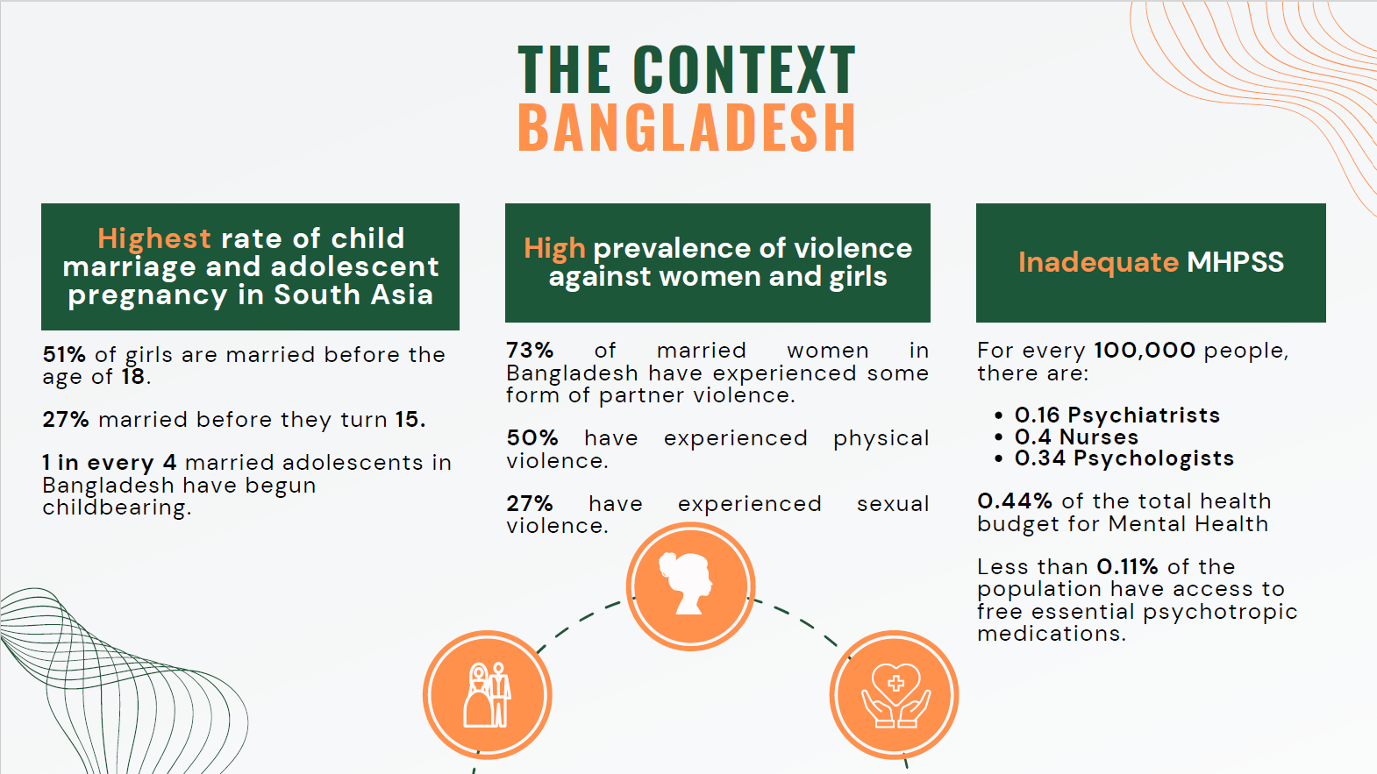

Slide 57
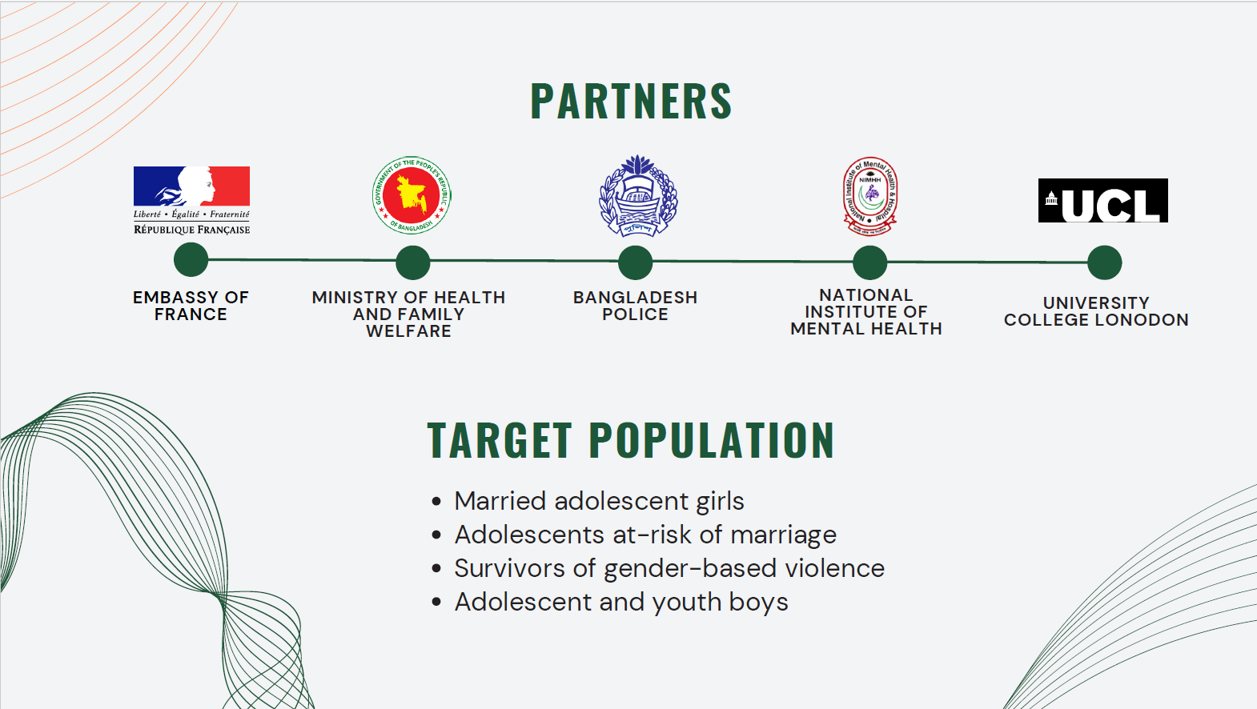

Slide 58
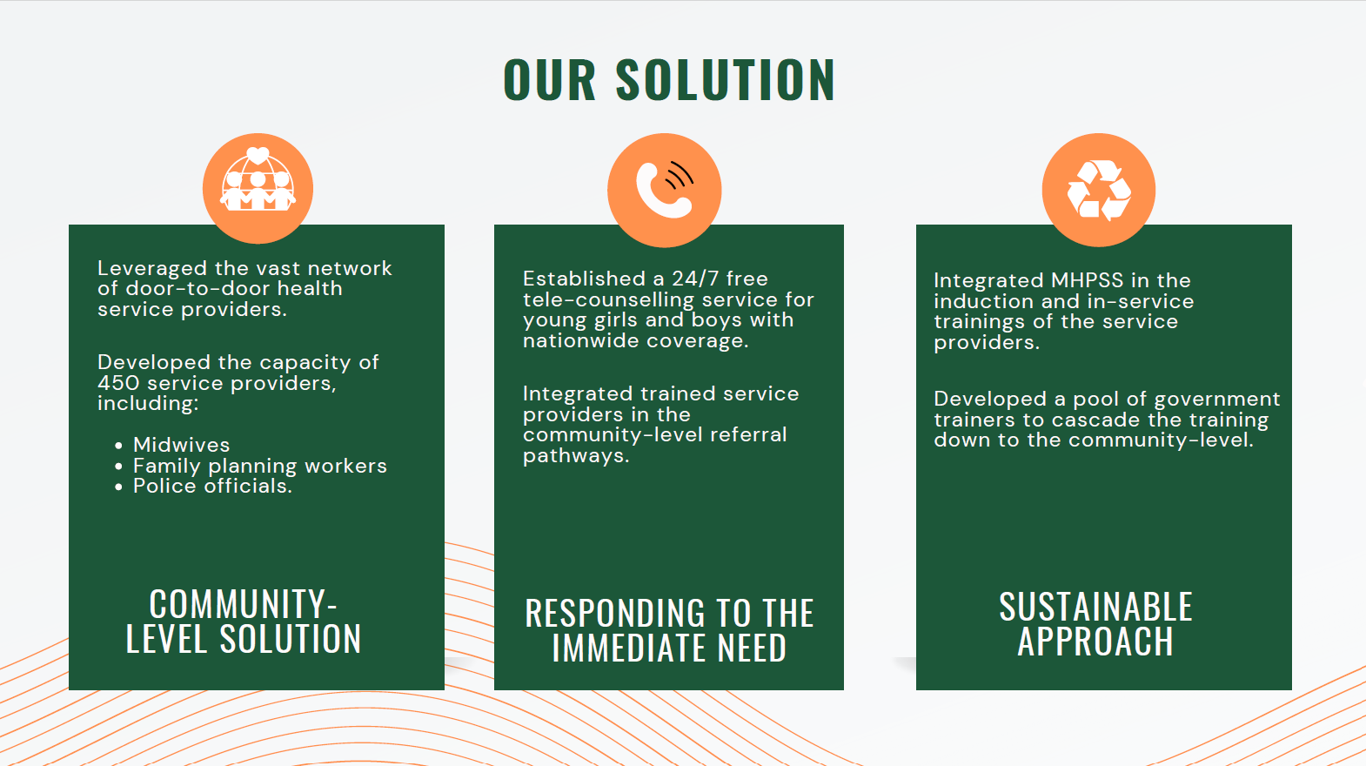

Slide 59
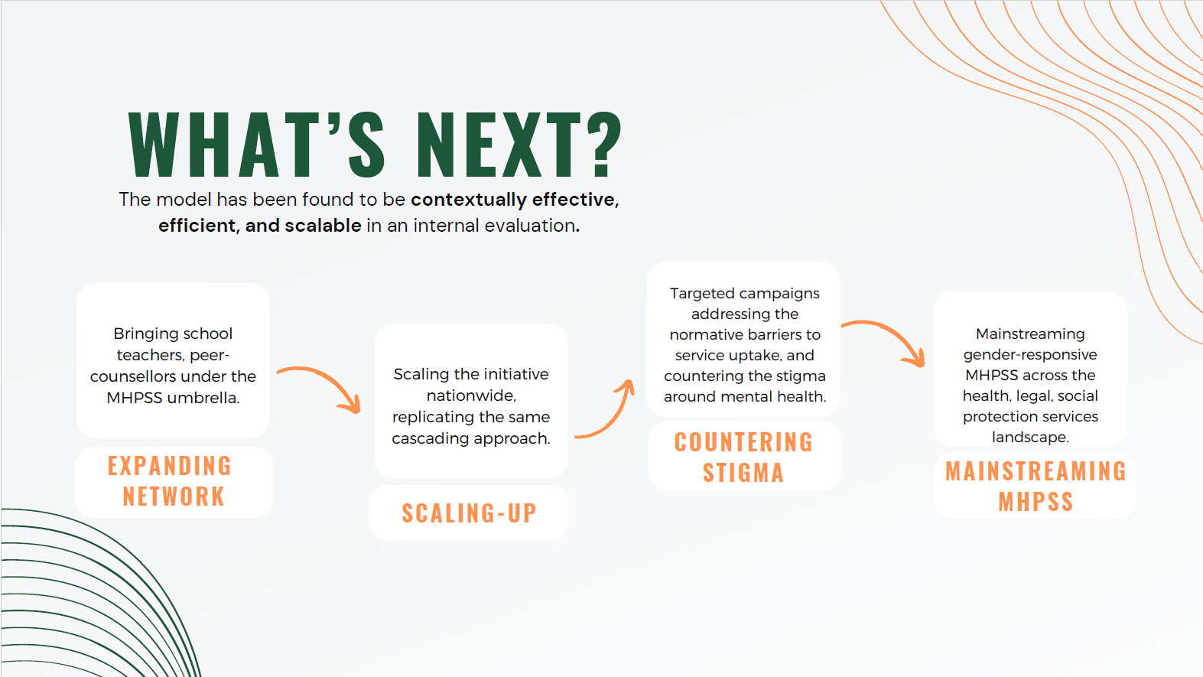

Slide 60


Slide 61
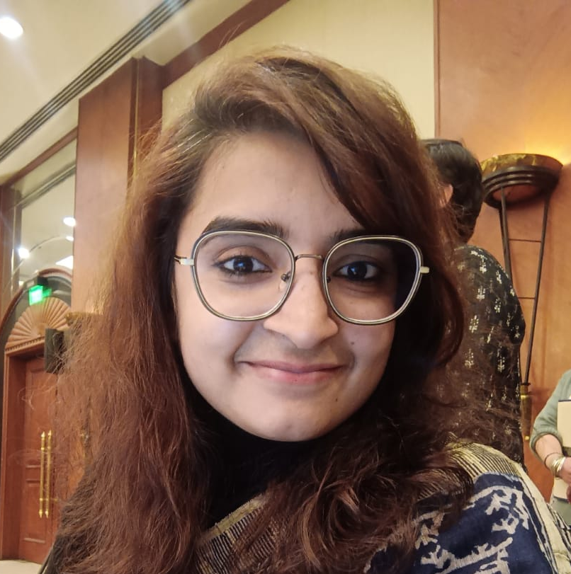
Speaker
Adolescent- and youth-centric work addressing mental health and care practices with adolescents and young people
SURBHI KUMAR
THE YP FOUNDATION

Slide 62


Slide 63
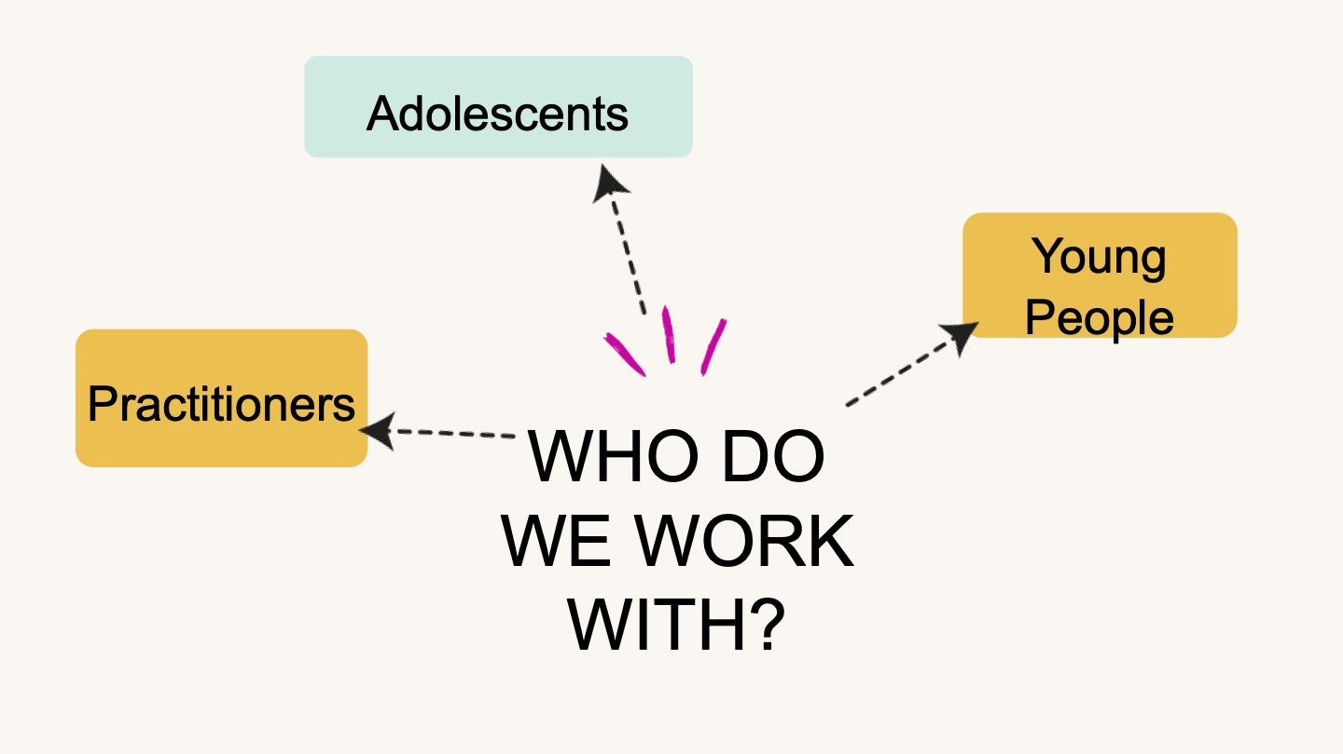

Slide 64
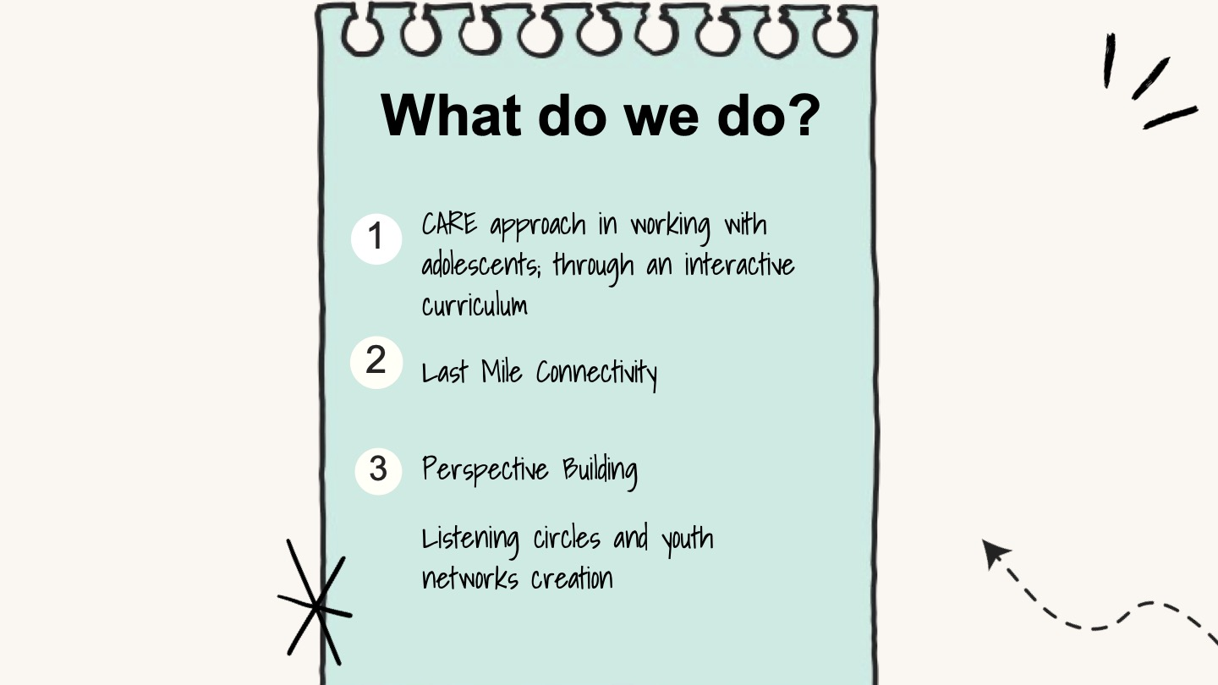

Slide 65
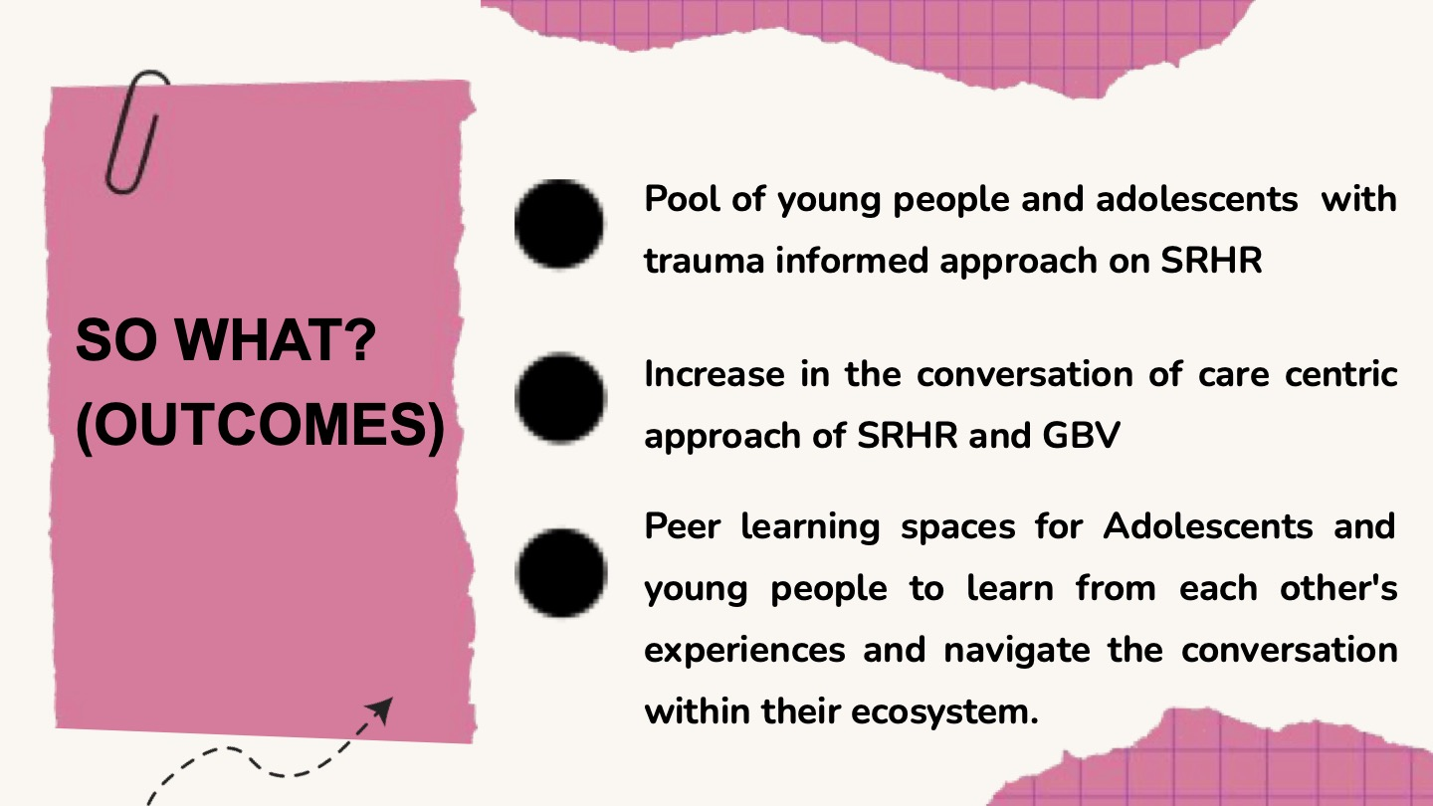

Slide 66
What’s Working: Examples of programmes addressing mental health needs across contexts
Q&A Session
©UNICEF, 2019

Slide 67
COMFORT BREAK AND QUESTION:
What is the most significant thing you learned from the case studies?
GO TO WWW.MENTI.COM
ENTER CODE: 6571 6781
Notes:
Housekeeping:
A warm welcome to people joining us from all around the world – we have around 400 people registered, which underscorces the importance of this event, and we are so greatful for the opportunity to be here together this afternoon.
We are recording today’s event
Self care notice – we may discuss topics, subjects and experiences that people may find triggering, we ask that you please feel free to do what is needed for your wellbeing, which may include taking breaks, and coming back to proceedings at another time.
For those in the room: No planned fire alarms

Slide 68
What’s Next: Working now with what we know – policy and practice priorities
©UNICEF, 2019

Slide 69


Speakers
WHO
CHRISTINA PALLITTO
ROZARIA MEMORIAL TRUST
LOVENESS MUDZURU

Slide 70
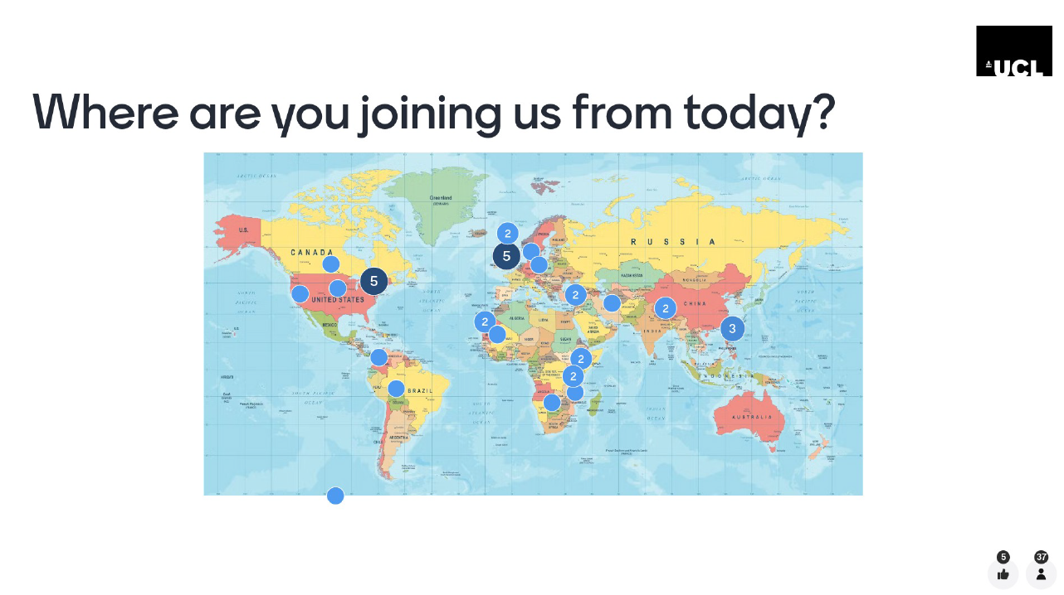
CONCLUDING THOUGHTS
MENTI EXCERPTS/SCREEN SHOTS

Slide 71
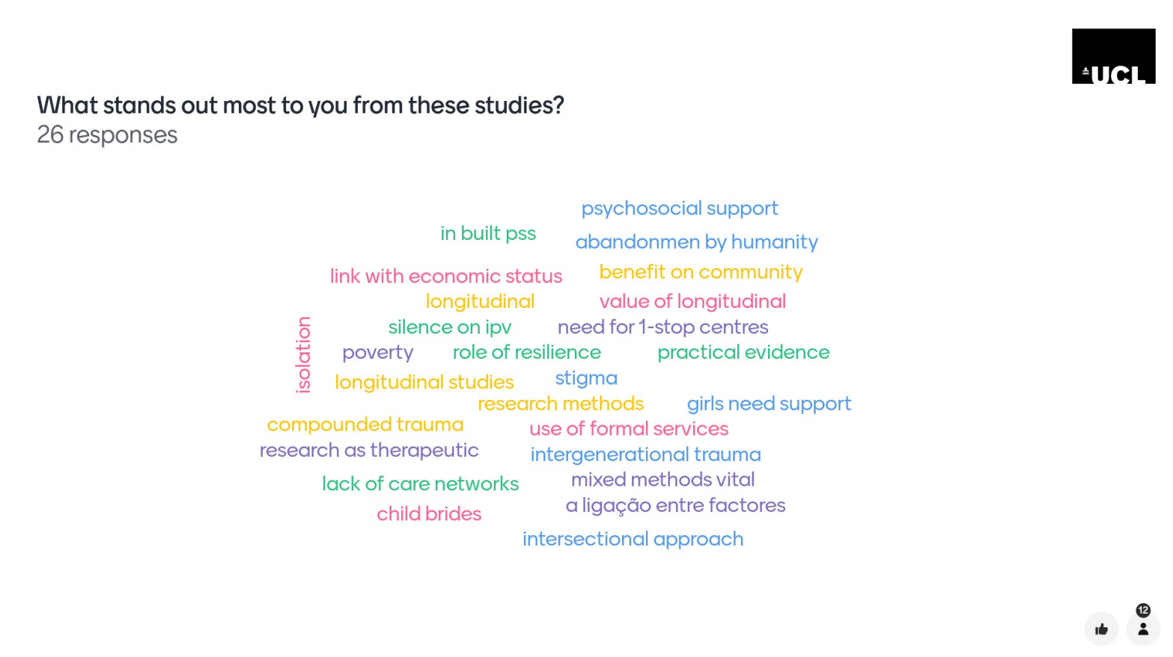

Slide 72
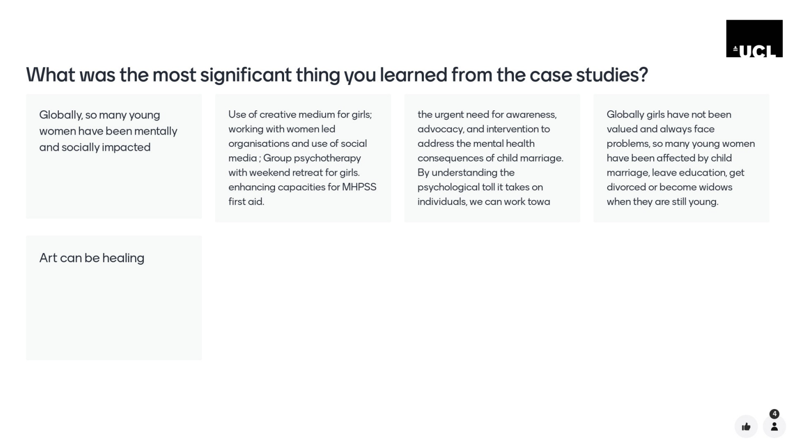

Slide 73

MENTAL HEALTH & CHILD MARRIAGE
1
CONTEXT MATTERS
2
RESEARCH AS A HEALING OPPORTUNITY
WE CAN REDUCE THE BURDENS
3
SAFE SPACES AS INTERVENTION
4
ACTIVATE ECOSYSTEMS FOR CARE
5
COMMUNITY LEVEL IS MANDITORY

Slide 74
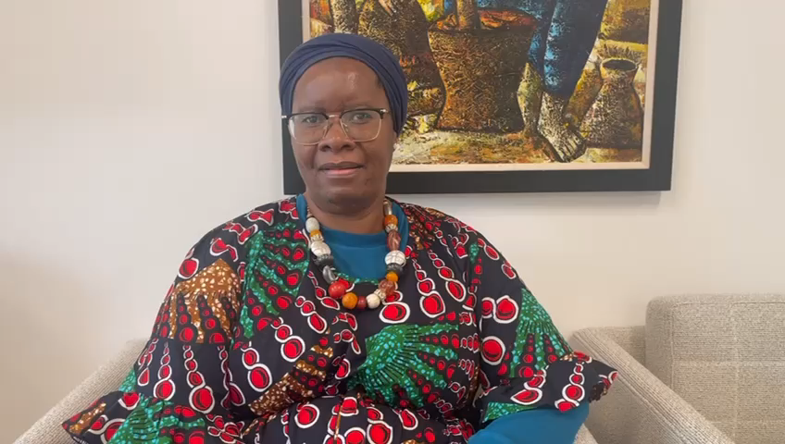

Slide 75

With Thanks to our sponsors
GENEROUS SUPPORT PROVIDED BY:
ACADEMY OF MEDICAL SCIENCES (MARCH-ZIM PROJECT FUNDING)
UCL INSTITUTE FOR GLOBAL HEALTH (PUMP PRIMING FUND)
GIRLS NOT BRIDES - PARTNERSHIP TO END CHILD MARRIAGE
THE CRANK: UNFPA - UNCIEF GLOBAL PROGAGRAMME TO
END CHILD MARRIAGE & GRILS NOT BRIDES
ORGANISING TEAM MEMBERS:
GLOBAL NETWORK FOR MENTAL HEALTH AND CHILD MARRIAGE:
GIRLS NOT BRIDES / THE CRANK

