Slide 1
Working in partnerships
Girls Not Brides
Amsterdam, 10 November 2016
By Woutine van Beek

Slide 2
Objectives of the workshop
Explore and discuss on practical issues that participants are facing in their partnering work
Facilitate exchange between participants on good practices and personal experiences in working together in partnerships
Provide insights, guidance and practical tools to participants on effective partnership management and on building and consolidating strong working relationships (to help participants find solutions for the problems they are facing)

Slide 3
Programme
Introduction
Game
Group discussions (explore and discuss)
Plenary feedback
Interactive presentation ( insights, guidance, practical tools)
Personal take-aways
Closure

Slide 4
Group dicussions
Topics:
Coordination and support mechanisms
Communication (internal and external)
Governance and decision making
Partnership agreements
Member engagement

Slide 5
What is a partnership?

Slide 6
Defining the term partnership
Based on a dictionary definition, the term
partnership can be understood as:
an ongoing working relationship where risks and benefits are shared
In practical terms this implies that
each partner is involved in:
  Co-creating the partnership’s activities
  Bringing contributions (of different kinds) to the partnership
  Committing to mutual accountability
Source: This is a definition developed by The Partnering Initiative

Slide 7
The partnering context
Whilst there may be many common features in the partnering process, no single partnership is like any other.
All partnerships are highly context-specific and will invariably be a reflection of the surrounding circumstances.
Sometimes it is necessary to settle for a ‘good enough’ partnership until the local conditions change.
[This is not an excuse for sloppy partnering!]

Slide 8
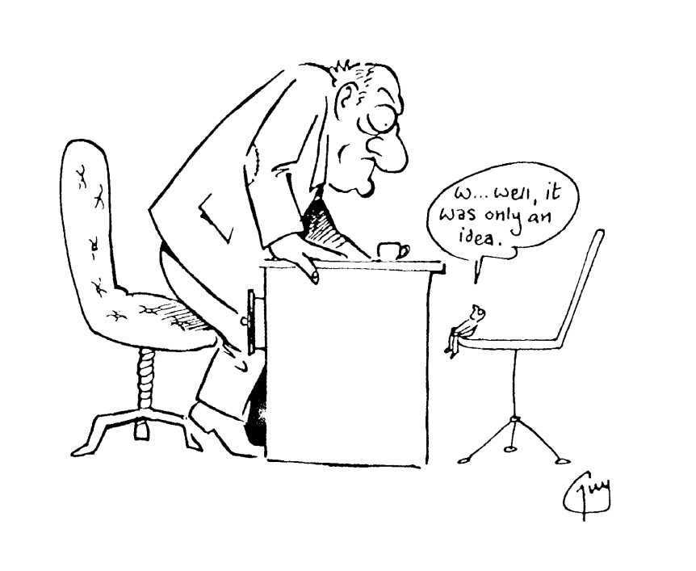

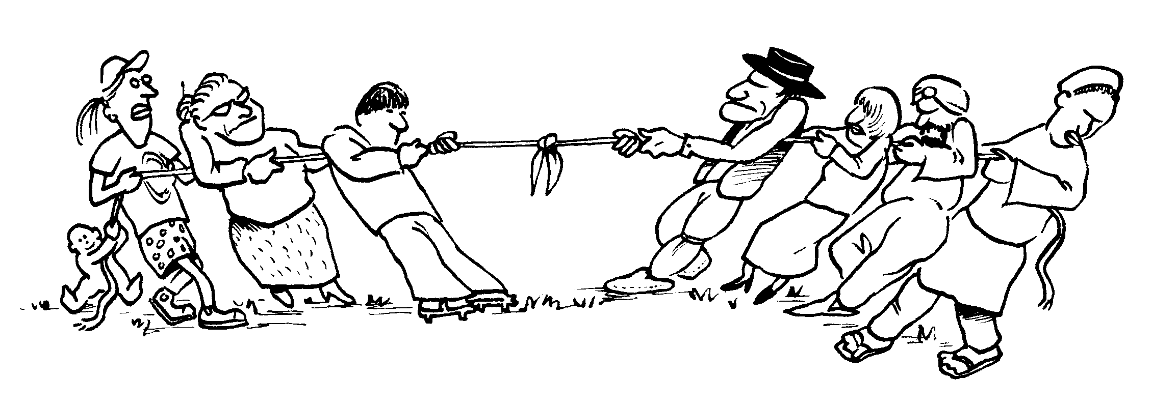
Easier said than done...
Power imbalances
Hidden agenda’s
Each partner determined to ‘win’ on own terms...
Source: The Partnering Toolbook

Slide 9
3 core principles
1. EQUITY
because it leads to
RESPECT
for the added value each
party brings
2. TRANSPARENCY
because it leads to
TRUST
with partners more willing
to innovate & take risks
3. MUTUTAL
BENEFIT
because it leads to
ENGAGEMENT
more likely to sustain &
build relationship over time
Source: The Partnering Toolbook
Notes:
Equity not the same as equality: contribution does not have to be the same. But each partner has an equal right to be at the table and each partners contribution is valued
Transparency: needed to built trust. Trust is often mentioned as challenge, but is not there from the start. Open, honest, accountability
Mutual benefit: if a partner is expected to contribute, they are also entitled to gain from it. Only in this way, partners will be committed (reference to game).
Make them explicit and regularly reflect on them!

Slide 10
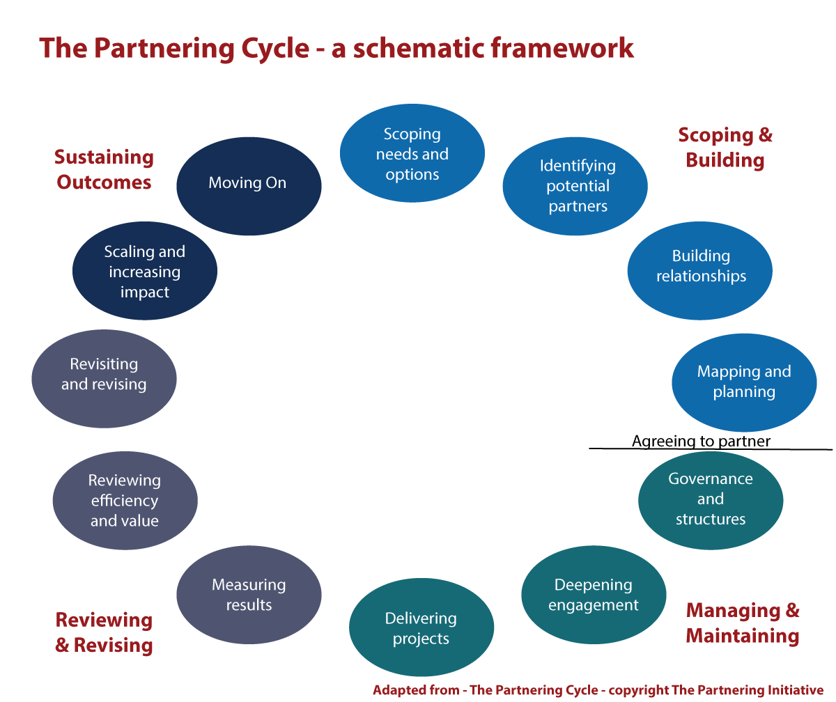
Notes:
Although each partnerships is unique in owm setting, there are some typical steps and activities in each partnership
Where would you position your partnership in this framework?
What are main obstacles or challenges you encounter in this phase?

Slide 11
Scoping and Building
Scoping:
  Make the partnering case
  Think of initial ideas and possible contributions of partners
Identifying:
  Initial contact with potential partners: explore!
  Check out suitability of partners: VALUES!
Building:
  Getting to know each other
  Formulate principles and ground rules
Planning:
  Brainstorm and agree on objectives, activities, indicators
  Resource mapping
  SIGNING OF PARTNERSHIP AGREEMENT
Notes:
Partnering is not always the best option: partnership as a means, not as a goal
Explore: keep options open as long as possible
Invest in relationships and deepening understanding before committing to partnership: assumptions, values. Investing now will pay off later.
Bottlenecks:
Signing agreements too soon: not enough time invested in getting to know each other and each other values and expectations. A lot left ‘implicit’ and vulnerable to different interpretations
Agreements made on what you want to achieve, but not on how
Objectives and activities agreed are too ambitious/not realistic: no discussions on challenges and constraints the coalition may face > this will lead to frustrations later

Slide 12
Partnering agreement
Who will be involved?
Why collaborate? (vision, shared objective)
What will the collaboration involve? (project, contributions from each partner, indicators, sustainability strategy)
When will things happen? (timeframes, milestones)
How will it work? (behaviour protocols, governance, decision making, risk mitigation, capacity strengthening, review procedures)
Communications issues (communication procedures, rules for branding, public profile, intellectual property and confidentiality issues, external communication protocols)
What if? (grievance mechanisms to resolve differences, procedures for leaving/joining, exit strategy)
But also think of: key definitions, shared values, ...
Notes:
All take a piece of paper and write down in some key words:
What is child marriage? (age, setting)
Why is it a problem?

Slide 13
Notes:
Although each partnerships is unique in owm setting, there are some typical steps and activities in each partnership
Where would you position your partnership in this framework?
What are main obstacles or challenges you encounter in this phase?

Slide 14
Managing and Maintaining
Structuring:
  Embedding of partnership in each organisation
  Governance arrangments & Decision-making procedures
  Coordination mechanisms
  Communications plan
Mobilizing:
  Secure resource commitments
  Widen engagement (also of other stakeholders)
Delivering:
  Roles and responsibilities
  Monitor and follow up of agreements and commitments
  Keep partners and stakeholders informed of progress
  Celebrate successes
Notes:
Difficult phase: from planning to doing mode
Over or under promised
Typical bottlenecks in this phase:
The partnership is reliant on just a few individuals. Roles and responsibilities are not clear or do not work out as expected
Administration and support mechanisms of partnership: internal/external. How to ensure commitment?
Communication: internal and external.
Decision making processes: understood and equal power to all partners. Who records and communicates decisions?
Is everybody contributing as agreed?
Do not operate in isolation: reach out to stakeholders

Slide 15
Notes:
Although each partnerships is unique in owm setting, there are some typical steps and activities in each partnership
Where would you position your partnership in this framework?
What are main obstacles or challenges you encounter in this phase?

Slide 16
Reviewing and Revising
Measuring:
  Agree/confirm succes indicators
  Monitor compliance of partners
  Keep track of deliverables, outputs, outcomes and impact, added value for each partner
Reviewing:
  Take stock of efficiency and effectiveness of partnership and agree on changes
  Record unexpected benefits
  Consider new opportunities
Revising:
  Agree on changemanagement process
  Make agreed changes
  Revise partnering agreement in case necessary
Notes:
Typical bottlenecks in this phase:
No clear indicators milestones set for the partnership: difficult to keep track of how it is going
No eye for unexpected benefits/outcomes
To make changes when things do not work out as desired/expected: adapt plans and agreements if necessary

Slide 17
Notes:
Although each partnerships is unique in owm setting, there are some typical steps and activities in each partnership
Where would you position your partnership in this framework?
What are main obstacles or challenges you encounter in this phase?

Slide 18
Sustaining Outcomes and moving on
Scaling:
  Expanding established projects and/or
  Publicise the projects and/or
  Encourage others to adopt partnering approach
Moving on:
  Concluding the partnership or
  Handing over current project and start something new
  Establish partnership as new ‘institution’ with independent structure and strategy
Notes:
Typical bottlenecks:
Partnership seen as goal and not as means: focus on how to sustain partnership instead of the outcomes
Recognize what has been achieved and learned

Slide 19
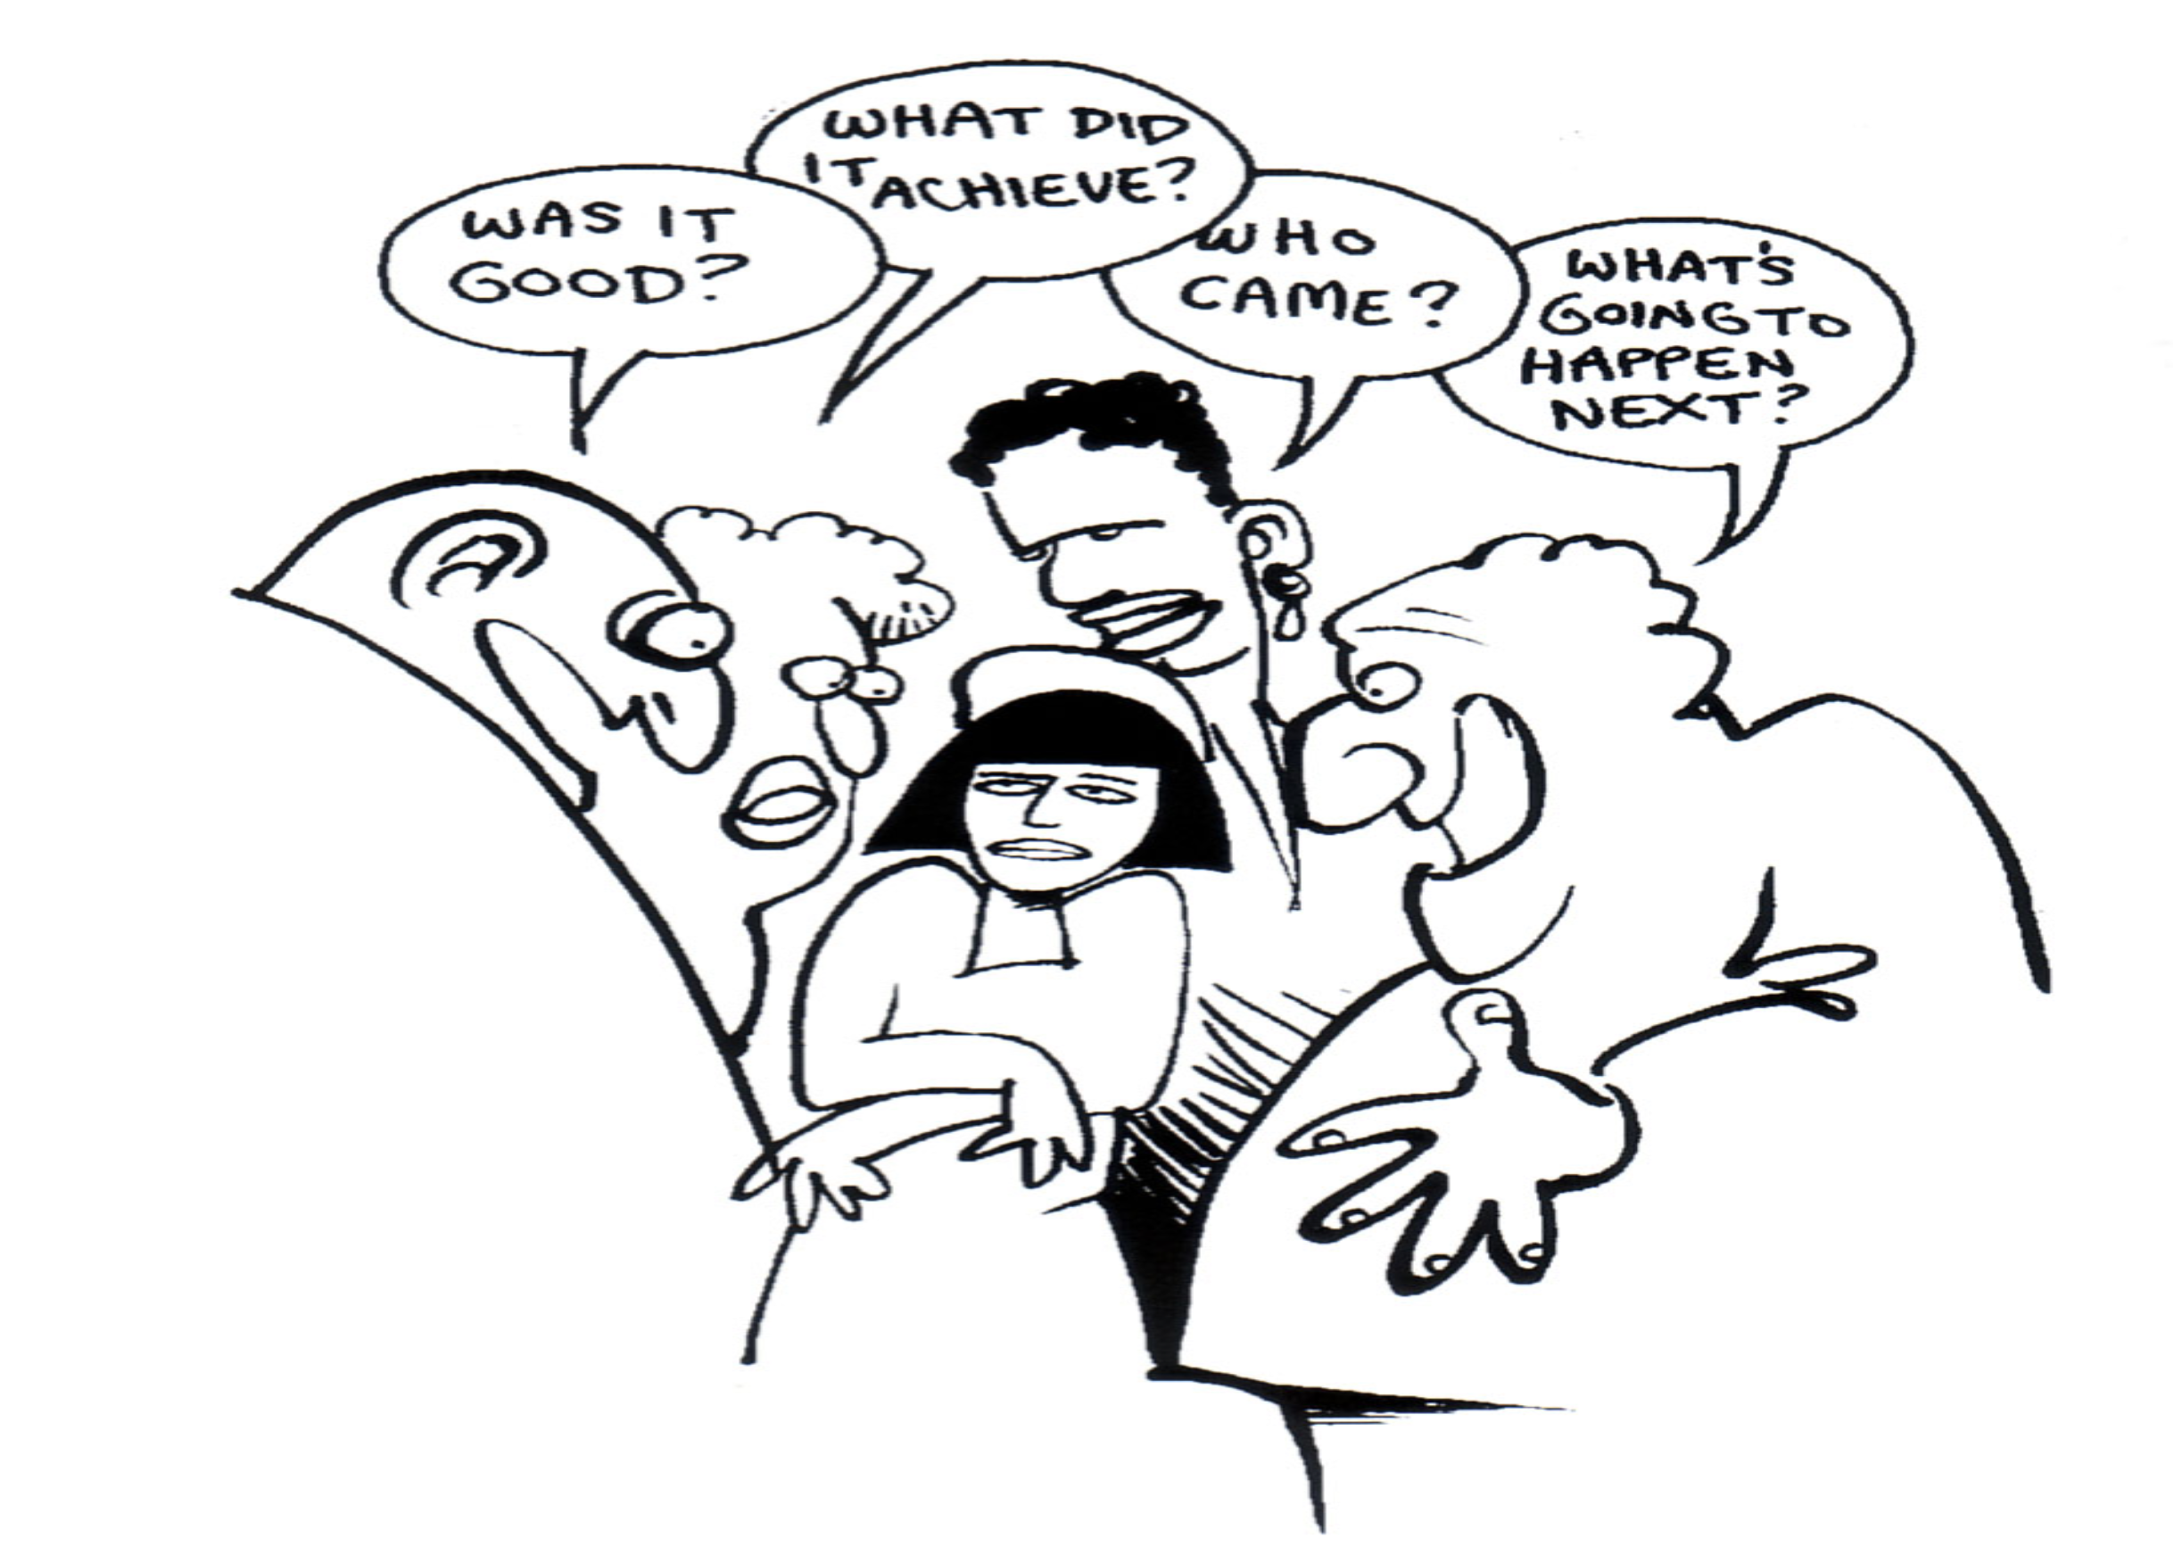
Personal actions...
What is the main thing I take home from this session?
What will be the first thing you do/take up to strengthen the Girls Not Brides partnership in your country?

Slide 20
Materials and contact
Partnerships: Frameworks for working together (Compassion Capital Fund National resource Center)
The Partnering Toolbook (The International Business Leaders Forum (IBLF) and the Global Alliance for Improved Nutrition (GAIN))
Also check: thepartneringinitiative.org
Further contact:
Woutine van Beek
woutinevanbeek@gmail.com

